Slide 1
Club Registration Session

Slide 2
Welcome!
Clubs and organizations are an important part of Campus Life at San Bernardino Valley College. Whether you are looking to meet new people, share a common interest, plan campus events or volunteer, there is a club for you! Being involved with a club or organization is a great way to connect with the SBVC community and build relationships with fellow students, staff and faculty.

Slide 3
Facility Requests
You must use the link below to access facility requests:
http://www.valleycollege.edu/about-sbvc/offices/office-vp-admin-services.aspx
Facility Request- Used for basic information. Times, dates, places, and signatures.
Request A- Used to draw a diagram or setup.
Request B- Used when your club wants to request multiple dates or make changes.

Slide 4
What is Board Approval??
SBVC and CHC fall under the San Bernardino Community College Board of Trustees.
Remember this analogy: SBCCD owns the house SBVC and CHC rent rooms.
Board Approval is required for:
Travel
Food
Contracts (Even if you aren't paying the speaker)
Events over $ 500.00
What doesn’t required board approval?
Supplies, i.e. t-shirts, pens, pencils, or promotional items

Slide 5
Why do I need board approval?
Liability.

Slide 6
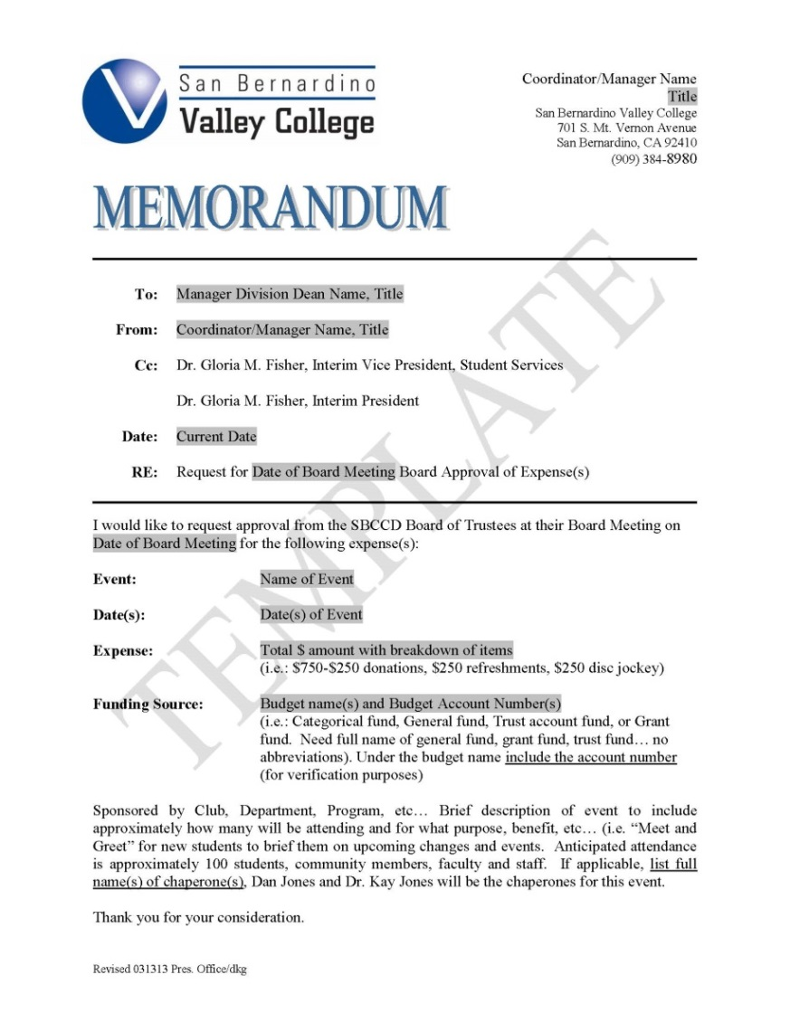
What's a board Memo?
A board memo gives a includes the event name, date, expense, funding source, and description of the event.
A board memo is your way of asking the board for permission to host an event in their house.

Slide 7
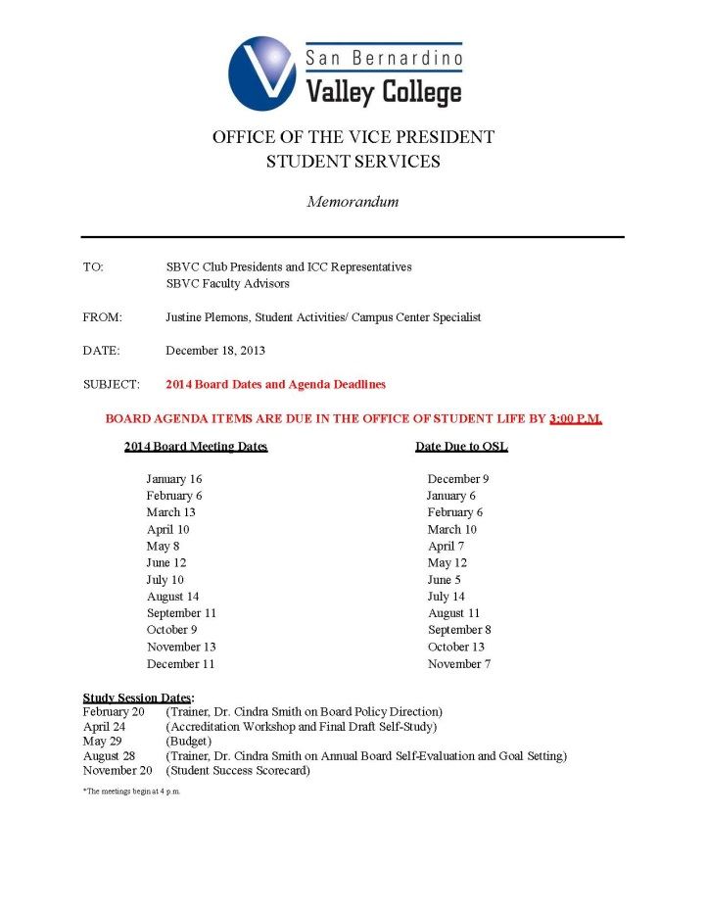
Board Deadlines
What deadline do I follow?
You will need to turn in the board memo by OSL’s due date.
If you want my help come see me BEFORE OSL’s due date

Slide 8
Banking
Registered student organizations are required to have a College District Club Account, maintained by the Campus Business Office (CBO).
All financial transactions shall be handled through this account. Club accounts shall not be carried in personal bank accounts for any reason.
DO NOT CARRY CASH WITH YOU! Deposit all profits into your club account.
Deposits may be taken directly to the Campus Business Office (AD/SS 206).

Slide 9
How do I pay for stuff?
There are three ways to pay for items?
Cutting a check to the vendor
Reimbursement
Cash Advancement
What is a purchase requistion?
A purchase requisition or a PR, is a form, found in OSL to request payment for something.

Slide 10
What to do before completing the purchase requisition.
Step 1: Check your account balance. You can do this with me.
Step 2: Your club has to agree to purchase something, reimburse someone, or give some a cash advancement. I must have minutes to pay for anything.
An invoice or quote from the company if you plan on sending a check directly to the vendor.

Slide 11
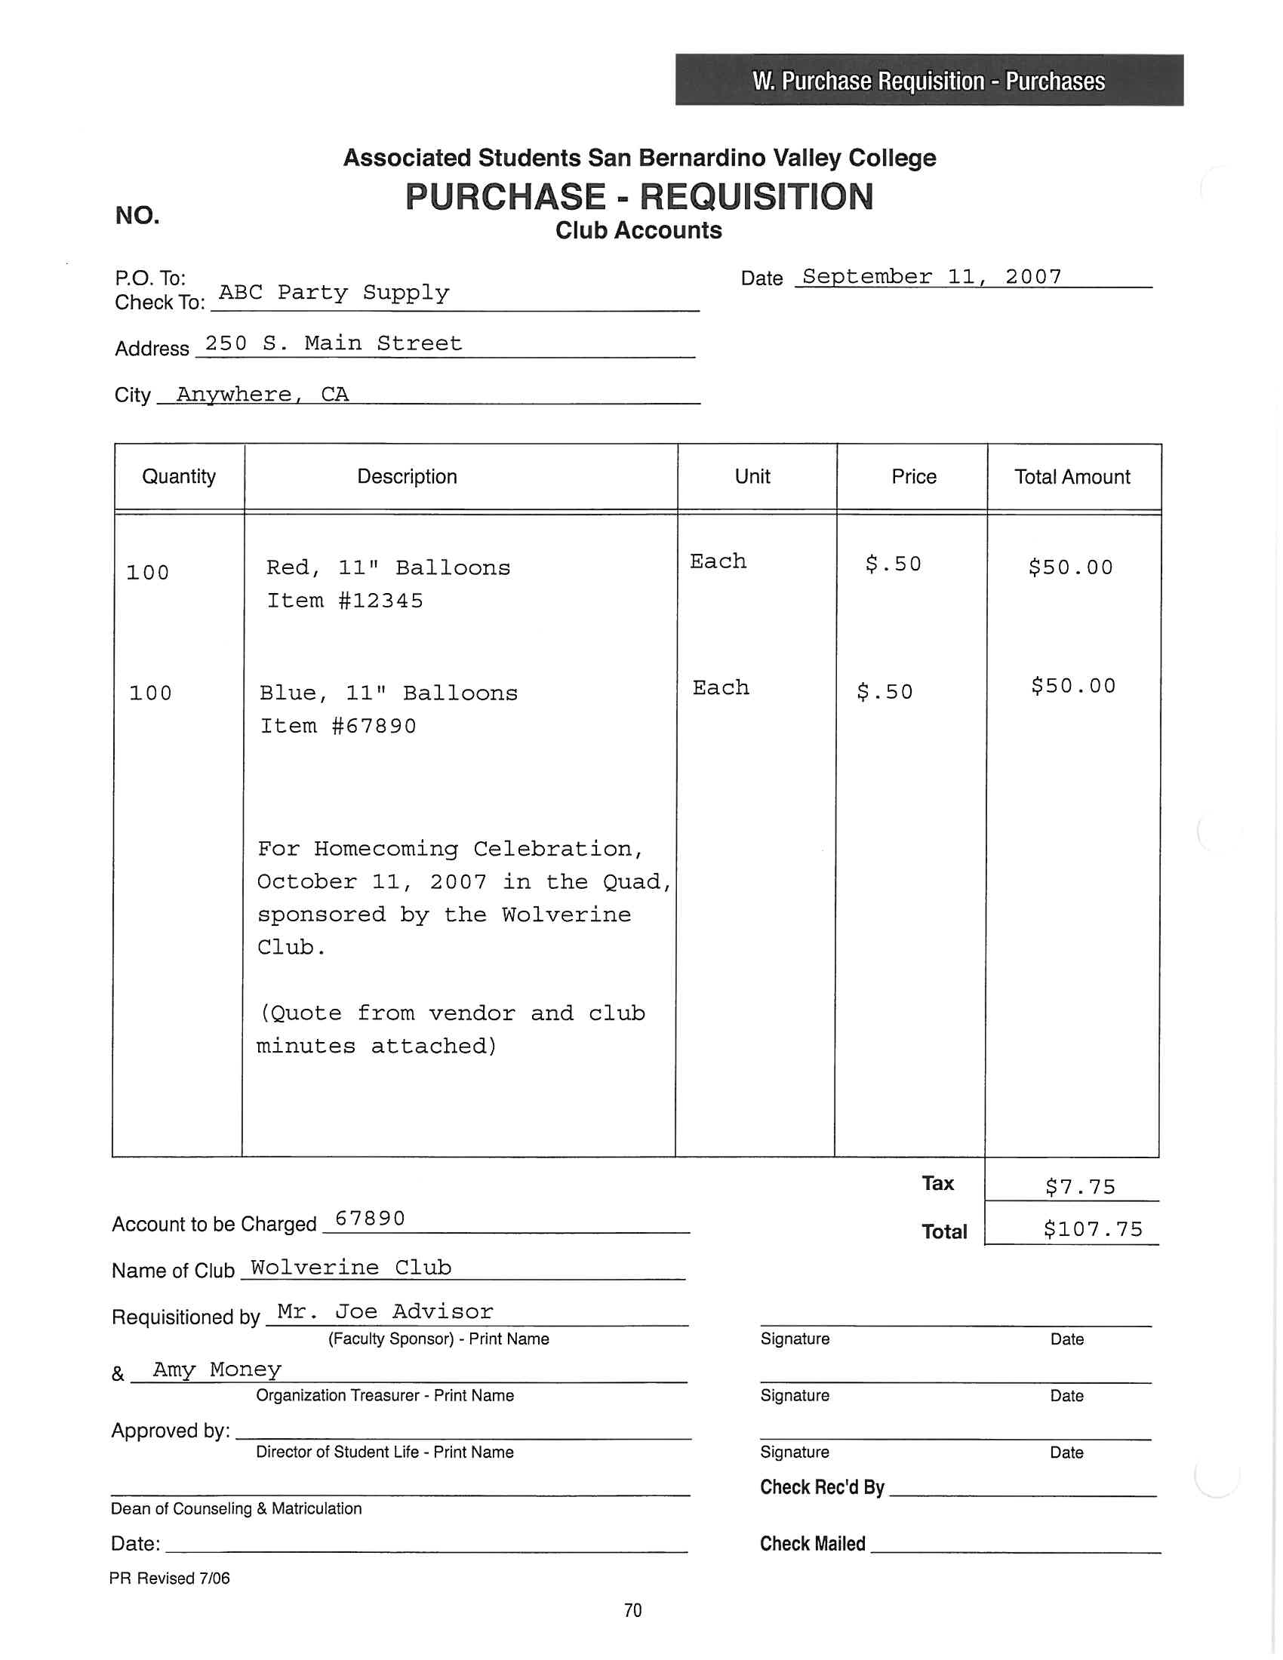
Purchase Requisition Example
← This is what a PR looks like.
Blank PRs are available in the Office of Student Life

Slide 12
Direct pay
This is the best way to pay for items.
What's needed for direct pay?
A completed purchase requisition.
Club minutes approving the expense.
A quote or invoice from the company

Slide 13
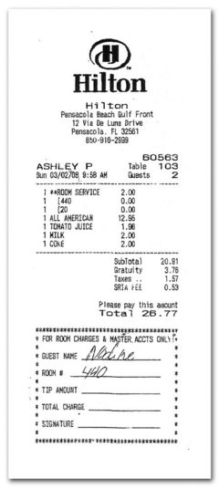
Reimbursements?
Clubs can choose to reimburse a student/ faculty advisor for items purchase for an approved club event.
What's need to reimburse someone?
A completed purchase requisition.
Original itemized receipts signed by the individual
Club minutes approving the reimbursement.
Example verbiage, “ The Spanish Club moves to reimburse John Garcia $42.00 for the refreshments purchased for the Welcome Week Event on September 3, 2013”

Slide 14
Advancements
Advancements are made only to the faculty advisors. Students cannot be advanced funds.
What's needed for an advancement?
A complete PR
Club minutes approving the advancement
What's needed once the items are purchased?
Please return all original and itemized receipts to me.
All unused funds must be deposited into the club account. All receipts should total the original advanced amount.

Slide 15
Contracts/Travel
Yes, board approval is needed for contracts. Even if they are doing it for free.
Why? Liability.
Yes, the district and the college needs to know where you are traveling. Why? Yes, liability.
This process can be lengthy. Please see me a minimum 3 months in advance before you want to travel. Even longer if you want to travel out of state.

Slide 16
FOOD!
Food that requires board approval:
Any “meal” served to students regardless of cost.
Food that doesn’t require board approval:
Refreshments under $500.00
Refreshments over $500.00. Yes, if it $501.00 it must go to board.
What’s considered refreshments? Muffins, cake, chips, fruit trays, etc.

Slide 17
More about food….
A food handlers card isn't need for commercially pre-packaged food
A food handlers card is needed for hot food or “homemade” food.
“Open air food”, is defined as any food that’s not commercially packaged. Clubs are allowed to host three “open air food” fundraisers within a 90 day period.
Example of “Open air food”
Bake sale
BBQ
Pizza Sale

Slide 18
Contact Information: jplemons@valleycollege.edu 909-384-8692 Questions??

