Slide 1







SAN BERNARDINO VALLEY COLLEGE
Arrival
Arrival
Mo
Mo
Mo
Mo
Group Activity
Group Activity
Lunch
Lunch
Welcome to Base Camp
9:00 am

Slide 2
SAN BERNARDINO VALLEY COLLEGE
Arrival
Arrival
Mo
Mo
Mo
Mo
Group Activity
Group Activity
Lunch
Lunch
Base Camp Battle
9:30 am

Slide 3


Slide 4
SAN BERNARDINO VALLEY COLLEGE
Arrival
Arrival
Mo
Mo
Mo
Mo
Group Activity
Group Activity
Lunch
Lunch
Charting the Course
10:00 am

Slide 5




Slide 6
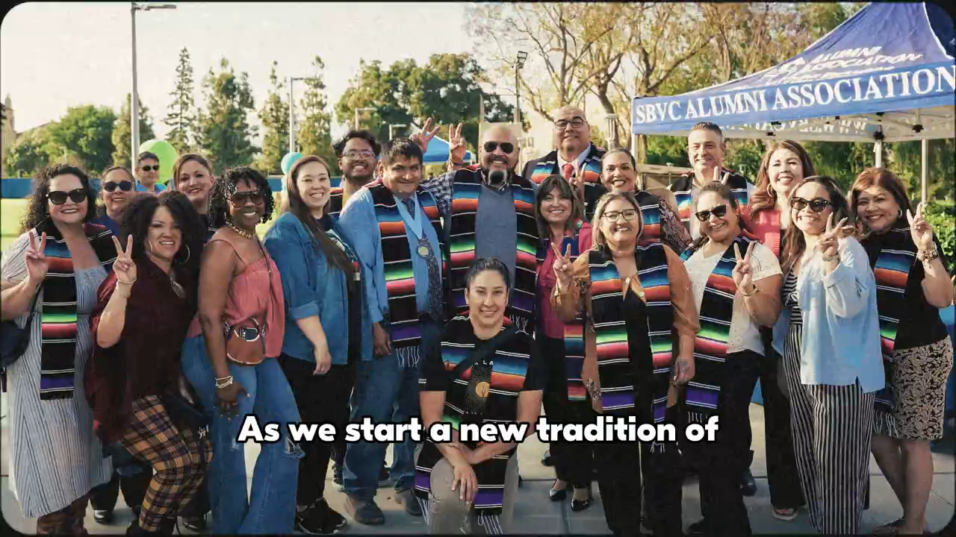

Slide 7


Slide 8

VALLEY UP! INITIATIVE 2025-2030
Come with a Dream, Leave with a Future

Slide 9
The Valley Up! Initiative 2025-2030
strives to advance the mission of Valley College through intentional strategic planning that leverages existing planning documents and sets the vision as Valley College enters its second century.

Slide 10
132
goals across various departments and plans.
While each goal had merit, the sheer volume made it difficult to prioritize, align resources, and demonstrate progress.
1
Guiding Principle
Advancing Community
4
College Priorities

Slide 11
College Priorities
Career & Transfer
Health & Safety
Boldly Student-Centered
Opportunities for All

Slide 12
Advancing Community
We understand how much Valley College means to the community and how much the community means to Valley College.
For 100 years, Valley College has provided the community with access to education and social mobility.
Our history shares a story of innovation, cultural diversity, and a strong connection with the diverse communities served by the college.
HSI BSI LBGTQ+ AANAPISI Military Friendly Dual Enrollment

Slide 13
1. Career & Transfer
Primary mission of the California community college system.
In 2025, Valley College celebrated the largest graduating class in the 100-year history of the school.
We strive to become the #1 feeder community college for CSU San Bernardino as well as strengthen outcomes for students with UC Riverside and University of Redlands. We also want to fully develop pathways in Engineering with Cal Poly Pomona.
Valley College serves as a regional leader in career technical education, adult education, and workforce preparation. We are proud of the apprenticeship pathways, job placement, alumni network, community partnerships, and regional collaborations that advance opportunities.

Slide 14
2. Health & Safety
Central to fostering a sense of belonging is prioritizing the health and safety of the College community.
During the 2024-25 academic year, College Council received a presentation about the mental health of our students—the presentation demonstrated the need for expanded mental health support for our campus community.
Valley College will foster safety as a collective priority, including physical, emotional, and psychological safety. We must prioritize expanded safety training opportunities, emergency preparedness, active shooter training, earthquake preparedness, and bring our emergency planning current with new personnel at Valley College.

Slide 15
3. Boldly Student-Centered
A boldly student-centered College creates an organizational structure, decision-making processes, and culture based on the student experience. Decisions should all be made based on what is best for students.
The management team must have the authority, support, and accountability to lead.
The College must serve employees holistically in order for our teams to serve students holistically.
The College must entrust faculty to lead 10+1 efforts based on the student experience and provide faculty with support to advance teaching and learning.
The College must entrust classified professionals to support the work of the College and define a boldly student-centered experience with stellar service standards.
Advancing professional development, cultural intelligence, and wellness are essential to building strong teams to support the diverse needs of our students and the communities served by Valley College.

Slide 16
4. Opportunities for All
Transform our college to meet the needs of the students instead of expecting students to adapt to fit into Valley College
Diversity of thought
Dual enrollment
Transform from retrospective data to intervention data
Celebrate similarities and engage in respectful, graceful, and humble discourse about our differences

Slide 17
10 College Targets
Strive to increase student success, student equity, and maximize the revenue generated by the Student-Centered Funding Formula as well as pursue additional grant opportunities that align with our guiding principle and four (4) college priorities.
Intentionally align with all major institutional plans, such as:
Accreditation
Educational Master Plan
Student Equity Plan
Enrollment Management Plan
Facilities Master Plan
San Bernardino Community College District Strategic Plan
CCCCO Vision 2030
CCCCO Student Centered Funding Formula (SCFF)

Slide 19

Goals for Valley Up! the Mountain today
From the Mountain to Valley College
Other Major Initiatives
100 Centennial Events
Committee Structure
EMP
Reorganization

Slide 20


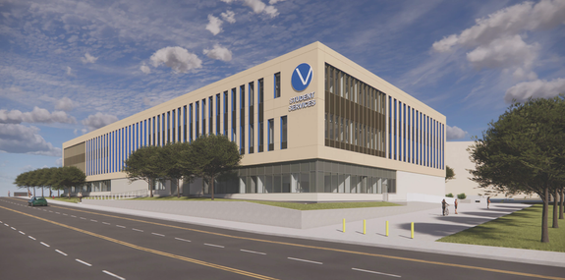
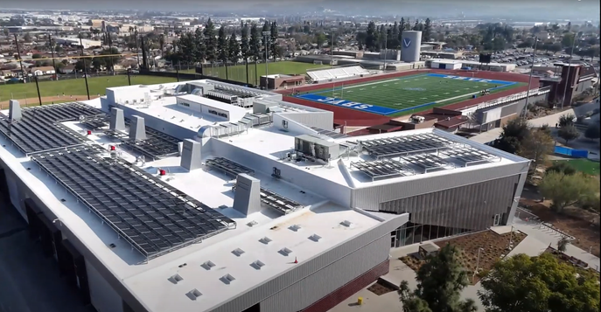


REIMAGINING SBVC:
A FRESH START FOR OUR NEXT CENTURY
TIMELINE
STAGE I:
VISION FOR REIMAGINING SBVC
STAGE II:
CAMPUSWIDE INPUT
STAGE III:
REVISIONS & APPROVAL
STAGE IV:
IMPLEMENTATION STEPS
Town Hall Meetings in B-100.
NOVEMBER 12
AUGUST 22
OCTOBER 13
Revised model presented at College Council.
SPRING 2026
Rationale for reimagining introduced at Fall Opening Day.
9:30 AM & 1:30 PM
Board approvals, updates, onboarding
OCTOBER 14
NOVEMBER 19
SEPTEMBER 10
9:30 AM & 1:30 PM
Academic Senate first read.
College Council introduces reorganization timeline.
OCTOBER 15
DECEMBER 3
STAGE V:
VISION GOES LIVE
5:00 PM - 7:00 PM
Academic Senate second read.
SEPTEMBER 24
OCTOBER 16
DECEMBER 10
JULY 1, 2026
Initial draft of reorganization proposal, rationale and vision presented at CC.
9:30 AM & 1:30 PM
College Council agenda item.
New org structure implemented.
OCTOBER 20-24
EARLY OCTOBER
Library Viewing Room open for feedback.
Instructional & Student Services Divisions present draft proposal.
OCTOBER 10 & 11
Presentations to Department Chairs.

Slide 21

REIMAGINING SBVC:
A FRESH START FOR OUR NEXT CENTURY
WHY
The current ORG CHART does not reflect all the work being done by Valley College.
Some areas of the College may make more sense in a different location on the ORG CHART.
Good timing for a big picture REORG with Vision 2030, Valley College Committee Structure updates, the Valley UP! Initiative 2025-30, and preparing for the next 100 years!

Slide 22
REIMAGINING SBVC:
A FRESH START FOR OUR NEXT CENTURY
OUTCOMES
A simplified and streamlined student experience.
A College organizational structure that minimizes duplication of services.
An inclusive approach for a big picture reorganization that advances emerging areas, complex educational and support needs of students, and maximizing the priorities in the Valley Up! Initiative, 2025-30.

Slide 23
REIMAGINING SBVC:
A FRESH START FOR OUR NEXT CENTURY
GUIDELINES
Employees will not lose their jobs as part of the REORG, but job duties may change.
All employees will be supported to participate in REORG opportunities outlined in the timeline.
The timeline is subject to change to ensure all voices are heard—getting it right is more important than rushing to a decision.

Slide 24
SAN BERNARDINO VALLEY COLLEGE
Arrival
Arrival
Mo
Mo
Mo
Mo
Group Activity
Group Activity
Lunch
Lunch
Tackling the Trail
10:30 am

Slide 25
SAN BERNARDINO VALLEY COLLEGE
Arrival
Arrival
Mo
Mo
Mo
Mo
Group Activity
Group Activity
Lunch
Lunch
Base Camp Bites
12:00 pm

Slide 26
SAN BERNARDINO VALLEY COLLEGE
Arrival
Arrival
Mo
Mo
Mo
Mo
Group Activity
Group Activity
Lunch
Lunch
Choose Your Adventure
12:45 pm

Slide 27
SAN BERNARDINO VALLEY COLLEGE
Arrival
Arrival
Mo
Mo
Mo
Mo
Group Activity
Group Activity
Lunch
Lunch
Climbing the Mountain
2:00 pm

Slide 28
SAN BERNARDINO VALLEY COLLEGE
Arrival
Arrival
Mo
Mo
Mo
Mo
Group Activity
Group Activity
Lunch
Lunch
Campfire Circles
3:15 pm

Slide 29
SAN BERNARDINO VALLEY COLLEGE
Arrival
Arrival
Mo
Mo
Mo
Mo
Group Activity
Group Activity
Lunch
Lunch
From the Mountain to Valley
4:00 pm

