Slide 1
Student Success Scorecard Data from ARCC 2.0 2015 Year Ending in 2013-2014
Revised 12/1/15
Prepared and Presented by:
Dr. James Smith, Dean, Institutional Effectiveness, Research & Planning
Dr. Giovanni Sosa, Interim Dean of Institutional Effectiveness, Research, & Planning
Dr. Keith Wurtz, Dean, Interim Executive Director of Institutional Effectiveness, Research & Planning
Notes:
ARCC – Accountability Reporting for the Community Colleges

Slide 2
Purpose of ARCC 2.0
To facilitate the improvement of student progress and success
ARCC 2.0 is part of the Statewide Student Success Initiative and the Student Success Act and was a recommendation of the Student Success Task Force

Slide 3
ARCC 2.0 Momentum Point Outcomes
Remedial (English and Math) – Percentage of credit students tracked for six years from 2008-09 to 2013-14 who started below transfer level in English, mathematics, and/or ESL and completed a college-level course in the same discipline.
Persistence – Percentage of first-time degree and/or transfer-seeking students tracked for six years from 2008-09 to 2013-14 who enrolled in the first three consecutive terms. This metric is considered a milestone or momentum point. Research shows that students with sustained enrollment are more likely to succeed.
30 Units – Percentage of first-time degree and/or transfer seeking students tracked for six years from 2008-09 to 2013-14 who achieved at least 30 units. Credit accumulation, 30 units specifically, tends to be positively correlated with completion and wage gain.
Notes:
Leinbach and Jenkins (2008, pp. 1) define momentum points as “measurable educational attainments, such as completing a college-level math course, that are empirically correlated with the completion of a milestone.” The CCCCO Student Success Task Force (SSTF, 2011) refers to momentum points as progression metrics.
Persistence – The percentage of first-time students with minimum of 6 units earned who attempted any Math or English in the first three years and achieved the following measure of progress (or momentum point) within six years of entry:
• Enroll in first three consecutive primary semester terms (or four quarter terms) anywhere in the CCC system.
30 Units – The percentage of first-time students with minimum of 6 units earned who attempted any Math or English in the first three years and achieved the following measure of progress (or milestone) within six years of entry:
• Earned at least 30 units in the CCC system.
Remedial (English and Math) – The percentage of credit students who attempted a course designated at “levels below transfer” in:
• Math and successfully completed a college-level course in Math within six years.
• English and successfully completed a college-level course in English within six years.
• ESL and successfully completed the ESL sequence or a college-level English course within six years.
The cohort is defined as the year the student attempts a course at “levels below transfer” in Math, English and/or ESL at that college.

Slide 4
ARCC 2.0 Completion Outcomes
Completion (SPAR) – percentage of first-time degree and/or transfer-seeking students tracked for six years from 2008-09 to 2013-14 who completed a degree, certificate or transfer related outcomes.
Career Technical Education (CTE) – Percentage of students tracked for six years from 2008-09 to 2013-14 who completed several courses classified as career technical education (or vocational) in a single discipline and completed a degree, certificate or transfer related outcome.
Notes:
Completion (SPAR) – The percentage of first-time students with minimum of 6 units earned who attempted any Math or English in the first three years and achieved any of the following outcomes within six years of entry:
• Earned AA/AS or credit Certificate (Chancellor’s Office approved)
• Transfer to four-year institution (students shown to have enrolled at any four-year institution of higher education after enrolling at a CCC)
• Achieved “Transfer Prepared” (student successfully completed 60 UC/CSU transferable units with a GPA >= 2.0)
Career Technical Education (CTE) – The percentage of students who completed a CTE course for the first-time and completed more than 8 units in the subsequent three years in a single discipline (2-digit vocational TOP code where at least one of the courses is occupational SAM B or C) and who achieved any of the following outcomes within six years of entry:
• Earned any AA/AS or credit Certificate (Chancellor’s Office approved)
• Transfer to four-year institution (students shown to have enrolled at any four-year institution of higher education after enrolling at a CCC)
• Achieved “Transfer Prepared” (student successfully completed 60 UC/CSU transferable units with a GPA >= 2.0)

Slide 5
ARCC 2.0 Comparison Groups
Remedial Progress Rate (Unprepared for College) - The percentage of credit students who start out at any levels below transfer in English, Mathematics, and/or ESL
College Prepared Rate – First attempted math or English was transfer level.

Slide 6
New Student Scorecard Measure
Career Skills Builder Students
Skills builders are workers who are maintaining and adding to skill sets required for ongoing employment and career advancement. Skills-builders successfully complete a limited number of courses, but do not earn a certificate or degree, or transfer to a four-year college
Notes:
Definition: The median inflation adjusted wages before and after the year of enrollment for students who completed a SAM A, B, or C course of at least (.5 units) and passed all CTE coursework in a given academic year. These students were no longer enrolled anywhere in the system the following academic year and did not earn an award or transfer to a four year college the year of enrollment or the following year.

Slide 7

San Bernardino Valley College

Slide 8
San Bernardino Valley College
Student Success Scorecard data supports goal setting in several campus planning documents:
Strategic Plan
Educational Master Plan
Student Equity Plan
Basic Skills Plan
Student Success Plan
Enrollment Management Plan
The scorecard provides a basis to focus on specific content areas and the needs of specific student sub-groups.

Slide 9
SBVC ARCC 2.0 Momentum-Point Rates
Persistence made a noticeable increase. Math and English rates continue to improve. Math success is higher than the state average and significantly higher than peer campuses. The 30 units completion rate declined, due primarily to the section cuts for this cohort.
Notes:
Persistence has made a noticeable increase. English rates continue to improve. Math rates show no meaningful change but math success is higher than the state average and significantly higher than peer campuses. The 30 units completion rate has declined. The maintained enrollment but completed fewer units.

Slide 10
SBVC Momentum-Point Rates by Gender
Gender | Persistence | 30 Units | English | Math
Overall | 68.5% | 57.0% | 33.0% | 31.6%
Female | 69.5% | 58.6% | 34.4% | 32.5%
Male | 67.6% | 55.1% | 30.8% | 30.2%
No significant achievement gaps exists between men and women, but women do slightly better on every measure.

Slide 11
SBVC Momentum-Point Rates by Ethnicity
Ethnicity | Persistence | 30 Units | English | Math
Overall | 68.5% | 57.0% | 33.0% | 31.6%
African American | 63.7% | 47.6% | 26.0% | 23.0%
Native American* | 64.0% | 48.0% | 13.0% | 23.8%
Asian | 68.7% | 61.4% | 43.4% | 48.3%
Filipino* | 77.5% | 62.5% | 50.0% | 44.4%
Hispanic | 69.7% | 57.8% | 33.0% | 31.9%
Pacific Islander* | 57.1% | 42.9% | 25.0% | 20.0%
White | 68.0% | 62.4% | 38.8% | 37.4%
Red circles identify disproportionate impact levels (less than 80% of the highest preforming group.) Ethnic
groups with small counts were not used for high performing reference groups.
Notes:
Red circles identify disproportionate impact levels (less than 80% of the highest preforming group.)

Slide 12
SBVC Completion Rates
The decline in completion the rate for CTE is largely due to a lack of adequate advising that followed several full-time faculty retirements.

Slide 13
Completion Rates by Gender
Gender | CTE | Completion
Overall | 41.4% | 33.5%
Female | 50.2% | 34.3%
Male | 34.8% | 32.7%
Women are completing Career Technical Education (CTE) programs at a higher rate than men. This is largely due to the high completion rates in nursing and child development programs where women are the majority .
Notes:
Course Retention Rates 2012-13
Aeronautics 95.59%
Automotive Technology 89.91%
Child Development 89.98%
Electricity & Electronics 91.62%
Inspection Technology 99.46%
Library Technology 87.03%
Machinist Technology 91.82%
Nursing 97.80%
Psychiatric Technician 97.50%
Refrigeration & AC 94.32%
Water Supply Technology 95.27%
Welding Technology 95.80%

Slide 14
SBVC Completion Rates by Ethnicity
Ethnicity | Completions | CTE
Overall | 33.5% | 41.4%
African American | 32.6% | 45.8%
Native American* | 24.0% | 30.4%
Asian | 44.6% | 59.4%
Filipino* | 37.5% | 71.9%
Hispanic | 30.4% | 40.3%
Pacific Islander* | 21.4% | 62.5%
White | 42.5% | 35.1%
(*) Asterisk identifies groups with very small populations
Groups with small counts were not used as references.
Notes:
Disproportionate impact

Slide 15
SBVC Improvement Rates Over Prior Year
ARCC Outcome | 07- 08 to 12-13 | 08- 09 to 13-14 | Improvement over Prior Year
Persistence | 64.0% | 68.5% | +4.5%
30 Unit Completion Rate | 57.5% | 57.0% | -0.5%
Completion Rate | 33.5% | 33.5% | 0%
Remedial Rate English | 32.1% | 33.0 % | +0.9%
Remedial Rate Math | 30.4% | 31.6% | +1.2%
CTE Rate | 52.0% | 41.4% | -10.6%
Red circle identifies the measures with the largest change between cohort years—Increase in Persistence and decline in CTE Rate

Slide 16
SBVC Rates Compared to State
ARCC Outcome | 2008- 09 to 2013 -14 |  | SBVC rates compared to the State
 | State | SBVC
Persistence | 71.7% | 68.5% | -3.2
30 Unit Completion Rate | 66.5% | 57.0% | -9.5
Completion | 46.8% | 33.5% | -13.3
Remedial Rate Math | 31.0% | 33.0 % | +2.0
Remedial Rate English | 43.4% | 31.6% | -11.8
CTE Rate | 49.9% | 41.4% | -8.5
Success rates in math are 2% points higher than the state average and
SBVC is significantly above its peer group average in Math.

Slide 17
SBVC Completion Rate Examined Further (by cohort year)
Completion | 2004-05 | 2005-06 | 2006-07 | 2007-08 | 2008-09
Overall | 1,477 | 1,470 | 1,534 | 1,718 | 2,083
 | 36.0% | 37.3% | 35.2% | 33.5% | 33.5%
College Prepared | 128 | 143 | 155 | 143 | 183
 | 60.9% | 58.7% | 54.2% | 58.7% | 55.7%
Unprepared (Remedial) | 1,349 | 1,327 | 1,379 | 1,575 | 1,900
 | 33.7% | 35.0% | 33.1% | 31.2% | 31.4%
Completion rates have declined for prepared students. Success rates have increased slightly for unprepared students. The Overall rate remains unchanged from last year.

Slide 18
Success in Math and English by Ethnicity
Success rates are higher in English for all groups except Asian and Native American students. Native Americans, Pacific Islanders and Filipinos have very low enrollment –their measures have reduced validity. Asian, Filipino, and White students have the highest success rates.

Slide 19
Success Differences Between Prepared and Unprepared Students by Ethnicity
Prepared student represent less than 10% of the cohort. They show significantly higher success rates in all ethnic groups. Unprepared Asian students have the highest success rates.
Notes:
These ethnicities comprise the majority of the students (African American = 13.6%, Hispanic = 61.8%, White = 15.3%).

Slide 20
Current support programs are helping.
Program Name | Course success rate for program | Course success rate for campus | Course retention rate for program | Course retention rate for campus
CARE* | 77% | 65% | 91% | 88%
EOP&S | 72% | 65% | 90% | 88%
Puente | 70% | 65% | 93% | 88%
STAR | 70% | 65% | 87% | 88%
Student Success Center | 73% | 65% | 90% | 88%
Tumaini | 53% | 65% | 90% | 88%
Valley Bound | 67% | 65% | 93% | 88%
MCHS | 90% | 65% | 99% | 88%
These programs need regular review and assessment. These data are from 2014 – 15.
*2012 – 13 data

Slide 21
Successful Strategies Supported by SBVC Research
Strategy | Program /Service | Outcome
Increase full-time enrollment | -First-year experience programs -Improved F/A service -Outreach for students to enroll directly after HS graduation | -Increase persistence -Increased 30 unit rate -Increased completions
Improve success in developmental and basic skills courses | -Writing lab -Reading lab -Student success center -Non-credit ESL courses | -Higher success rates in English and math
Increase participation in learning communities | -Student cohorts taking courses together -Targeted counseling -Required tutoring | -Higher completion rates

Slide 22
Ongoing Strategies to Supported SBVC Student Success
Strategy | Program /Service | Outcome
Promote transfer to Historically Black Colleges and Universities (HBCUs) | Invite representative to campus Promote transfer through the transfer center | Higher transfer rates
Increase success rates in basic skills English and reading | Supplemental Instruction Linked courses Contextual learning Faculty directed tutoring | Greater success in upper-division courses
Promote student engagement through Arts and Lectures | Guest speakers Cultural programs | Higher levels of student engagement Higher persistence
Notes:
Best predictor of transferring to a four-year institution is to complete transfer level math
Minority Science and Engineering Improvement Project (MSIEP)
Student Success Centers (Dreamer’s Center; Athletes; students with children)

Slide 23
New and Innovative Approaches to Support Student Success
Strategy | Program /Service | Outcome
Job placement and employment tracking | Exploring job placement tracking software | Increased success rates in CTE programs
Outreach to students who break enrollment | Phone surveys with students who discontinue enrollment to identify reasons | Increase program completion rates.
Support students with special needs | Guardian Scholars Program to support foster youth Dreamers/AB540 Center Veteran’s center | Increase success rates
Notes:
Best predictor of transferring to a four-year institution is to complete transfer level math
Minority Science and Engineering Improvement Project (MSIEP)
Student Success Centers (Dreamer’s Center; Athletes; students with children)

Slide 24
New and Innovative Approaches to Support Student Success
Strategy | Program /Service | Outcome
Increase support to and outreach for STEM Programs | Outreach activities : Women/men in math STEMAPALOOZA STEM support programs | Higher STEM enrollment Higher course success rates Higher graduation rates Higher transfer rates
Expand tutoring hours | Exploring the use of a 24 hr. tutoring service. Expand campus tutoring services | Increase overall course success rate
Expand partnership | UCR & CSUSB STEM programs, e.g., HSI-STEM, USDA, and NSF grants Water treatment program | Higher graduation rates Higher CTE completion rates

Slide 25
New and Innovative Approaches to Support Student Success
Strategy | Program /Service | Outcome
Textbook bank for overnight textbook use | Exploring 24 hr. textbook loan | Higher retention
Strengths Quest Assessment | Hope accounts for 30% of course and program success | Higher persistence Higher completion rates
Professional Development | Basic skills workshop for faculty (4 - 6) to provide interdisciplinary training | Develop teaching skills to integrate basic skills development across disciplines

Slide 26
How can trustees help SBVC?
Continue to support grant development
Support innovative activities and programs on our campus
Support exploring the development of alternative modalities:
Online courses
Courses offered at satellite locations
Non-credit ESL
Continue to support our diverse set of student support programs
Support other innovative programs and partnerships:
Accelerated course model for basic skills
Supplemental Instruction
Tutoring
Professional development for faculty (SI, Online, SLOs, Technology )
Partnerships with K-12 and 4-year colleges

Slide 27
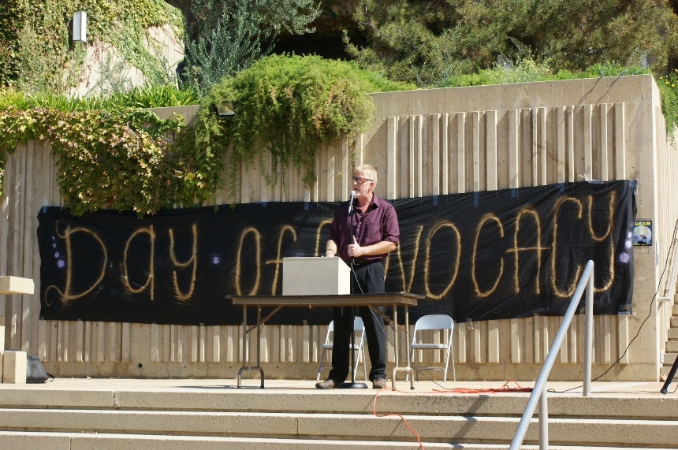


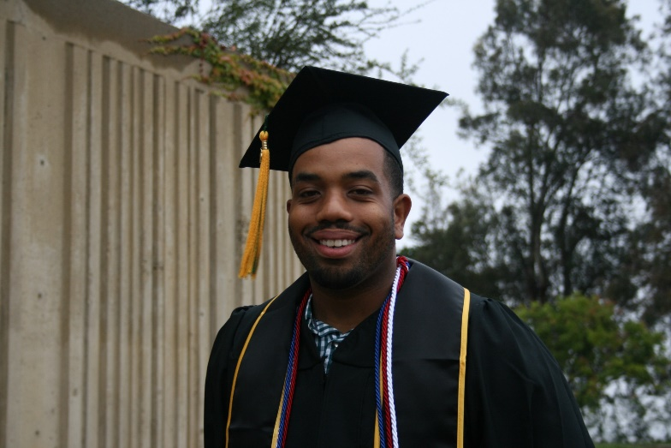

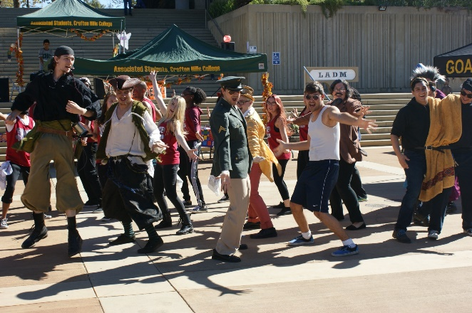
Crafton Hills College

Slide 28
Crafton ARCC 2.0 Momentum-Point Rates
Notes:
Comment that the strategies we implemented will not be impactful for two more years.

Slide 29
CHC Momentum-Point Rates by Gender
Gender | Math | English | Persistence | 30 Units
Overall | 30.1 | 48.7 | 72.9 | 60.8
Female | 33.8 | 53.3 | 74.3 | 62.9
Male | 25.1 | 43.1 | 71.6 | 58.6
The percentages reflect the percent of students in the six year cohort who completed each momentum point
Males appear to struggle slightly more with improving in math than females.
The other differences are not substantially different from each other.
Notes:
If use the 80% rule and divide Male Math improvement rate of 25.1 by Female math improvement rate of 33.8 the result is 74.0% which is lower than 80%. Suggesting that males struggle more at math improvement than females. Same relationship as last year, males struggle more with math improvement than females. This was not identified in student equity because using a three year math throughput rate and not the six year rate that is seven years old. The student equity data is more current.
Using the 80% rule, even though males struggle more with English improvement rates, does not meet the 80% rule criterion: 43.1/53.3 = 80.9.

Slide 30
CHC Momentum-Point Rates by Ethnicity
Ethnicity | Math | English | Persistence | 30 Units
Overall | 30.1 | 48.7 | 72.9 | 60.8
African American | 39.5 | 39.5 | 64.6 | 50.0
Native American | 50.0* | 50.0* | 61.5* | 61.5
Asian | 46.4 | 47.6 | 76.3 | 73.7
Filipino | 7.1** | 53.8 | 80.0 | 60.0
Hispanic | 29.5 | 48.3 | 77.7 | 62.6
Pacific Islander* | 28.6 | 0.0 | 33.3 | 66.7
White | 33.0 | 50.3 | 71.7 | 60.8
*Cohort fewer than 10 students.
**Only 14 students are included in the cohort.
Notes:
Higher Rates
-African American and Native American students are more likely to improve in math than students overall and than Caucasian students
-Hispanic students are more likely to improve in English than students overall and than Caucasian students
Lower Rates
-Using the 80% rule, Hispanic (.295/.464 = .64) and Caucasian (.330/.464 = .71) students have substantially lower math improvement rate than Asians. However, n of referent group of Asian is 28. students
-Using the 80% rule, African American students had lower 30 unit rate (.50/.737 = .678) than Asian students

Slide 31
Crafton ARCC 2.0 Completion Rates
Notes:
The CTE programs contain three strategies that research has shown to work extremely well and may be reason for increase: clear goals, connected to faculty, and cohorts.
The CTE Completion rate is a new measure and one we will be exploring in the future.

Slide 32
CHC Completion Rates by Gender
Gender | CTE | Completion
Overall | 48.9 | 38.8
Female | 54.9 | 41.2
Male | 45.6 | 35.4
Males appear to struggle more with both the completion and CTE improvement rates than females.
Notes:
-Again used the 80% rule, and differences were not substantially different. Males had lower rates in both.

Slide 33
CHC Completion Rates by Ethnicity
Ethnicity | CTE | Completion
Overall | 48.9 | 38.8
African American | 28.6 | 47.9
Native American | 42.9* | 38.5
Asian | 58.8 | 44.7
Filipino | 50.0 | 20.0**
Hispanic | 51.8 | 34.9
Pacific Islander* | 80.0 | 33.3
White | 48.4 | 40.2
*Cohort fewer than 10 students.
**Only 10 students are included in the cohort.
Notes:
-Using 80% rule African American students have a lower CTE Completion (.286/.468=.588) than Asian students
-Using 80% rule Hispanic students (n = 358) have a lower Completion (.349/.479=..728) than African American students (n = 48).

Slide 34
Crafton Completion Rates Over Prior Year
ARCC Outcome | 07-08 to 12-13 | 08-09 to 13-14 | % Change | Improvement over Prior Year
Persistence | 70.4% | 72.9% | +2.5 | Yes
30 Unit Completion Rate | 62.6% | 60.8% | -1.8 | No
Completion Rate (SPAR) | 39.8% | 38.8% | -1.0 | No
Remedial Rate English | 41.8% | 48.7% | +6.9 | Yes
Remedial Rate Math | 32.6% | 30.1% | -2.5 | No
CTE Rate | 49.1% | 48.9% | -0.2 | Same
Notes:
Will see growth based on interventions in one year and we will need more sections to meet the demand.

Slide 35
Crafton Completion Rates Compared to State
ARCC Outcome | 2007-08 to 2012-13 |  | CHC Rate Higher than State
 | State | Crafton
Persistence | 71.7% | 72.9% | Yes
30 Unit Completion Rate | 66.5% | 60.8% | No
Completion Rate (SPAR) | 46.8% | 38.8% | No
Remedial Rate English | 31.0% | 48.7% | Yes
Remedial Rate Math | 43.4% | 30.1% | No
CTE Rate | 49.9% | 48.9% | No
Notes:
Will see growth based on interventions in two years and we will need more sections to meet the demand.

Slide 36
Completion Rates Examined Further
Completion | 2004-05 | 2005-06 | 2006-07 | 2007-08 | 2008-09
Overall | 947 | 989 | 1,033 | 1,075 | 1,176
 | 41.2% | 42.2% | 41.8% | 39.8% | 38.8%
College Prepared | 178 | 221 | 257 | 259 | 277
 | 62.4% | 62.4% | 58.8% | 61.0% | 55.6%
Unprepared | 769 | 768 | 776 | 816 | 899
 | 36.3% | 36.3% | 36.2% | 33.1% | 33.6%
Crafton extensively researched the Completion rate and learned that the largest predictor of the Completion Rate is to successfully complete transfer level math
Information is being used to inform writing of grants, student equity, and student success plans
Notes:
In this case, by far, more students are coming to us unprepared: 76% in the 2006-2007 cohort.

Slide 37
Crafton Student Learning and Success
Integration of Instruction/Student Services | First Year Implemented | First Year See Impact in Scorecard | Scorecard Outcome
 |  |  | Math | English | Persist | 30 Unit | Completion | CTE
Fast Track Math | 2013-2014 | 2019-2020 | X |  | X | X | X
Left Lane | 2012-2013 | 2018-2019 | X | X | X | X | X
Santos Manuel | 2010-2011 | 2016-2017 | X |  | X
Learning Communities | 2007-2008 | 2013-2014 |  |  | X
Tutoring (SI, SLA) | 2011-2012 | 2017-2018 | X | X | X
Note: The First-Year See Impact in Scorecard was estimated by calculating six years starting in the year the cohort would be identified and adding one year since the year the information is reported in the Scorecard one after the six-year cohort has ended. In this year there was 2.5% increase in persistence.
Notes:
Need to give example, For example, Fast Track is where students can take two math courses in the same semester. The first semester we did this was in Spring 2014, and three-year math throughput rate almost doubled.
In addition, with LCs will see impact in 2013-2014, which we will have data for next year.
*Many of the Title V Transfer Prep strategies were not implemented until a year after the grant had started in 2010-2011.
** Many of the Title V STEM strategies were not implemented until a year after the grant had started in 2011-2012.
Persistence did improve by ONE PERCENTAGE POINT, which is a pretty good start.
Need to spend time here and discuss. Research conducted at Crafton shows that each of these are related to student success.
Integration of Instruction and Support Services – Crafton has implemented these programs in the last two years and we should see increases in the Completion rate, 30 unit completion rate, persistence, and in the math and English improvement rates.
Left Lane Program -
Santos Manuel -
Learning Communities – Counselors are attached to classes
Tutoring (SI, SLA) -
Counselors Attending Classes -
Enhanced Transfer Programs and Services – These programs will help with the Crafton persistence, 30 unit rate, and completion rate.
Title V Transfer Prep Grant -
STEM and Trek Academy
Honors
Transfer Center
Transfer Advocates
Curricular changes
Reducing time to complete basic skills – Focus here is on moving towards acceleration.
Alignment and Partnership with K-12 – These strategies will also help to address the English and math improvement rates.
Common Core
SOAR
EAP

Slide 38
Crafton Student Learning and Success
Strategy | First Year Implemented | First Year See Impact in Scorecard | Scorecard Outcome
 |  |  | Math | English | Persist | 30 Unit | Completion | CTE
Enhanced Transfer Programs & Services
Title V Transfer Prep | 2011-2012* | 2017-2018 |  |  | X | X | X
STEM and Trek Academy | 2012-2013** | 2018-2019 |  |  | X | X | X
Honors Program | 2012-2013 | 2018-2019 |  |  | X | X | X
Transfer Center | 2012-2013 | 2018-2019
Transfer Advocates | 2012-2013 | 2018-2019 |  |  |  |  | X
Alignment and Partnership with K-12
SOAR | 2009-2010 | 2015-2016 | X | X | X | X | X
Early Assessment Program (EAP) | 2012-2013 | 2018-2019 | X | X | X | X | X
Common Core | 2014-2015 | 2020-2021 | X | X | X | X | X
Note: The First-Year See Impact in Scorecard was estimated by calculating six years starting in the year the cohort would be identified and adding one year since the year the information is reported in the Scorecard one after the six-year cohort has ended.
Notes:
*Many of the Title V Transfer Prep strategies were not implemented until a year after the grant had started in 2010-2011.
** Many of the Title V STEM strategies were not implemented until a year after the grant had started in 2011-2012.
Persistence did improve by ONE PERCENTAGE POINT, which is a pretty good start.
Need to spend time here and discuss. Research conducted at Crafton shows that each of these are related to student success.
Integration of Instruction and Support Services – Crafton has implemented these programs in the last two years and we should see increases in the Completion rate, 30 unit completion rate, persistence, and in the math and English improvement rates.
Left Lane Program -
Santos Manuel -
Learning Communities – Counselors are attached to classes
Tutoring (SI, SLA) -
Counselors Attending Classes -
Enhanced Transfer Programs and Services – These programs will help with the Crafton persistence, 30 unit rate, and completion rate.
Title V Transfer Prep Grant -
STEM and Trek Academy
Honors
Transfer Center
Transfer Advocates
Curricular changes
Reducing time to complete basic skills – Focus here is on moving towards acceleration.
Alignment and Partnership with K-12 – These strategies will also help to address the English and math improvement rates.
Common Core
SOAR
EAP

Slide 39
Crafton Student Learning and Success Funding Sources
Strategy | Funding Source
Integration of Instruction/Student Services
Fast Track Math | General Fund (Cost of Offering Sections)
Left Lane | SBCCD
San Manuel | San Manuel Band of Mission Indians
Learning Communities | Title V Transfer Prep and STEM Trek Grants
Tutoring (SI, SLA) | Title V Transfer Prep and STEM Trek Grants
Enhanced Transfer Programs & Services
Honors Program | Title V Transfer Prep Grant
Transfer Center | Title V Transfer Prep Grant
Transfer Advocates | Title V Transfer Prep Grant
Alignment and Partnership with K-12
SOAR | Student Success, Student Equity Left Lane, San Manuel
Early Assessment Program (EAP)
Common Core

Slide 40
Current support programs are helping.
Program | Success Rate
 | Program | Comparison Group
Left Lane | 74.5% | 66.7%
Supplemental Instruction: STEM | 74.6% | 59.9%
Supplemental Instruction: Title V | 75.5% | 57.4%
SOAR | 81.2% | 69.7%
STEM Counseling | 83.9% | 72.5%
Occupational Programs | 81.9% | 73.6%
Compressed Courses | 74.8% | 69.1%
Tutoring Center San Manuel Students | 77.1% | 69.2%
Notes:
Left Lane success rate is from the Fall 2013 cohort and includes the all discipline success rate (see Table 3A from 2014 report).
Supplemental Instruction if from RRN 848, Fall 2013 and Spring 2014 STEM brief.
Supplemental Instruction for Title V is from the Grades_CHC_GOR_20150624_FiveYears_1011to1415_NoLRC900.sav file.
SOAR Success rates are a summary from Fall 2009 to Fall 2012: RRN 380.
STEM Counseling is from 2013-2014 study: RRN 952.
Compressed courses is from the study conducted by Ben that looks at success from 1011 to 1213: RRN 688.
Tutoring Center San Manuel Students are San Manuel students who attended tutoring center: RRN 492. It was 2011-2012 though.

Slide 41
Crafton Student Learning and Success
Assess, Measure, and Continuous Improvement
Revision of QEIs to measure progress annually
Updating and revising EMP
Notes:
Assess, Measure, and Continuous Improvement – These are being addressed this year.
Revision of QEIs – QEIs will be aligned at each level of institution and programs will be able to see how they are contributing to each QEI. In addition, in process of developing annual measures that will inform the cohort tracking measures.
Updating EMP

Slide 42
Successful Strategies Supported by Crafton Research
Strategy | Approach
Successfully complete transfer level math and English | Left Lane, SOA³R, New Innovation in Higher Education and Title V Pathways Grant, Fast Track Math, SI, Student Equity Plan
Enroll full-time | Left Lane
Collaboration between Instruction and Student Services | Left Lane, SOA³R, Transfer Prep and STEM grants, Student Success, Student Equity
Student Education Plan (SEP) | Student Success, Student Equity, Left Lane, SOA³R
Tutoring Center
Accelerated Math & English | Math and English departments are exploring approaches to increase
Student engagement | Student employment on campus
Notes:
Best predictor of transferring to a four-year institution is to complete transfer level math
Students are more likely to transfer if they enroll full-time

Slide 43
Student Success Annual Effectiveness Indicators
Course Success
Course Completion (i.e. retention)
Degree/Certificate Completion Rate (Developing Methodology for annual measure)
Transfer Rate (Developing Methodology for annual measure)
Transfer Readiness Rate (Developing Methodology for annual measure)
Notes:
In order to be able to determine what kind of impact that Crafton is having we are in the process of developing annual indicators.

Slide 44
How can you help Crafton?
Continue to support the implementation of Degree Audit systems
All students need to have an SEP
Help Crafton to meet the requirements of the Student Success Act by supporting the addition of more sections to meet demand
Crafton will be able to plan courses based on SEPs
Crafton will be able to track student progress on meeting their educational goals and identify improvement areas
Notes:
This request has gone through TESS and has been prioritized.
Support the implementation of the priority registration process that requires students to continuously enroll in math and English until they have completed the math and English required in their SEP
Successfully completing transfer level math is the best predictor of achieving any ARCC milestone
Students are statistically significantly more likely to complete any ARCC milestone if they complete transfer level English within their first year

Slide 45
How can you help Crafton?
Educational Partnership Initiative (EPI) – Develops a student services portal that will customize and sequence matriculation information and activities to lead students toward successful completion of their educational goals – Includes an Educational Planning and Degree Audit system
Need to continue to balance incentives for growth with incentives for success
Notes:
Support the increase in math and English sections to meet student need
Crafton students need an additional 37 math sections and 47 English sections or 345 FTES
Or
First-time Crafton students need an additional 15 math sections and 23 English sections or 156 FTES

Slide 46
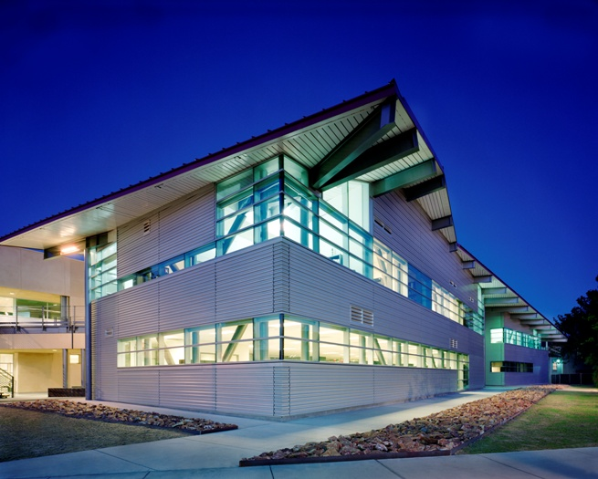
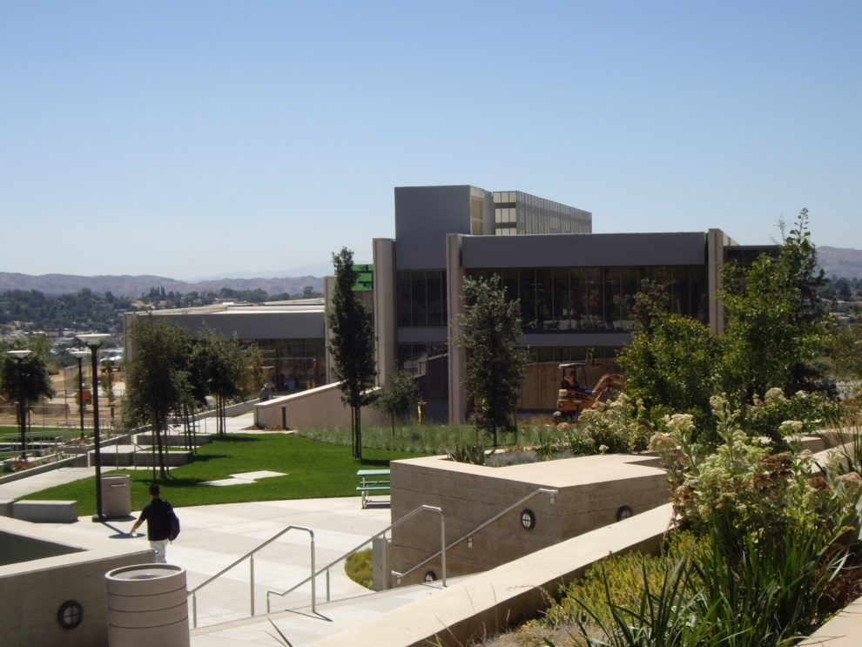
Questions?
.

