Slide 1
Welcome!
First Program Review Committee of 2026-27 academic year
Roll Call & Quorum
Call to Order
Approval of Agenda and Minutes
Notes:
=sharing

Slide 2
Introductions
Name
Department and/or role
Fun fact about yourself
Experience with Program Review (years, role, etc.)
0 I don't even know what I'm doing here. | 1 I am aware that Program Review is a thing I should know about. | 2 I've participated in Program Review and kind of know how it works. | 3 I more or less know what I'm doing here. | 4 I am a Program Review genius! Ask me anything!
Notes:
Bethany's Intro: https://drive.google.com/file/d/1gU0XpEmq6WEC5tEHgCr2D9takwmQGA0T/view?usp=sharing
Pic of Bethany at the California Community College Chancellor's Office: https://drive.google.com/file/d/1-CBta8YobrQX4lAuAwZervY4t0uw1w2W/view?usp=sharing

Slide 3
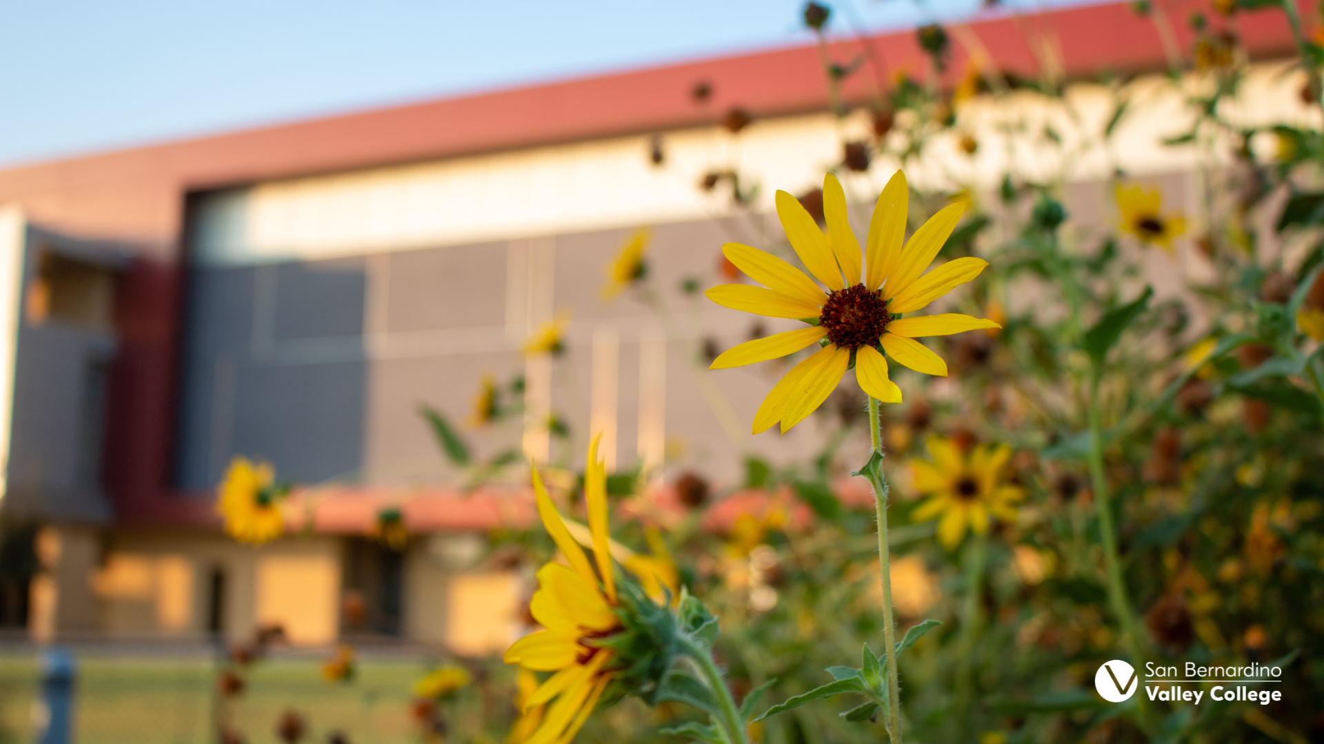
What Even Is Program Review?
A Broad perspective
Program Review Committee
September 14, 2026

Slide 4
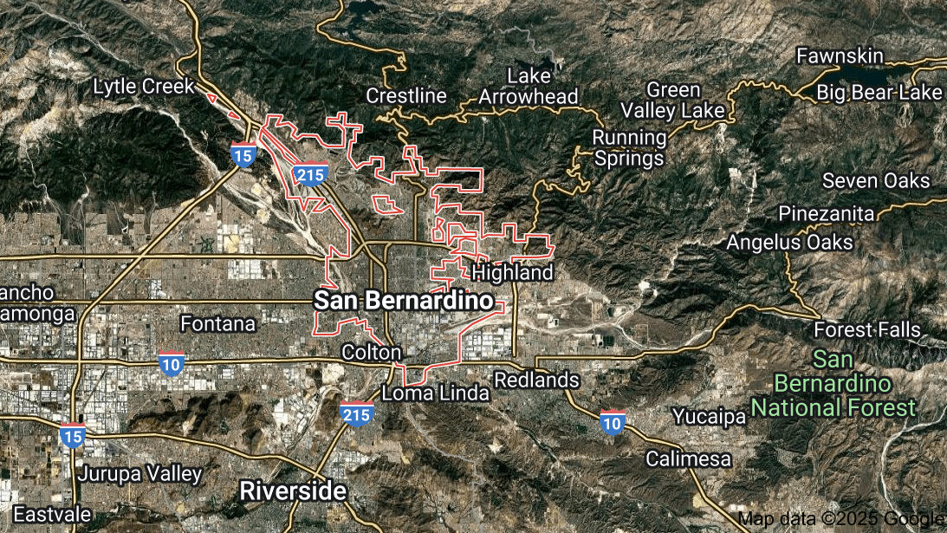
A 30,000 ft. View of Program Review
What's the point of Program Review?

Slide 5
Program Review
Program Review is a data-driven departmental self-evaluation.
Every college in the CA Community College System has a Program Review process!
  The CCCCO Program and Course Approval Handbook requires us to have a process for reviewing programs.
  Each CCC establishes a Program Review Process appropriate to that college's community needs.
Program Review is the process of review, analysis, and assessment of the content, currency, and quality of California Community College (CCC) programs.
It should align with SBVC's Mission, Vision, and Values, our college's planning documents (e.g. Educational Master Plan, Student Equity Plan).
It also needs to align with Accreditation Standards.
Notes:
College of the Siskiyous: https://www.siskiyous.edu/programreview/programReview_faq.htm#:~:text=Program%20Review%20is%20the%20process,to%20that%20college's%20community%20needs. da
Glendale Community College: https://www.glendale.edu/about-gcc/gcc-overview/institutional-effectiveness/program-review

Slide 6

Outcomes of Program Review
Resource allocation
  Funding
  Supplies
  Hiring
Develop programs that serve the needs of students
  Meeting days & times
  Curriculum
  Student support services (tutoring, library, etc.)
Programs that meet the needs of the college community
  Job placement
  Relevant skills
  Plan ahead rather than react
What we do.
How we do it.
How to do it better.

Slide 7
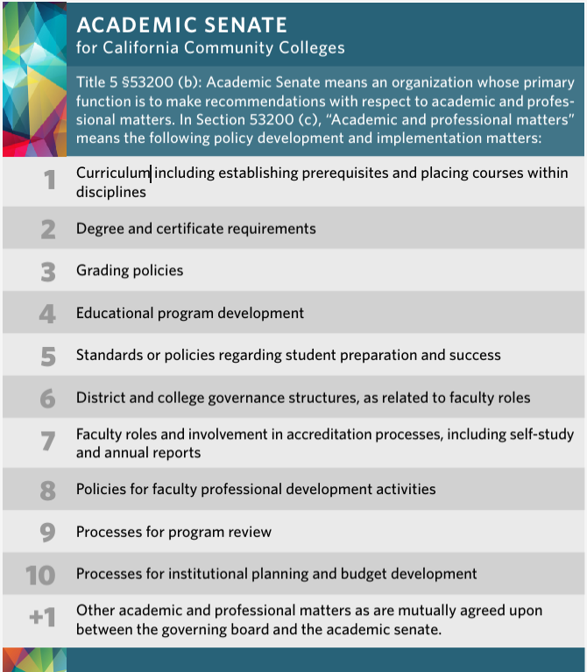
Program Review in Title 5
It's part of Title 5!
  Title 5 is a subset of CA Ed Code (developed by CA legislature)
  Title 5 implements laws from Ed Code
  CA Ed Code requires legislation to be changed
#9 in the 10+1 [§53200 (c)]
ASCCC White Paper
This means, we are empowered as a committee our local Academic Senate and by Title 5!
Notes:
CA Ed Code (~BPs) > Title 5 (~APs)(remember Title V is federal while Title 5 is state)

Slide 8
Program Review in Accreditation
The Accrediting Commission for Community and Junior Colleges (ACCJC) integrated Program Review into its revised 2024 Standards (appearing 13 times!).
ACCJC requires institutions to regularly evaluate and improve the quality of all instructional programs.
  Standard 1.4
  Standard 1.5
  Standard 2.5
  Standard 2.6
  Standard 2.7
  Standard 2.8
  Standard 2.9
  Standard 3.5
  Standard 3.6
  Standard 3.9
ASCCC Paper: Program Review and the Equity-Driven 2024 ACCJC Standards
Notes:
Remind that our visit

Slide 9
ACCJC Eligibility Requirements for Accreditation, January 2024
19. Institutional Planning and Evaluation: The institution systematically evaluates and makes public how well and in what ways it is accomplishing its purposes, including assessment of student learning outcomes. The institution provides evidence of planning for improvement of institutional structures and processes, student achievement of educational goals, and student learning. The institution assesses progress toward achieving its stated goals and makes decisions regarding improvement through an ongoing and systematic cycle of evaluation, integrated planning, resource allocation, implementation, and re-evaluation.
Required Documentation: Evidence the institution engages in regular self-reflective evaluation of its operations and of student learning outcomes, and uses the results to identify strengths and areas in need of improvement for purposes of developing institutional plans and maintaining educational quality
Notes:
https://accjc.org/wp-content/uploads/Eligibility-Requirements-for-Accreditation.pdf

Slide 10
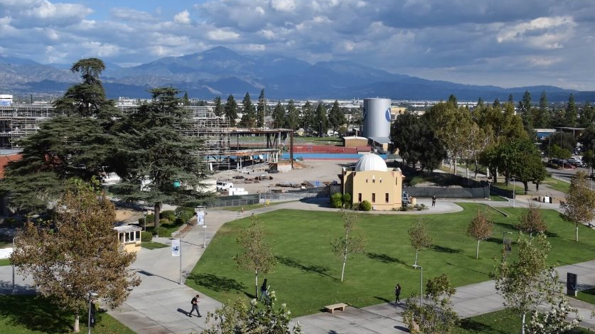
A 10,000 ft. View of Program Review
How does this apply to SBVC?

Slide 11
2026-2027 Meeting Dates
2nd and 4th Mondays 2:00 – 4:00 pm
Fall 2026
9/14
9/28
10/12
10/26
11/9
11/23 – no meeting, holiday break
12/14 (tentative) – Finals week
Spring 2027
1/25
2/8
2/22
3/8
3/22
4/12
4/26
5/10 (tentative) – Finals week

Slide 12

Program Review at SBVC
Annually, we examine the programs at SBVC.
What's new: This committee only reviews academic programs.
  Departments self-reflect and write a report using data.
  The committee reads the reports and provide:
    Constructive feedback
    Helpful suggestions
    Meaningful direction
  We also
    Look for themes and trends
    Make recommendations to Academic Senate

Slide 13
Program Review at SBVC
Who participates?
What do we mean by "academic program"?
Who backs our committee? What gives us the right?
Why does it matter for our committee to understand the culture of SBVC?

Slide 14
Program Review at SBVC: Charge & Purpose
According to Academic Senate bylaws (Article XIX):
The Program Review Committee examines and evaluates the resource needs and effectiveness of all instructional and service areas and their progress on meeting departmental, divisional, and institutional goals on one-, two-, and four-year cycles as determined by the District, College, and other regulatory agencies. In so doing, the Program Review Committee aids in short- and long-range planning and decision making, improvement of services, and dissemination of information and recommendations to other college processes as appropriate.
The Program Review Committee is authorized by the Academic Senate to make needs assessment recommendations to College Council and the college president and to report program efficacy ratings to the Academic Senate and the entire the campus.

Slide 15
Program Review at SBVC: Charge & Purpose
The Program Review Committee leads and manages the academic program review process, in alignment with ACCJC accreditation standards and linking self-evaluation to institutional planning. For purposes of this committee's scope, academic programs are defined as instructional programs and student services programs in which faculty hold primary responsibility for design, delivery, or oversight of program outcomes. The committee develops and refines program review processes, standards, and criteria through faculty-driven, evidence-based evaluation. Resource needs are collected and synthesized through academic program review and they shall be forwarded to the Planning and Resource Allocation Committee. (approved by the Academic Senate in Spring 2026)

Slide 16
Program Review at SBVC: Membership
Membership includes at least:
  Voting membership
    2 voting members from each division
    1 voting member from the Instructional Support Services division
    1 student, appointed by ASG
  Non-voting resource members
    Remaining division appointees (acting as alternates)
    2 managers
    1 classified senate designee
    Academic Senate President
    Chair of Chairs
    Noncredit Faculty Lead
    Outcomes Faculty Lead
    Institutional Effectiveness Tri-Chair
    Planning and Resource Allocation Committee Tri-Chair
  Chairs:
    Faculty Co-Chairs: Bethany Tasaka & Dani Pearson
    Administrative Co-Chair: Mike Cordero
  Administrative Assistant: Maureen Ryan

Slide 17
Program Review at SBVC: History
Prior to 2020:
2020 – 22: Recognized need to update program review process, data collection, evaluating & discussing process changes
2022 – 23: SWOT Pilot Spring 2023
  New process adopted and named: All Services & Programs Institutional Resources & Engagement (ASPIRE) process
  Aim was to create an inclusive process all services and programs could participate in as a self-reflective continuous improvement exercise

Slide 18
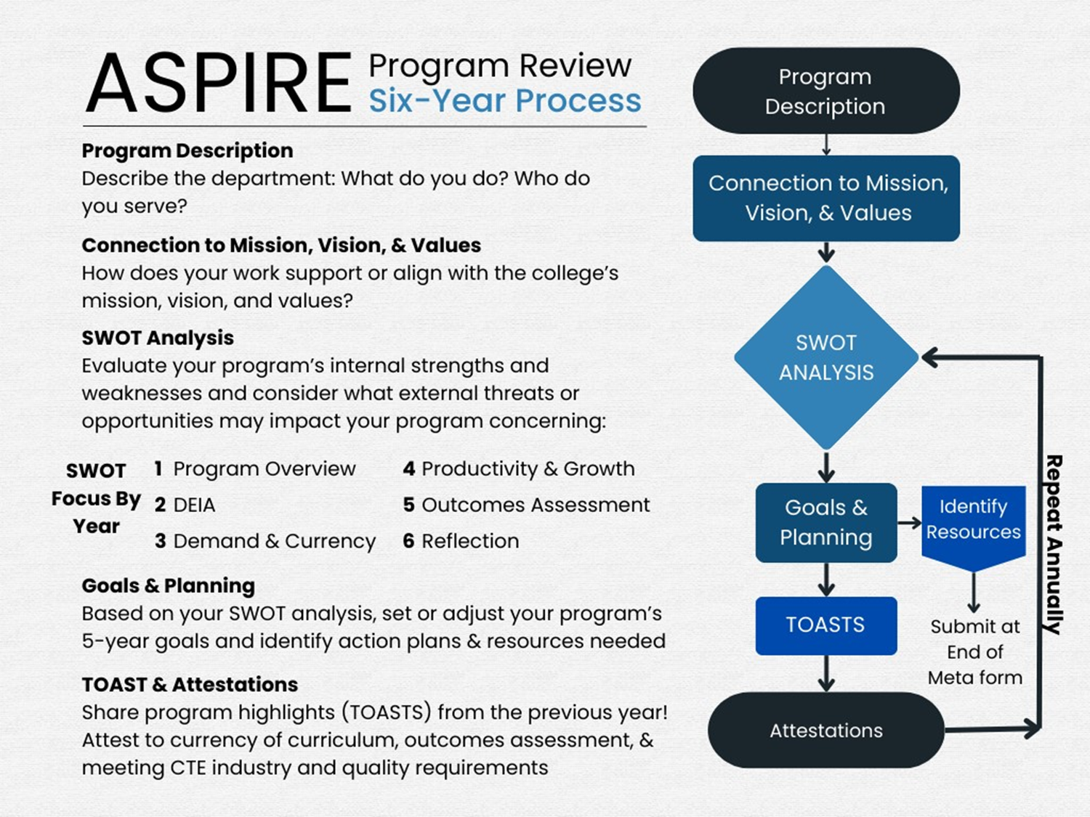
How does the ASPIRE process work?
?

Slide 19
Program Review at SBVC: Now
Prior to 2020
2020 – 22: Recognized need to update program review process, data collection, evaluating & discussing process changes
2022 – 23: SWOT Pilot Spring 2023
  New process adopted and named: All Services & Programs Institutional Resources & Engagement (ASPIRE) process
2023 – 24: ASPIRE Year 1: Overview of Programs
2024 – 25: ASPIRE Year 2: DEIA
2024 – 25: ASPIRE Year 3: Demand & Currency/Recency
Now Entering: ASPIRE YEAR 4: Productivity & Growth

Slide 20
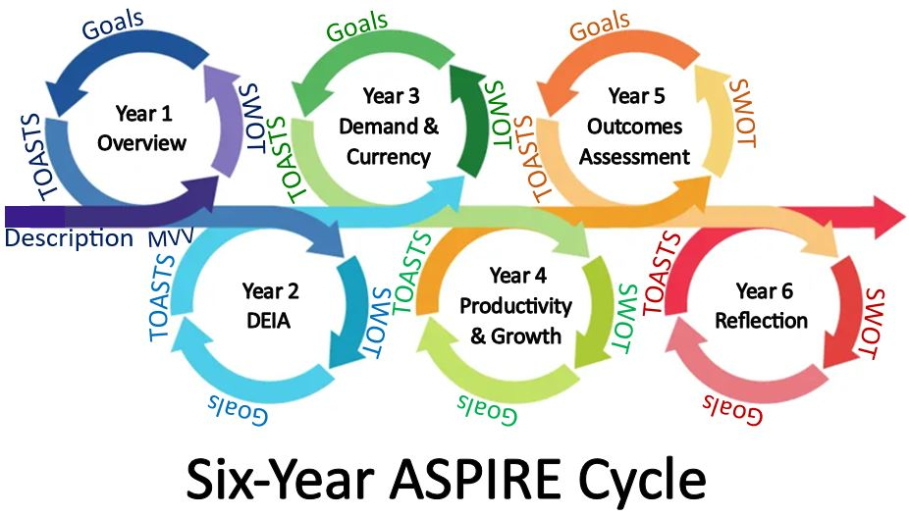


Slide 21
Some Guiding Questions
We need our colleagues to participate fully, to find meaning in this process. Otherwise, it's just another thing we are required to do.
  How do we meaningfully use data to support self-evaluations?
  How do we encourage our colleagues to be authentic and realistic?
  Where do we find cultural humility as we "evaluate" our colleagues and their programs? Are we creating a safe space for honesty?
  How do we hold programs accountable to the process?
  As a committee, how do we self-evaluate and make this process smoother?

Slide 22

Other Important Things
Brown Act Committee
Voting and quorum (you need to be here and on time)
  Alternates
Communication & sharing
  SharePoint

Slide 23
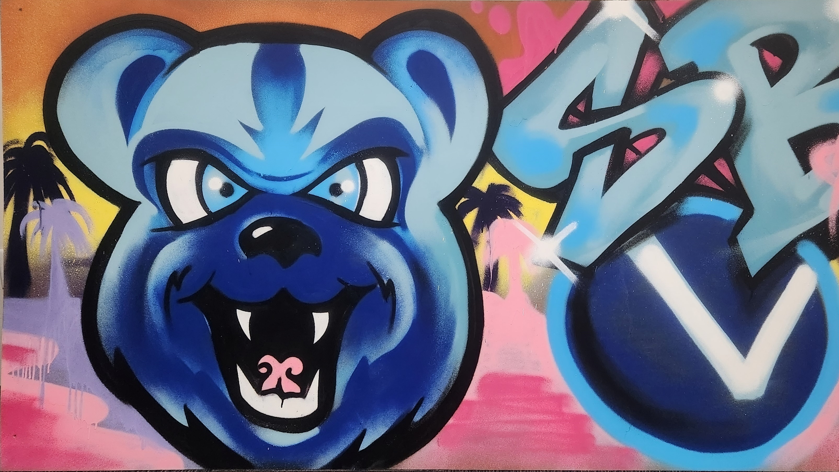
Questions?

Slide 24
Resources
10+1: https://www.asccc.org/10_1
ASCCC Paper - PROGRAM REVIEW: Developing a Faculty Driven Process: https://www.asccc.org/sites/default/files/publications/ProgReview_0.pdf
ASCCC Paper - PROGRAM REVIEW: Setting a Standard: https://www.asccc.org/sites/default/files/publications/Program-review-spring09_0.pdf
College of the Siskiyous: https://www.siskiyous.edu/programreview/programReview_faq.htm#:~:text=Program%20Review%20is%20the%20process,to%20that%20college's%20community%20needs.
Curriculum Resources for California Community Colleges: https://www.ccccurriculum.net/faq/#:~:text=Title%205%20section%2055003%20states,2(e).%20%E2%80%8B
Glendale Community College: https://www.glendale.edu/about-gcc/gcc-overview/institutional-effectiveness/program-review
SBVC Academic Senate: https://www.valleycollege.edu/about-sbvc/campus-committees/academic-senate/
SBVC Program Review: https://www.valleycollege.edu/about-sbvc/campus-committees/program-review/index.php

