Slide 1

SAN BERNARDINO VALLEY COLLEGE CAMPUS HOURS OF OPERATIONS (Update) Presented by SBCCD PD Acting Chief of Police Blake Bonnet

Slide 2
Campus Hours of Operations (Update)
Purpose #1: To promote overall campus safety and awareness
Purpose #2: To establish operational hours when staff, students, and campus visitors can expect buildings to be open and available for use

Slide 3
Campus Hours of Operations (Update )
Purpose #3: Standardize building usage and staff, student, and visitors presence on campus
Purpose #4: Help ensure the safety of people and property after hours and on weekends

Slide 4
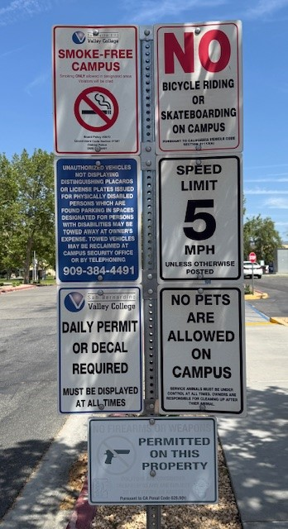
Current Campus Signage

Slide 5
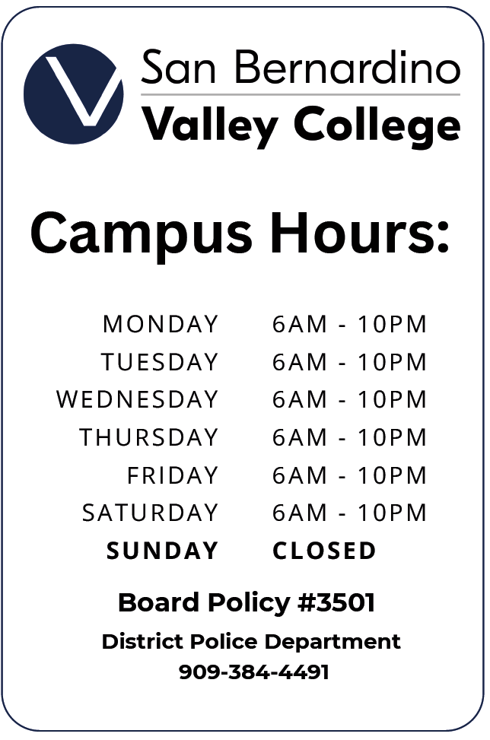
Proposed Signage

Slide 6
Campus Hours / Signage Timeline
AP 3501: Campus Security and Access goes to Board on May 8, 2025
If approved, signage language can be confirmed and created (May 2025)
Signage posted at entrances, College Information pages update with new information (June 2025)
New Hours in effect by July 1, 2025

Slide 7
Questions?
Blake Bonnet
Lieutenant/Acting Chief of Police
Bbonnet@sbccd.edu
909-387-1605

