Slide 1
Program Review
Academic Senate
September 16, 2026

Slide 2
Quick Overview
Where Program Review is.
Feedback on where it should go.

Slide 3
Program Review at SBVC: 2020-now
Prior to 2020
2020 – 22: Recognized need to update program review process, data collection, evaluating & discussing process changes
2022 – 23: SWOT Pilot Spring 2023
  New process adopted and named: All(?) Services & Programs Institutional Resources & Engagement (ASPIRE) process
2023 – 24: ASPIRE Year 1: Overview of Programs
2024 – 25: ASPIRE Year 2: DEIA
2024 – 25: ASPIRE Year 3: Demand & Currency/Recency
Now Entering: ASPIRE YEAR 4: Productivity & Growth

Slide 4
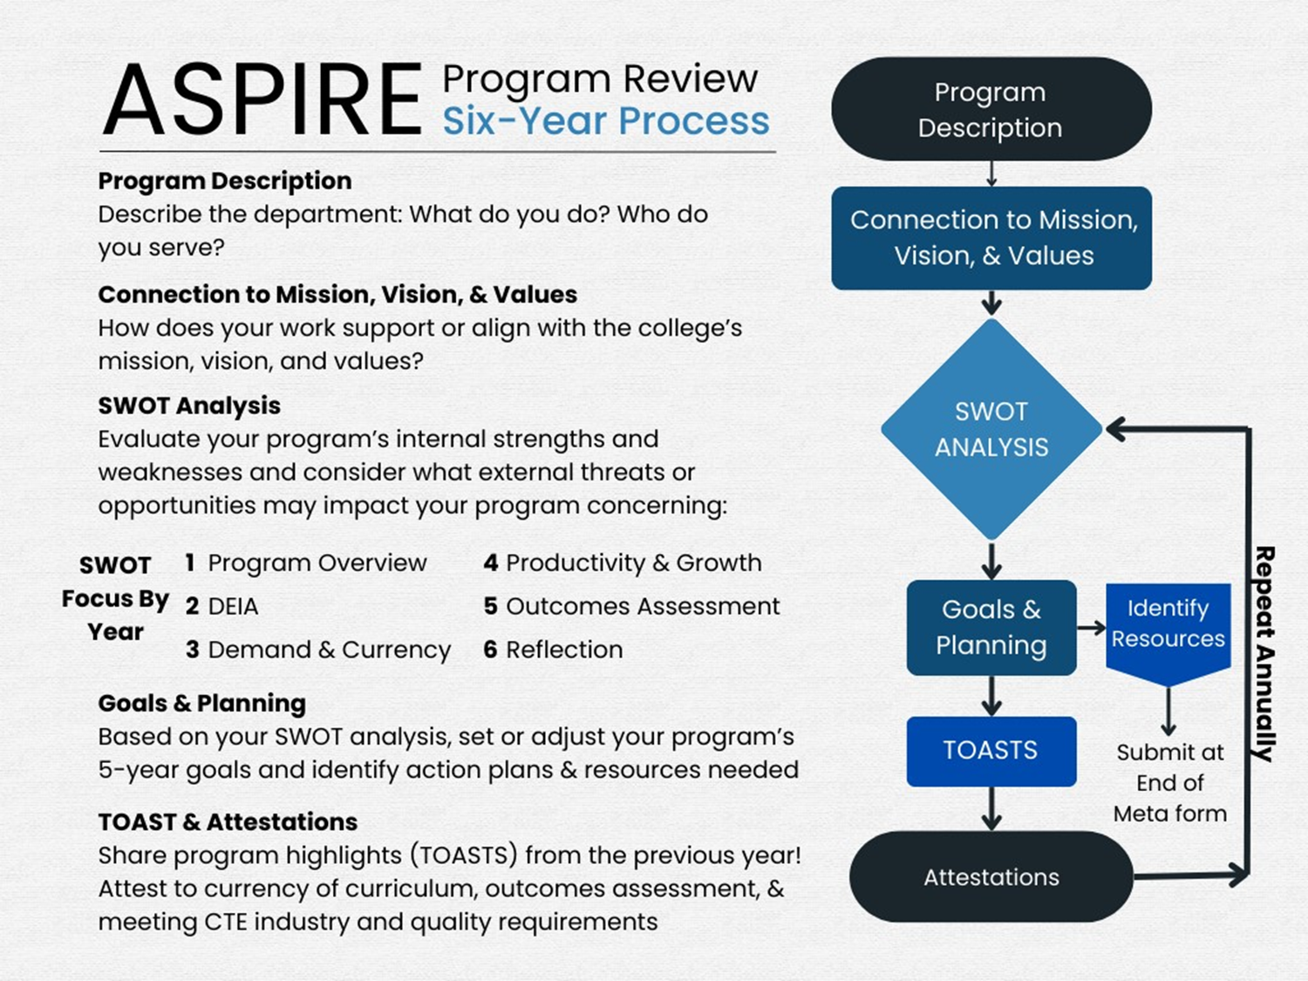

How is the ASPIRE process intendedto work?
?

Slide 5
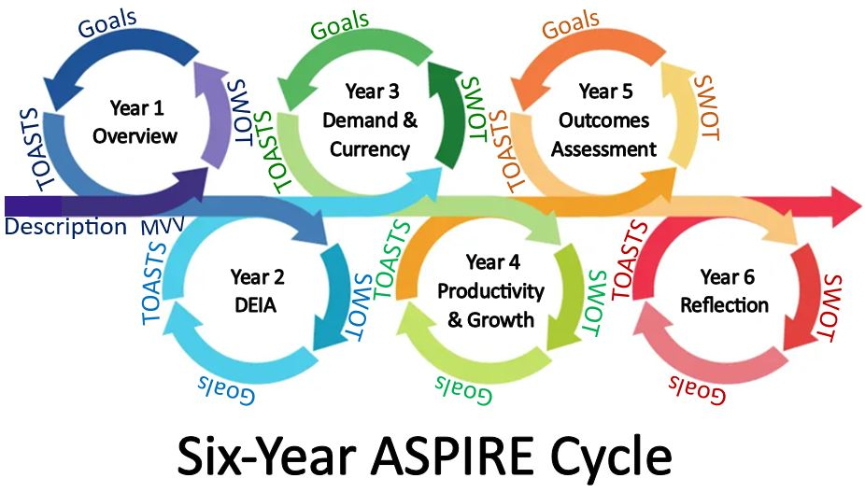

We are halfway through the full 6-year cycle

Slide 6
Challenges
What we hoped for vs. What ASPIRE has been
  Remember there are always outliers
  Depth of responses
  Annual reporting
  Use of CurrIQunet Meta
  Reliance on data

Slide 7
Priorities
What ASPIRE could be:
  Program evaluation
  Data-driven decision-making
  Opportunities to identify and talk about growth and program needs

Slide 8
Ask from senate
What direction can we provide the committee?
Questions:
  Continue ASPIRE as-is?
  What adjustments are needed?
  What do faculty need to feel supported and to honestly evaluate their programs?
This will be a continuing conversation...

