Slide 1
Student Equity Plan
Metrics, Strategies, and Action Items
2025-28

Slide 2





Student Equity & Achievement Metrics
Metric 1: Successful Enrollment
Metric 2: Transfer-Level Math and English Completion
Metric 3: Term-to-Term Persistence
Metric 4: Vision Goal Completion (Graduation)
Metric 5: Transfer to 4-Year University

Slide 3
Additional Data Pieces
In addition to the five SEA metrics, the Student Equity Plan requires colleges to examine:
Education Plans
Financial Aid*
Student Accessibility Services (SAS)
EOPS/CalWORKs
Foster Youth
Veterans Resource Center
Credit for Prior Learning (CPL)
Dual Enrollment*
Strong Workforce Program
*SBVC Priority

Slide 4
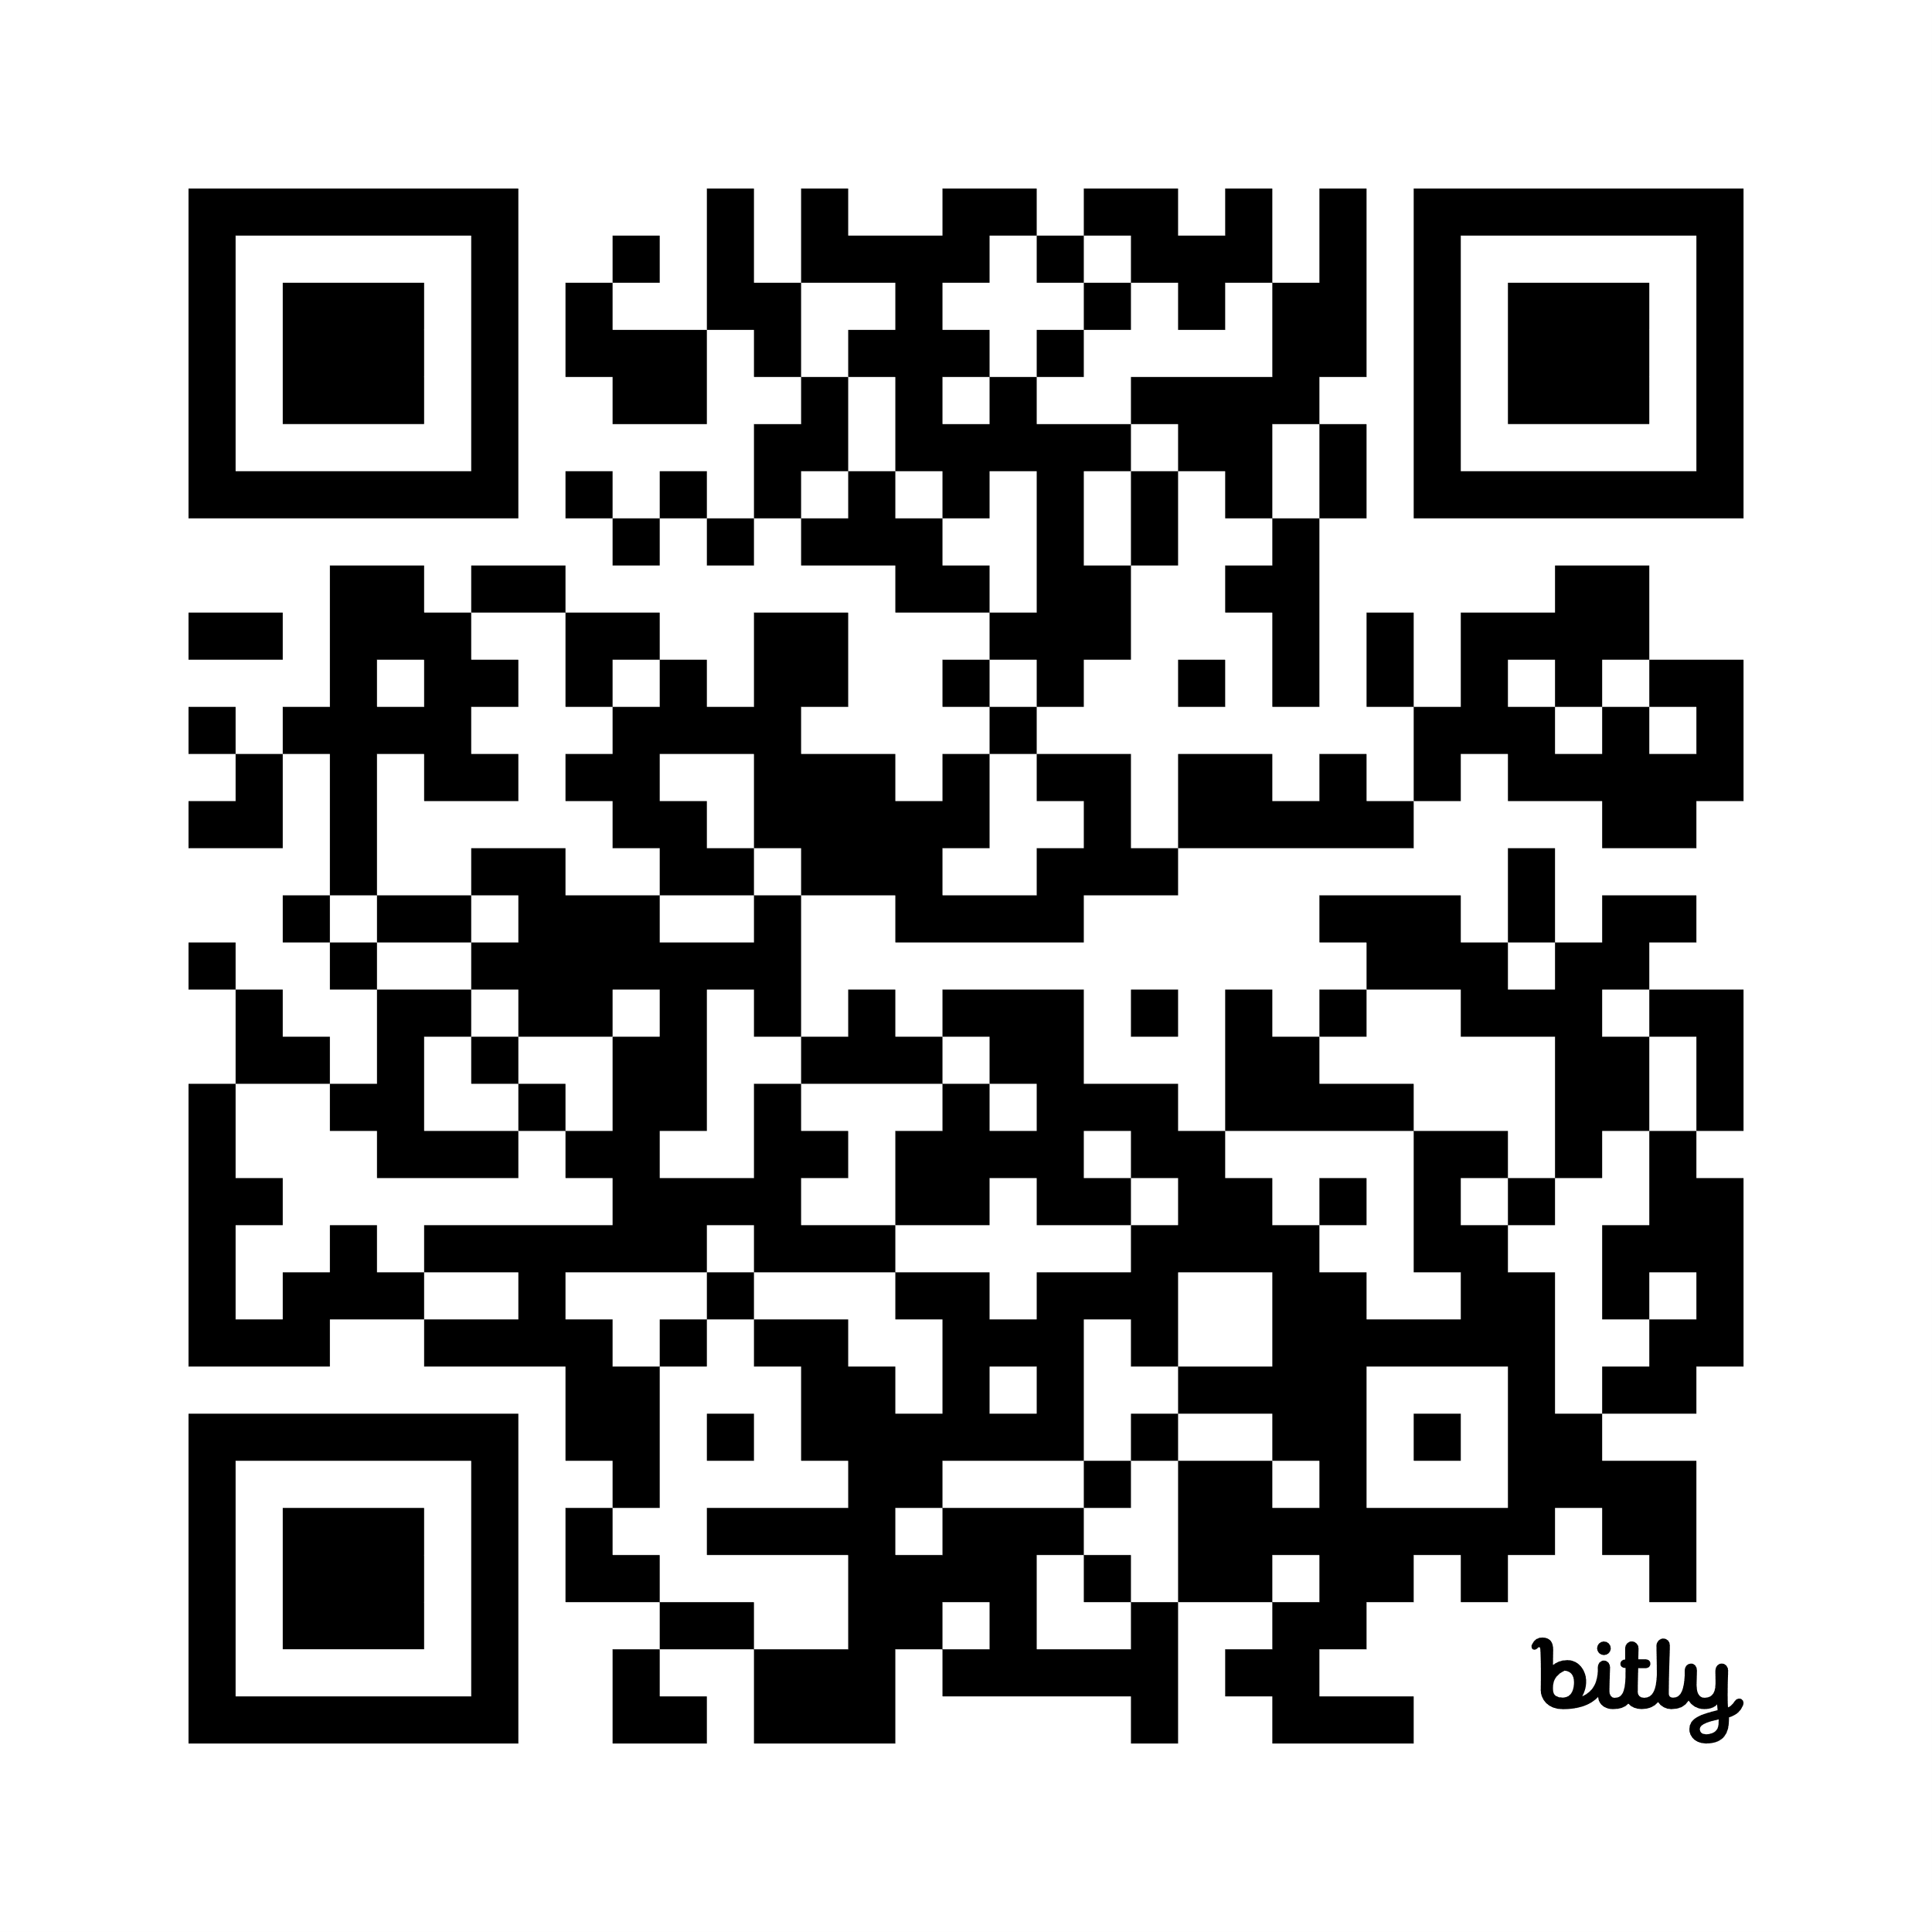
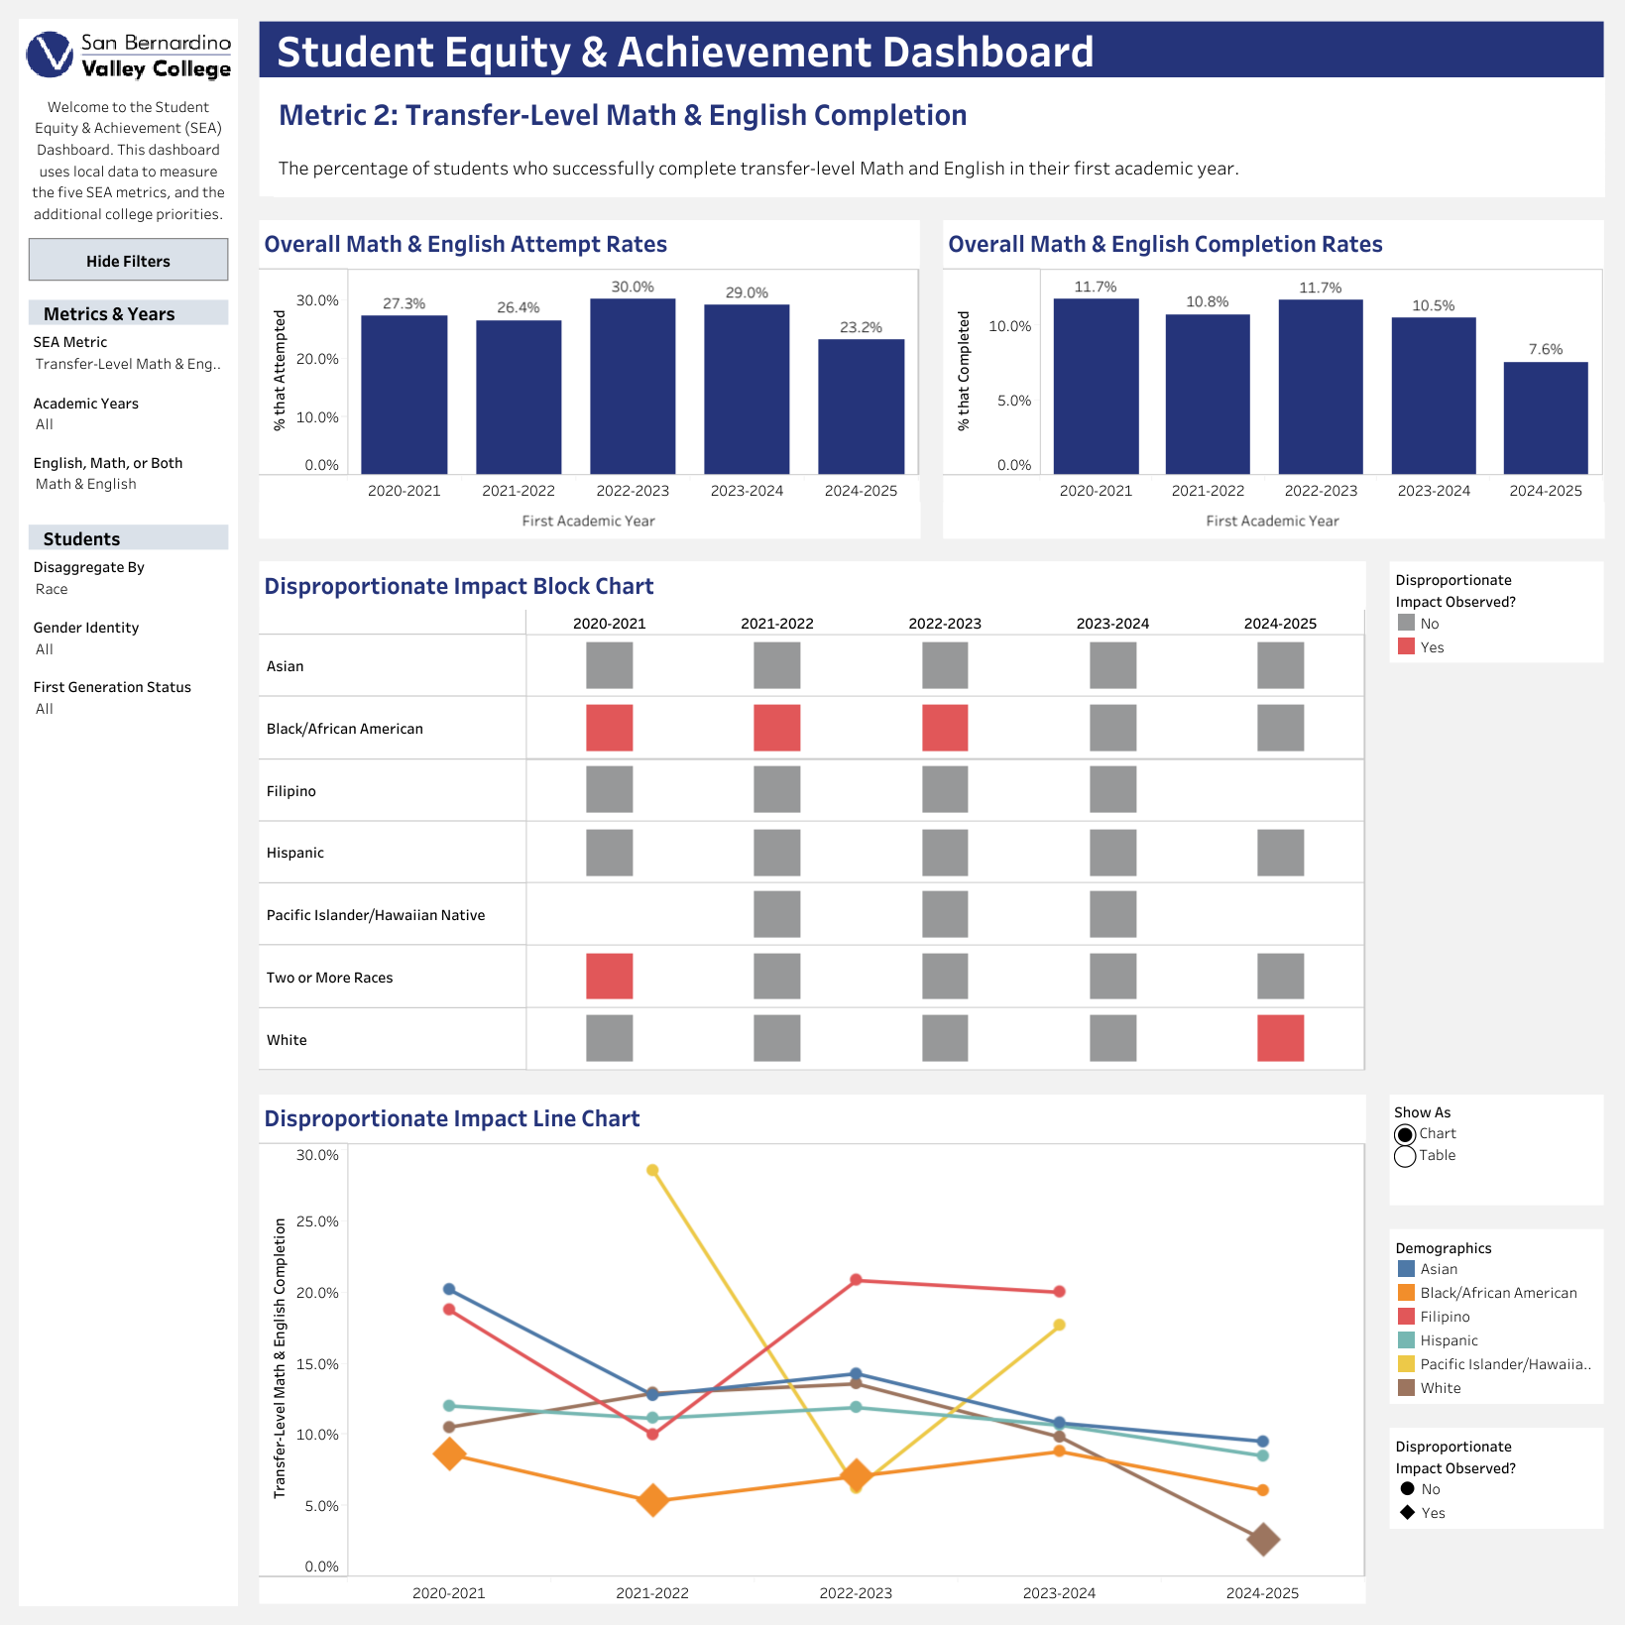
Student Equity & Achievement Dashboard
bit.ly/sbvcsea

Slide 5
Key Strategies
Access and Awareness
Equity-Minded Instruction
Create clear pathways and remove informational barriers so that prospective and current students understand their educational opportunities.
Embed equity into teaching practices, hiring, and curriculum development to ensure students experience inclusive and culturally responsive instruction.
Community Engagement
Student-Centered Support
Build strong, sustained partnerships with K-12 schools, universities, local organizations, and regional networks.
  Provide proactive, personalized support, especially during specific markers in students’ educational journeys.
Notes:
Many strategies and action items are listed for more than one metric.

Slide 6

Metric 1:
Successful Enrollment
Access and Awareness
  Research and Inquiry
  Diverse Course Offerings
  Marketing
  Textbooks and Course Materials
The percentage of first-time applicants who enroll by the end of that academic year (Summer to Spring).
Community Engagement
  High School and Regional Partnerships
  Informational Sessions
Disproportionately Impacted Students
Black/African American
Filipino
First-Generation White
35-49 years old
Student-Centered Onboarding
  Application and Enrollment Workshops
  Orientations and Onboarding Events

Slide 7
Metric 2:
Transfer-Level Math & English
Access and Awareness
  Research and Inquiry
  Marketing
  Textbooks and Course Materials
Equity-Minded Instruction
  Corequisite Review
  Communities of Practice
  Curriculum/SLO Review
  Hiring Procedure Review
The percentage of students who successfully complete transfer-level Math and English in their first academic year.
Disproportionately Impacted Students
Black/African American
Students w/ Disabilities
20-24 years old
40-49 years old
Student-Centered Support
  Counselor Liaisons & Faculty Communication
  Learning Communities
  Education Plans
  Mentorship Models

Slide 8
Metric 3:
Term-to-Term Persistence
Access and Awareness
  Research and Inquiry
  Marketing
  Textbooks and Course Materials
Equity-Minded Instruction
  Corequisite Review
  Communities of Practice
  Curriculum/SLO Review
  Hiring Procedure Review
The percentage of students who persist from their first primary term (Fall or Spring) to their second primary term.
Student-Centered Support
  Counselor Liaisons & Faculty Communication
  Learning Communities
  Education Plans
  Mentorship Models
  Student Center
  Intentional and Targeted Messaging
Disproportionately Impacted Students
Black/African American
White
20 years old or older
First-Generation Male

Slide 9
Metric 4:
Vision Goal Completion (Graduation)
Access and Awareness
  Research and Inquiry
  Career and Academic Pathway (CAP) Review
  Marketing
The percentage of students who graduate within three academic years of starting at SBVC.
Student-Centered Support
  Education Plans
  Intentional and Targeted Messaging
  Counselor Liaisons & Faculty Communication
  Learning Communities
  Mentorship Models
Disproportionately Impacted Students
19 years or younger
Female
Black/African American
First-Generation LGBTQ+

Slide 10
Metric 5:
Transfer to a
4-Year University
Access and Awareness
  Research and Inquiry
  Career and Academic Pathway (CAP) Review
Equity-Minded Instruction
  Corequisite Review
  Communities of Practice
  Curriculum/SLO Review
  Hiring Procedure Review
The percentage of students who transfer to a 4-year university within four academic years of starting at SBVC.
Disproportionately Impacted Students
Male
Hispanic
Students w/ Disabilities
First-Generation
LGBTQ+
Student-Centered Support
  Counselor Liaisons & Faculty Communication
  Learning Communities
  Education Plans
  Mentorship Models
  Student Center
  Intentional and Targeted Messaging

Slide 11
What can the Student Equity Planning Committee do to support you?

Slide 12
Thank you!

