Slide 1
Institute of Media Arts
A Project of the Film, TV, Media Department at San Bernardino Valley College

Slide 2
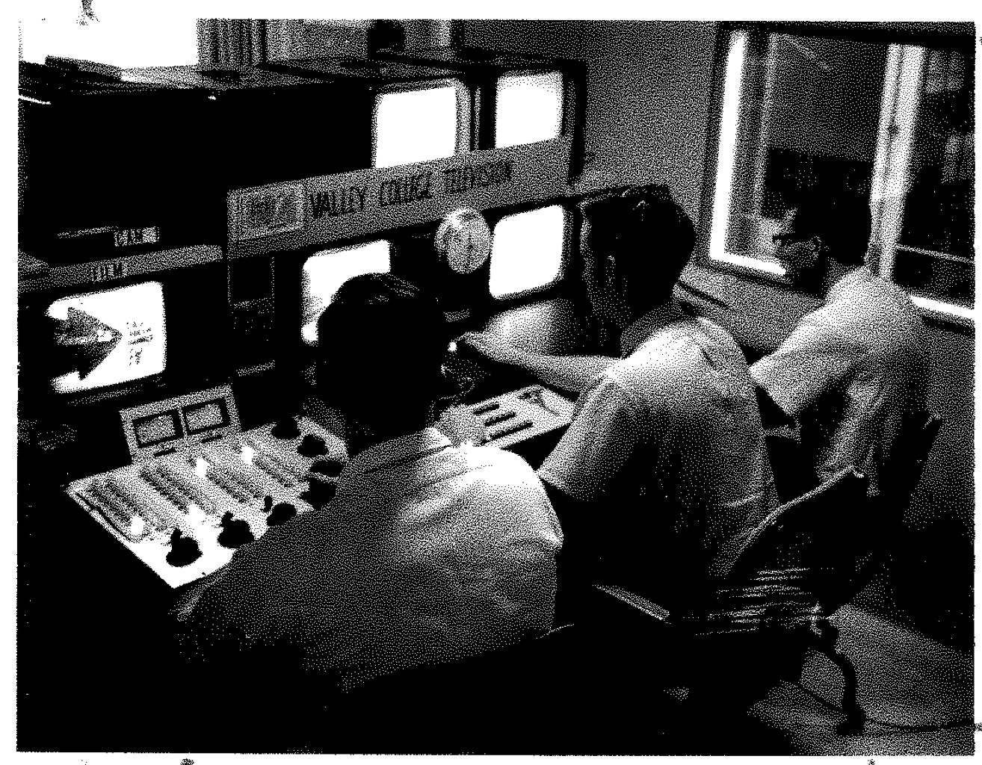
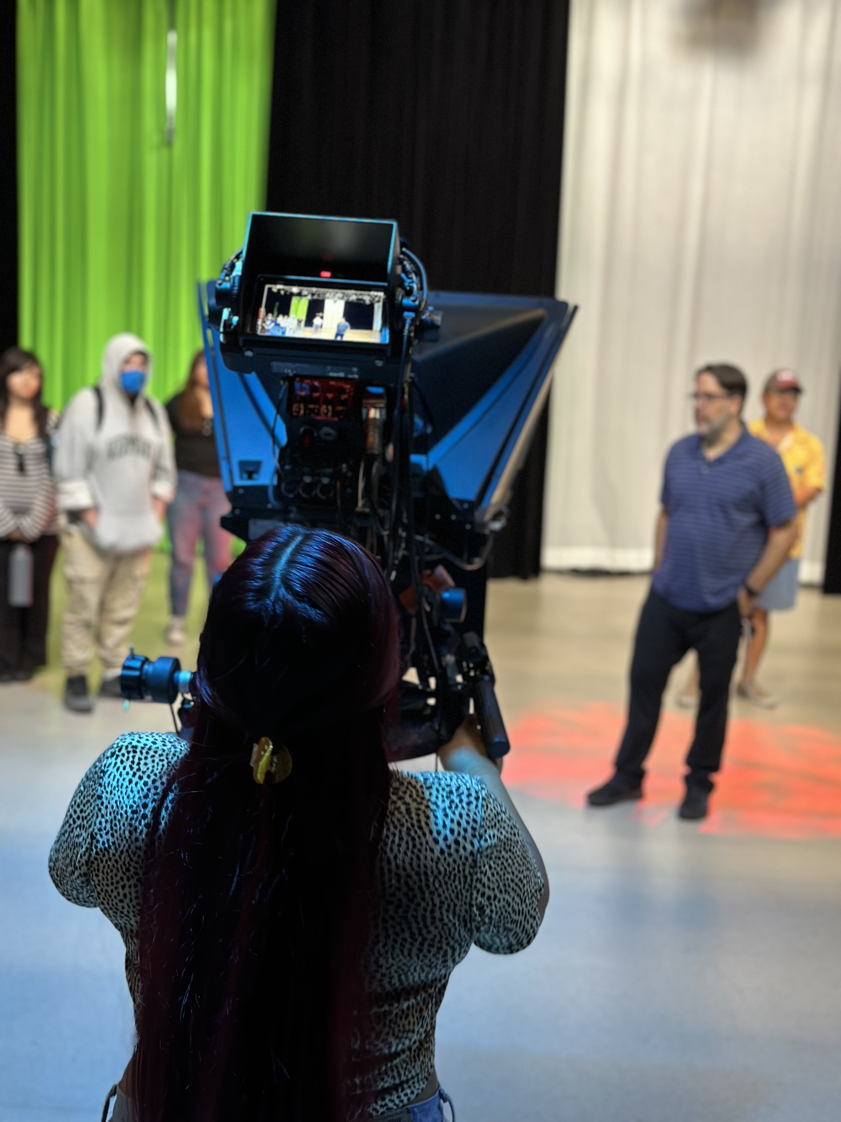
Background
SBVC Began Teaching Telecommunications in 1962
  KVCR Radio Began in 1953
  KVCR TV began in 1962
Bandwidth Auction set up current budget allotment 2018-2019
Modernization of facilities and instructional technology
Updating of curriculum to meet current Film, Television and Media Trends

Slide 3

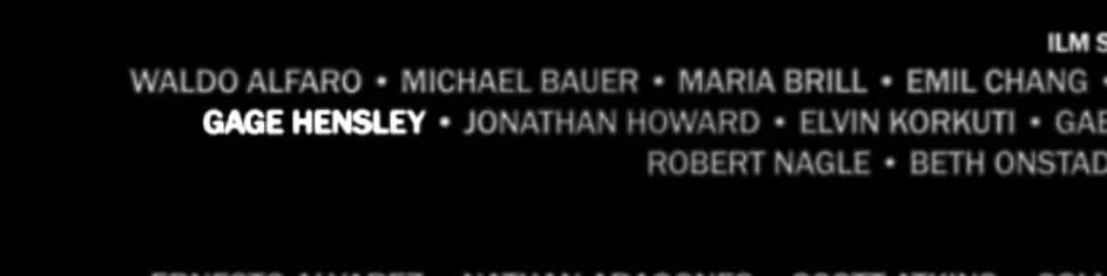
Models
STEM MESA for Media Students
Center for Media and Design Santa Monica Community College
Institute of Media Arts at San Bernardino Valley College
Media as an economic sector ranks 2nd in the state source California.com
  Media is
    FTVM
    Art
    Theatre
    Music
    Modern Languages
    English
    Communications Studies
    Basically, the Humanities

Slide 4
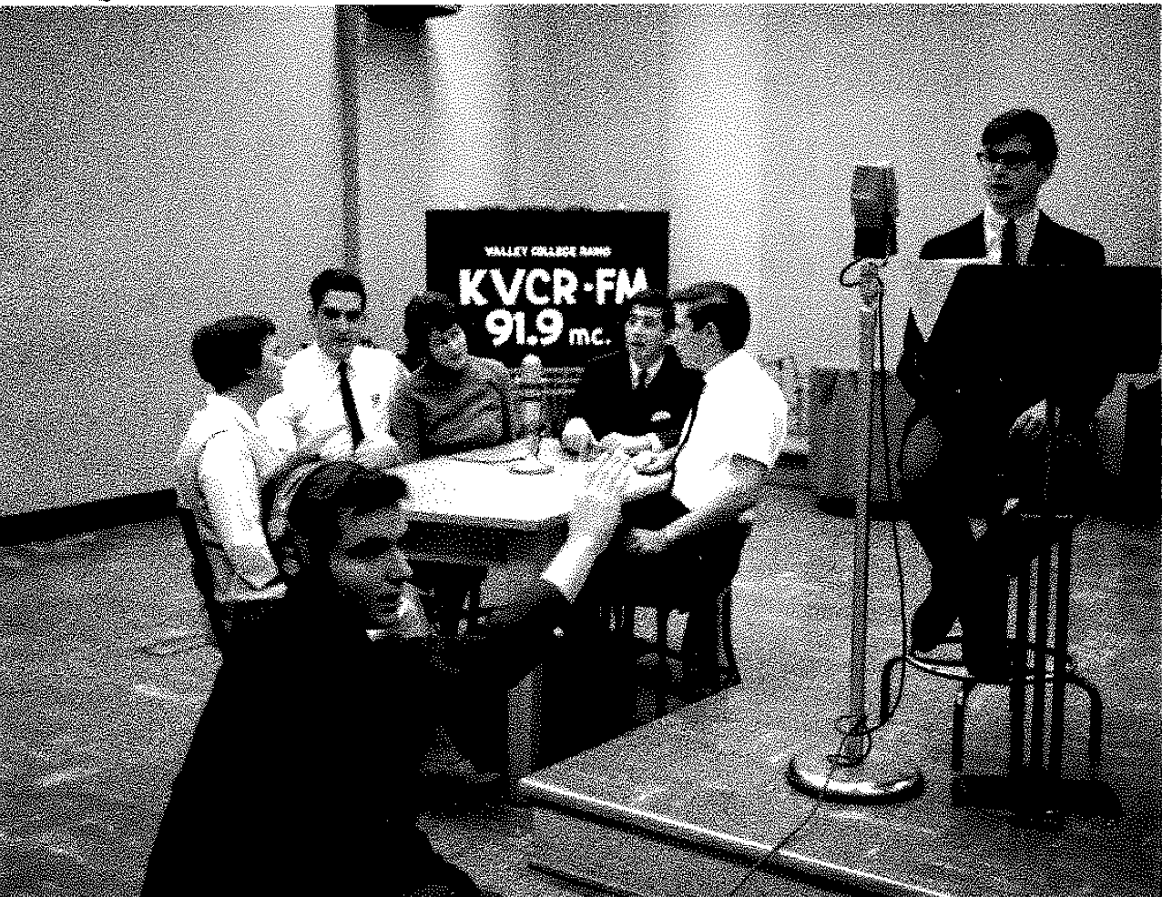
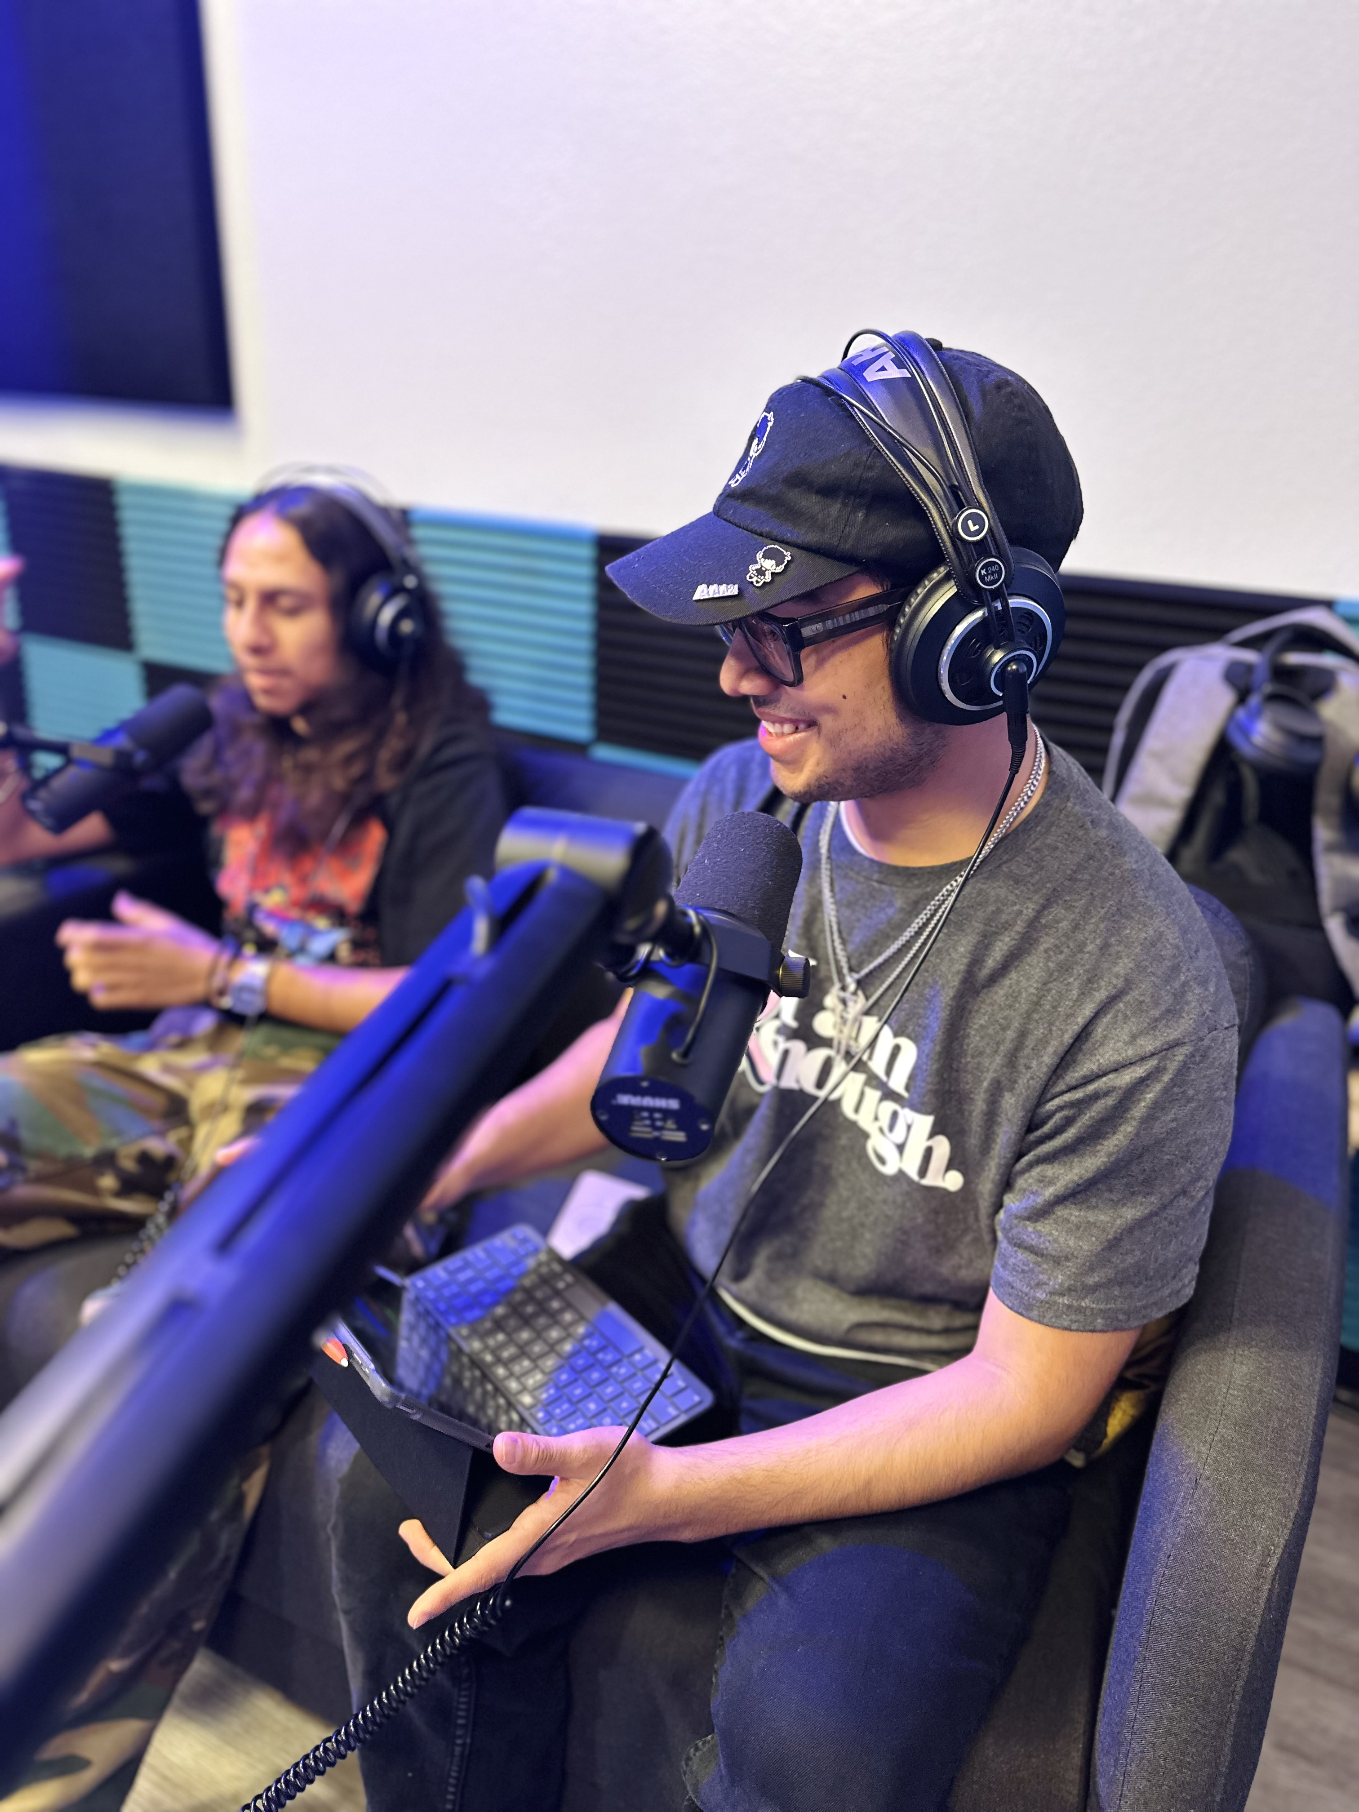
Items of Note
Updated Curriculum
Updates to both studio and classroom spaces
Release time for Full-time faculty
  Outreach
  Festivals
  Fellowship Program –
  Guided Pathways Model
    Create a path – Department Maps
    Choose a path
    Stay on the path
    Intentional Outcomes
Notes:
From radio to podcast

Slide 5
Curriculum Changes since 2018
New Department Name
  Film Television Media
Updated all classes to incorporate new tech
Added Courses:
  Broadcast News
  Sports Broadcasting
  Media Practicum (Transferable) – Internship or Non-Scripted Project Based course
  More GE Courses – Ethnicity and Identity in Media and Women in Cinema coming Fall 2026
  Several Non-credit: Steadicam, Producing 101, Film Cinematography, and Grip and Electric
  Film Photography coming Fall 2026. Cross listed with Art
Notes:
It’s not pretending

Slide 6

Interdisciplinary
Curriculum
Degrees
  Film Associates
    Arts – Post Production and Camera Path
    Music – Post Production Path
    Theatre – Directing Path
  Audio Associates
    Music
    Theater
  Journalism AS-T
    English
    Communications Studies
    Art
Certificates
  Art – Digital Marketing coming fall 2025
  History – Historical Documentary
  English – Journalism Certificate
  Communications Studies – Journalism and Digital Marketing Fall 2025
Notes:
It’s not pretending

Slide 7
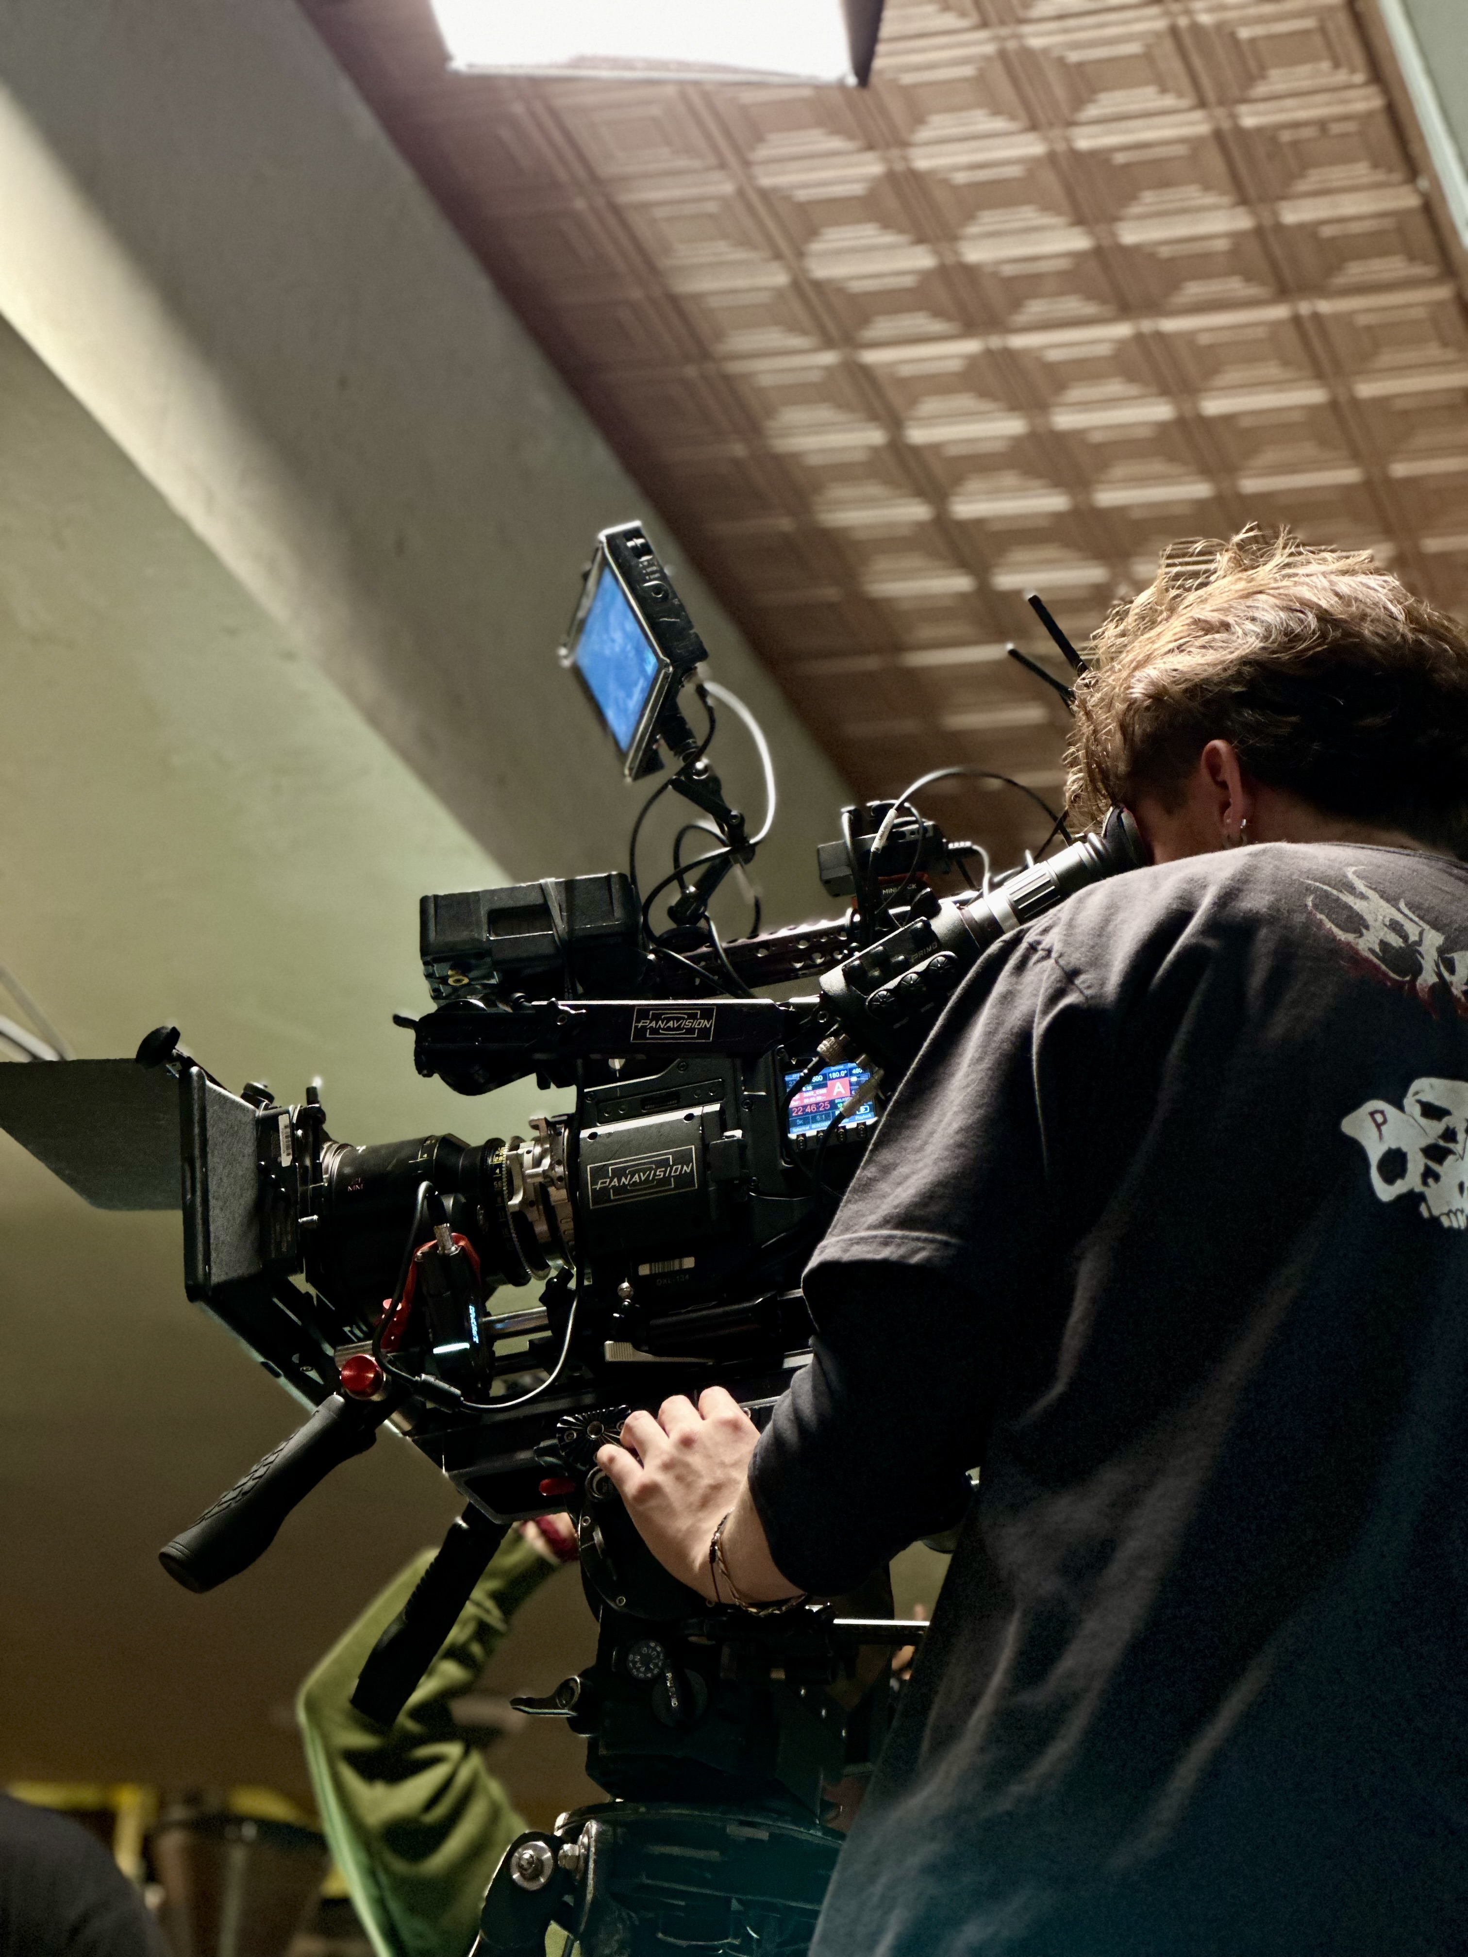
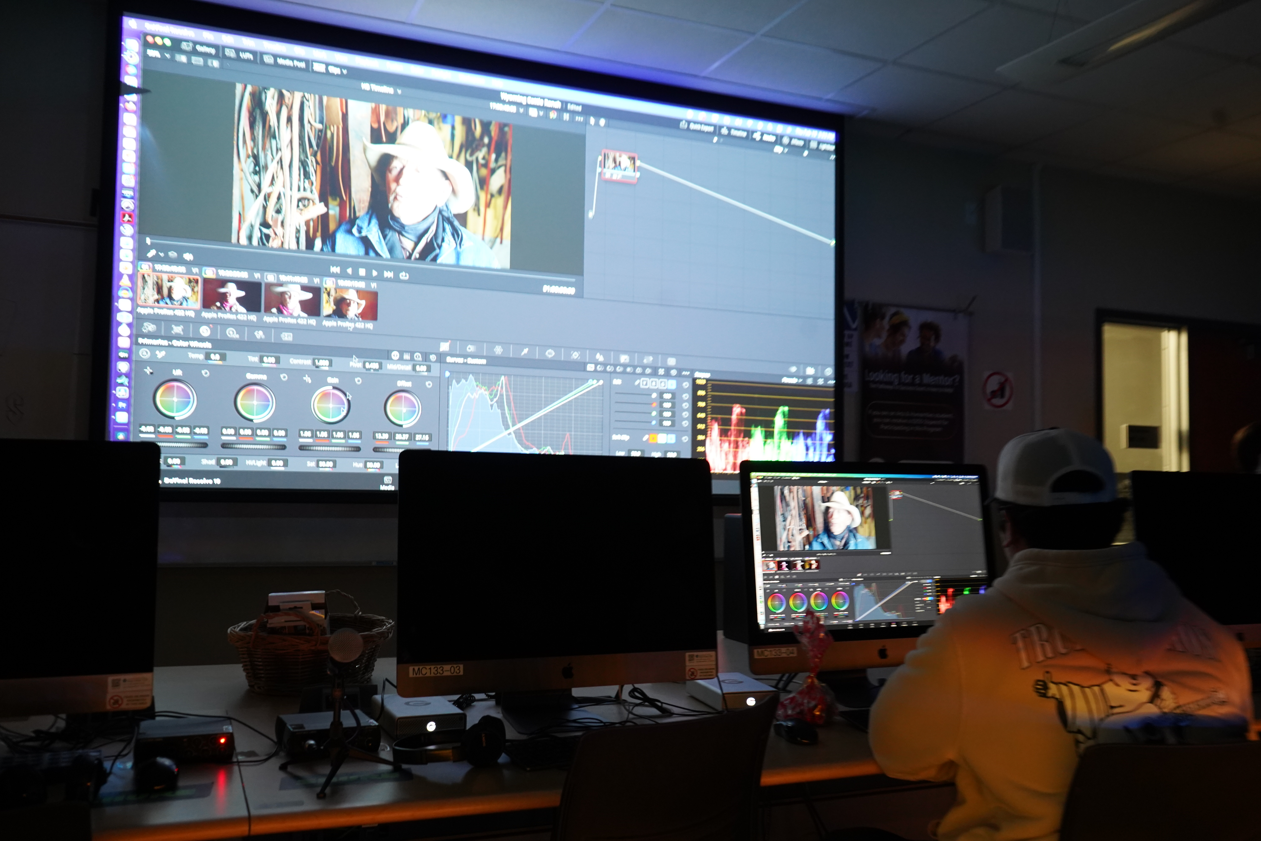
Investment
TV Studio - Auction
Podcast Room - Auction
Grip Truck – Strong Workforce
Steadicam – Perkins
Motion Capture – Perkins
Production Insurance
Cinema grade cameras – Auction and Strong Workforce
Notes:
Leveling up our students.

Slide 8
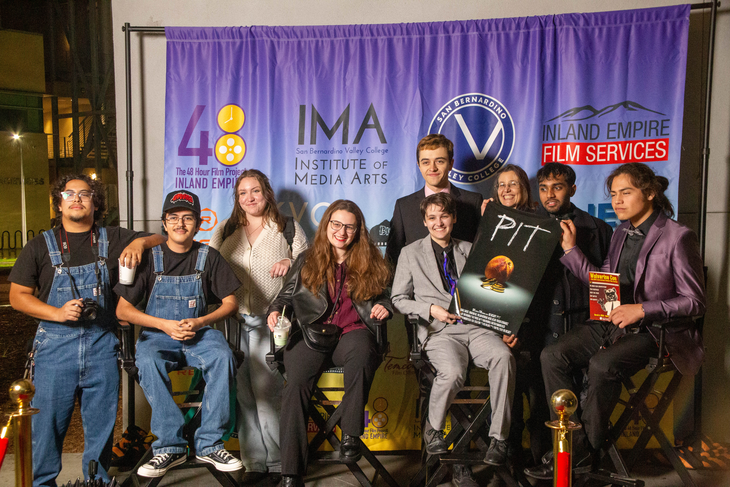
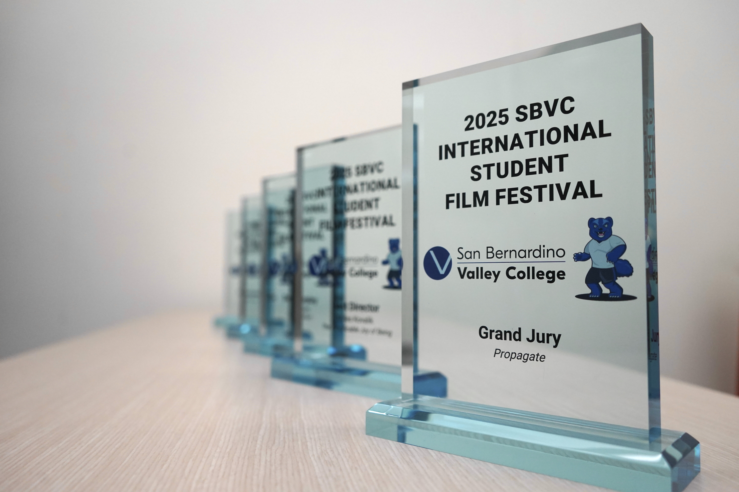
Outreach
High School Visits
  Fall of each academic year
  Then some in the spring
Festivals
  48 Hour Film Festival – International Open to all
  Wolverine Con - International for Students only
    Over 150 High School Students attended this year
    Career Development Events – Meet the Pros Mixer
Tours
Orientations
  Spring
  Early Fall
Community Partnerships
  Redlands Bike Classic
  Inland Empire Film Commission
  Orange Show Speedway
  Local Businesses
Notes:
It’s not pretending

Slide 9
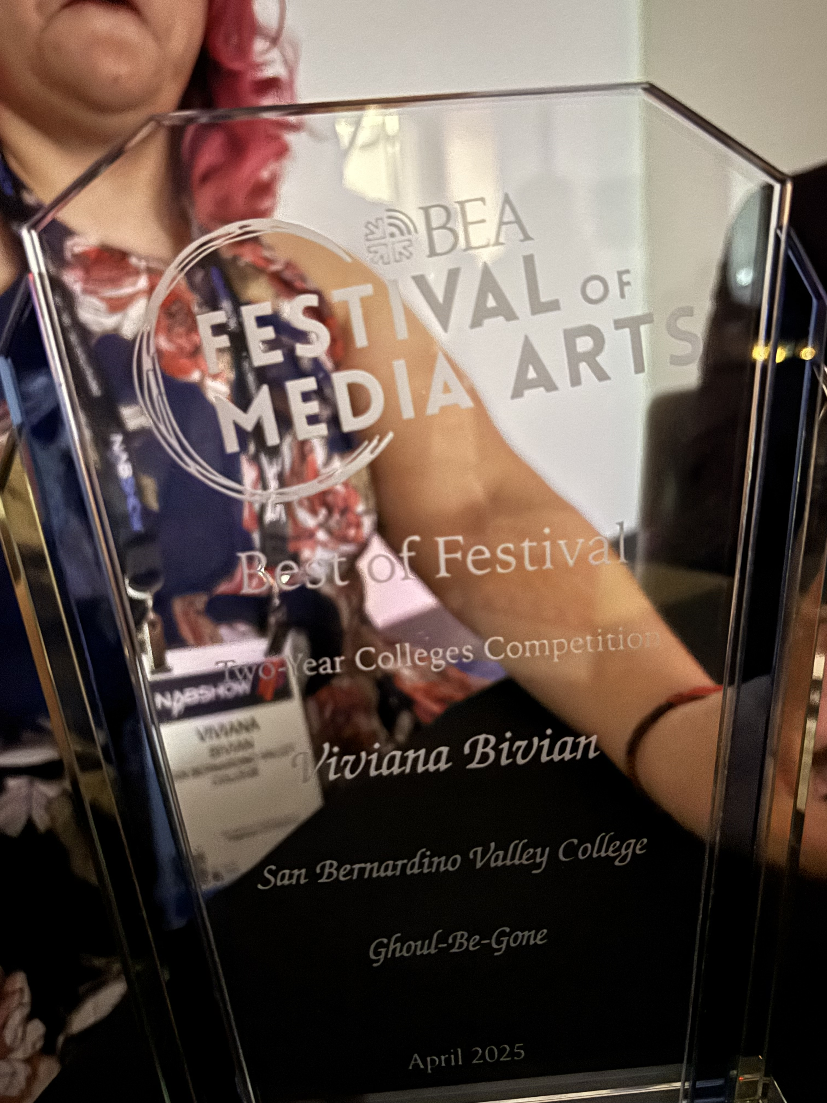
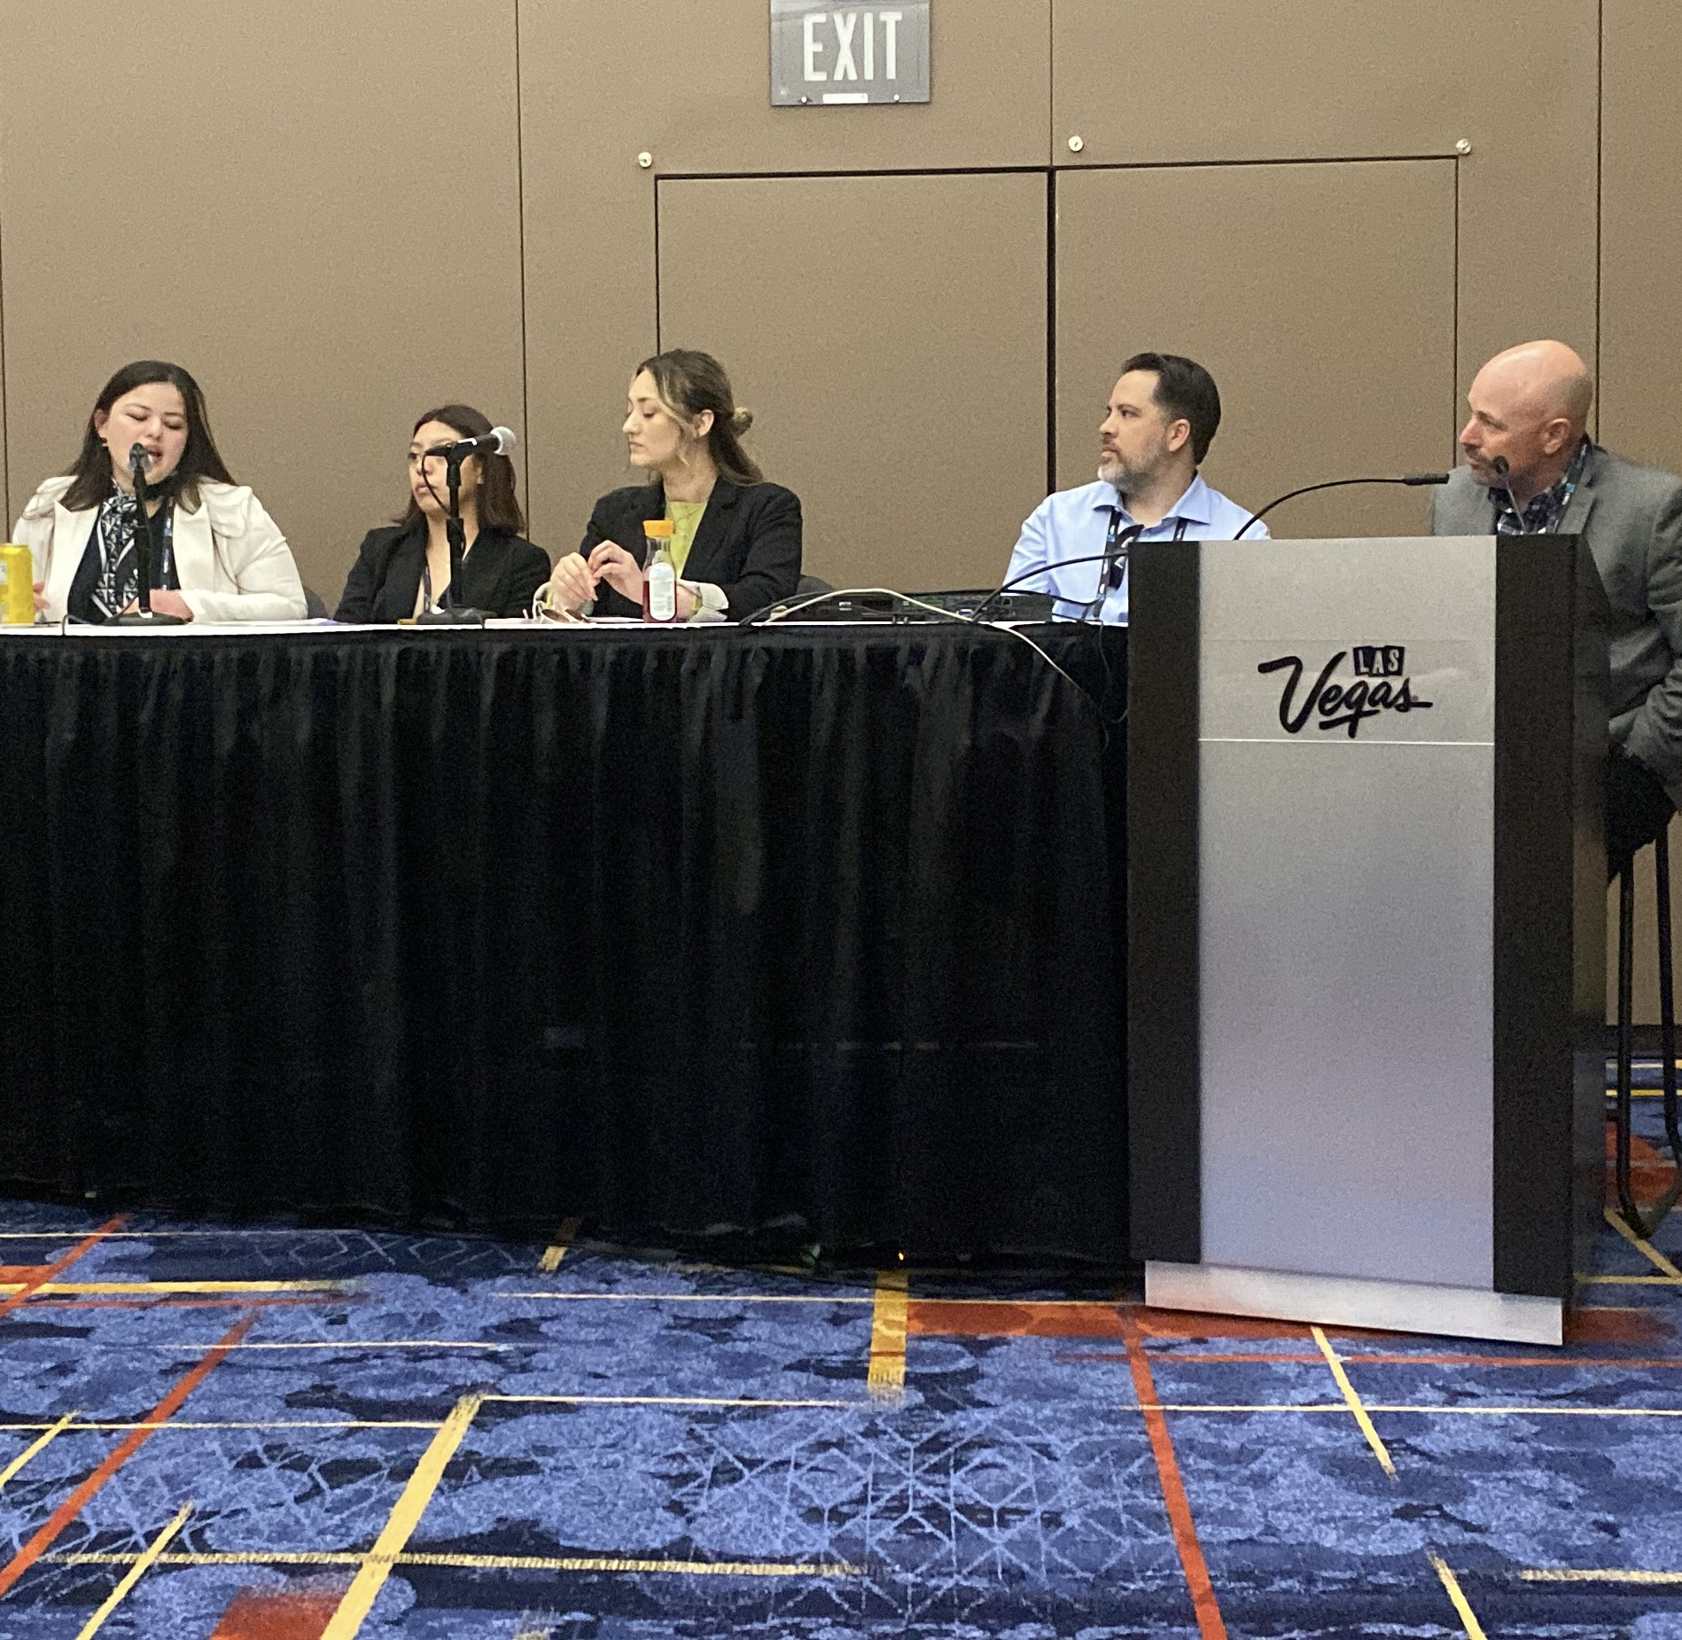
Outreach
Broadcast Educators Association
Annual Conference
  Presented a panel in 2024
  Chair the 2-Year category for Festival of Media Arts
University Connections
  CSUSB
  Cal State LA
  UCR
  LaVerne
  UNLV
Notes:
Last year we present ed at BEA this year a student won for best 2-year

Slide 10
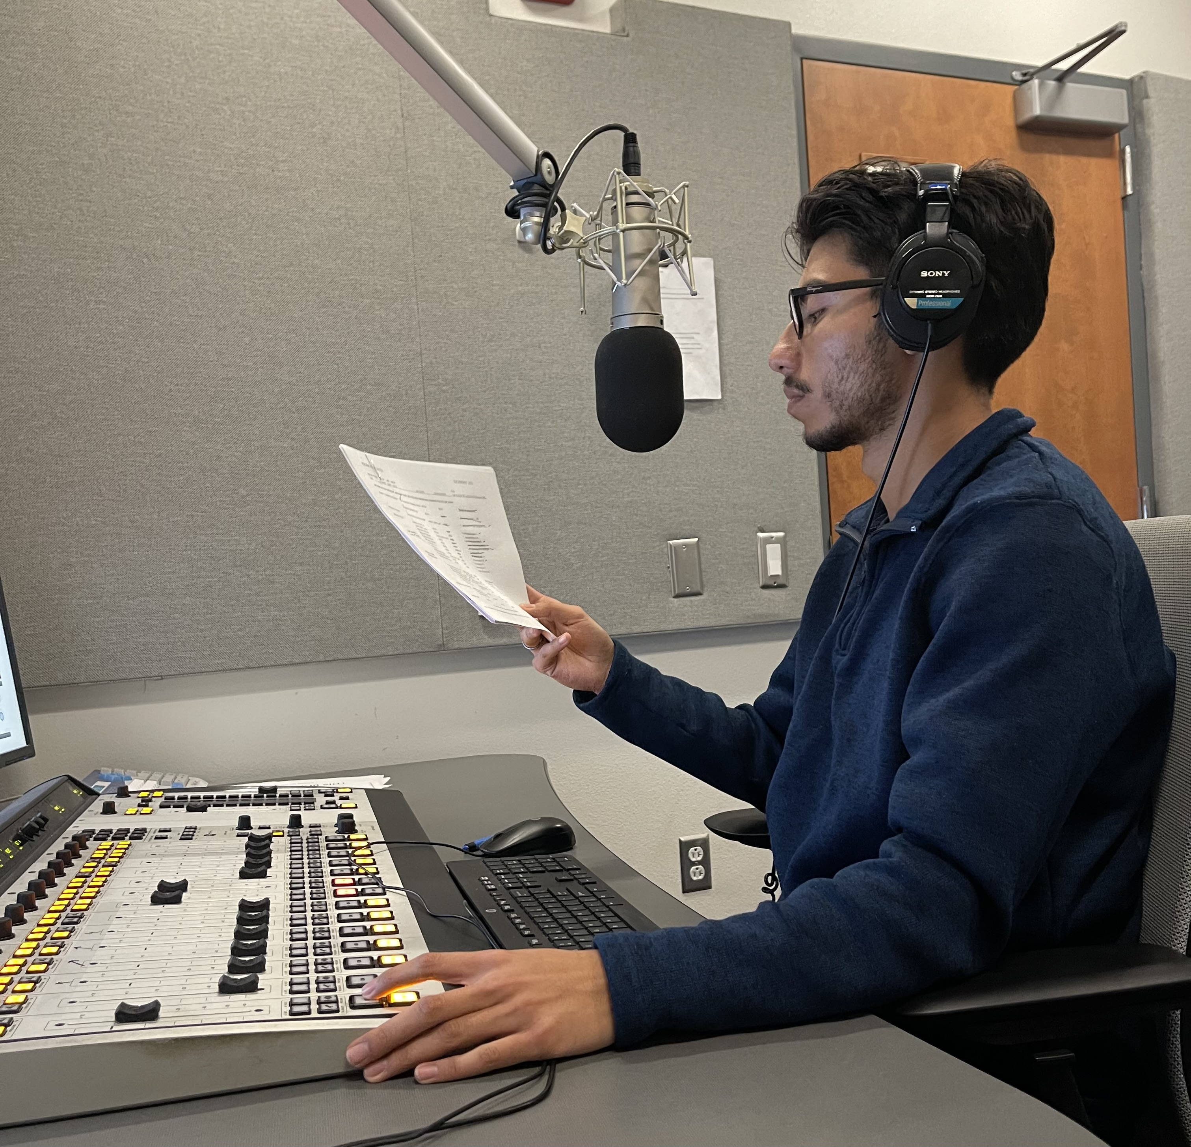
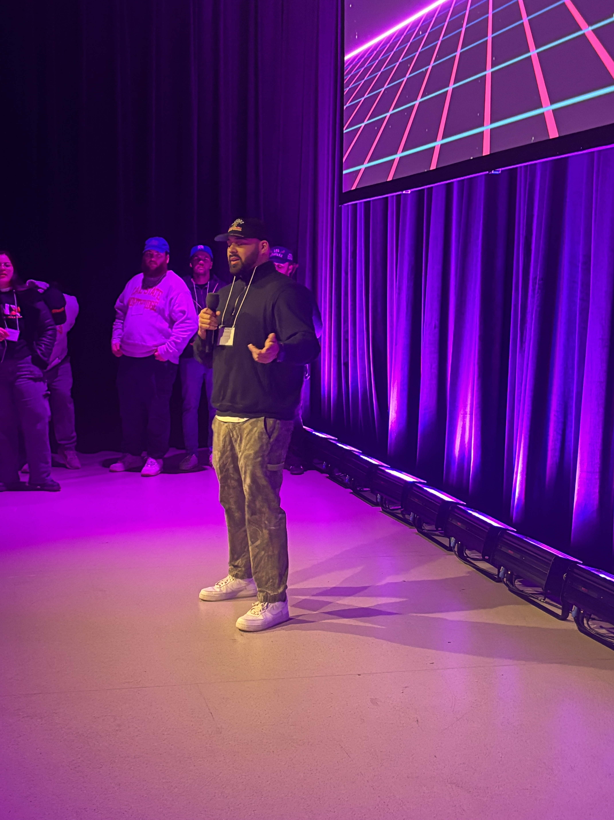

Fellowship Program
Keeps students on path
  Collaboration with CTE Counselor
    Annual Check in on Ed Plan
    Open lines of referral
  Peer Mentor
    Workshops on all things FTVM
    Career Workshops
  Department Interns
  Expanded Lab and studio hours
    Two full-time lab techs
    Temporary Full-time faculty
Intentional Outcomes
  Distribution of student projects
    KVCR and Festivals
  Internship Placement
    KVCR
    Local Businesses
    Other production companies
  Transfer Degree increase
Notes:
Anuar is a current paid intern at KVCR, and will be transferring to CSUN in the fall.
From our meet the pros mixer; this is Juan Ortiz, class of ‘21 and graduate of CSUDH and now a production coordinator talking to our students and local high school students about our program and career paths.

Slide 11
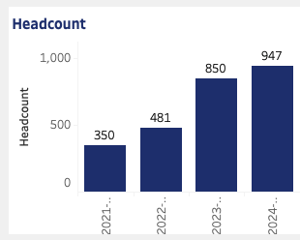
The Numbers
Overall Headcount

Slide 12
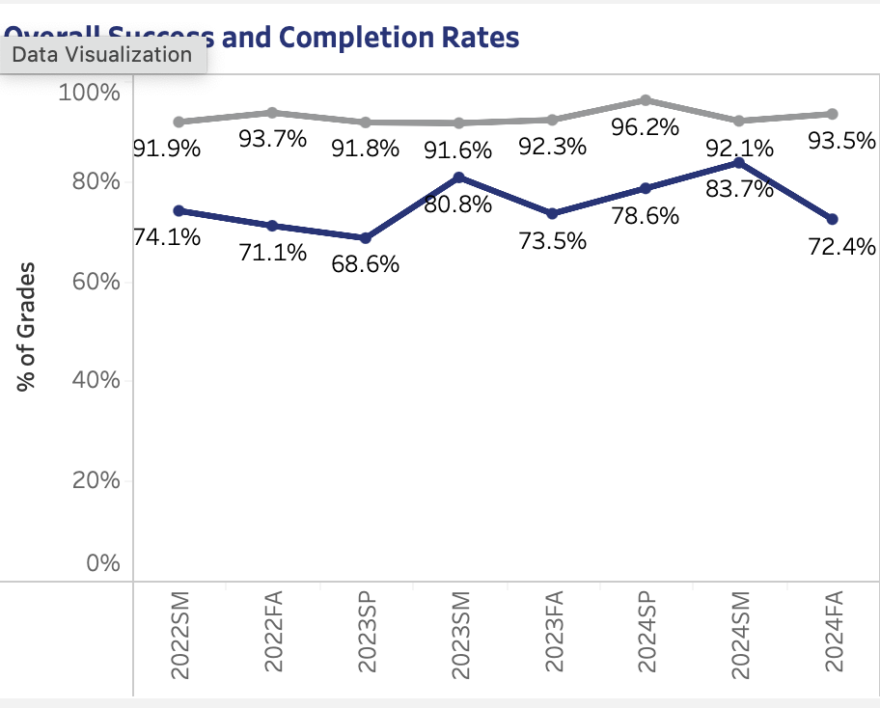
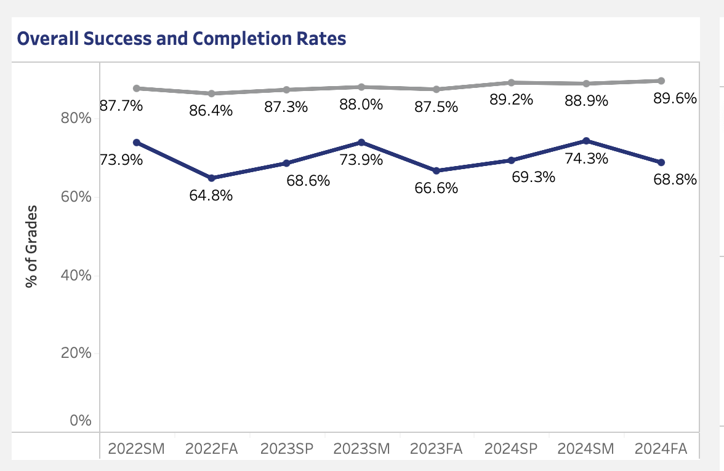
Success and Completion
FTVM Department
SBVC at Large
Notes:
Compare this to campus

Slide 13
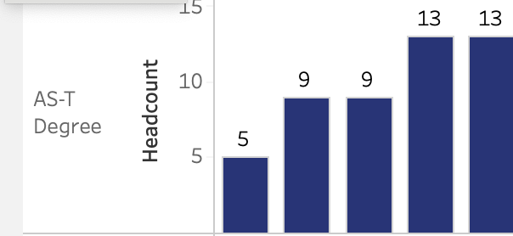
Transfer Degrees
19-20
23-24
Notes:
On average we total about 25 graduates a year, which includes certificates and our other degrees. Remember as CTE some of our graduates go right to industry

Slide 14
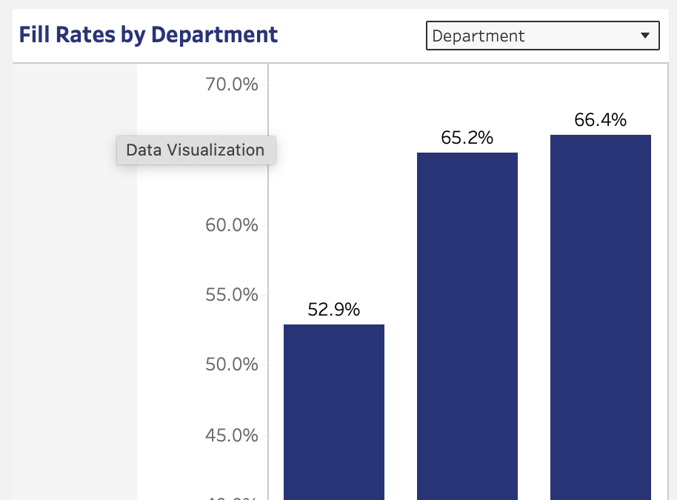
Fill Rate
23-24
Notes:
The fill rate has increased since that addition of the temporary full-time faculty.

Slide 15
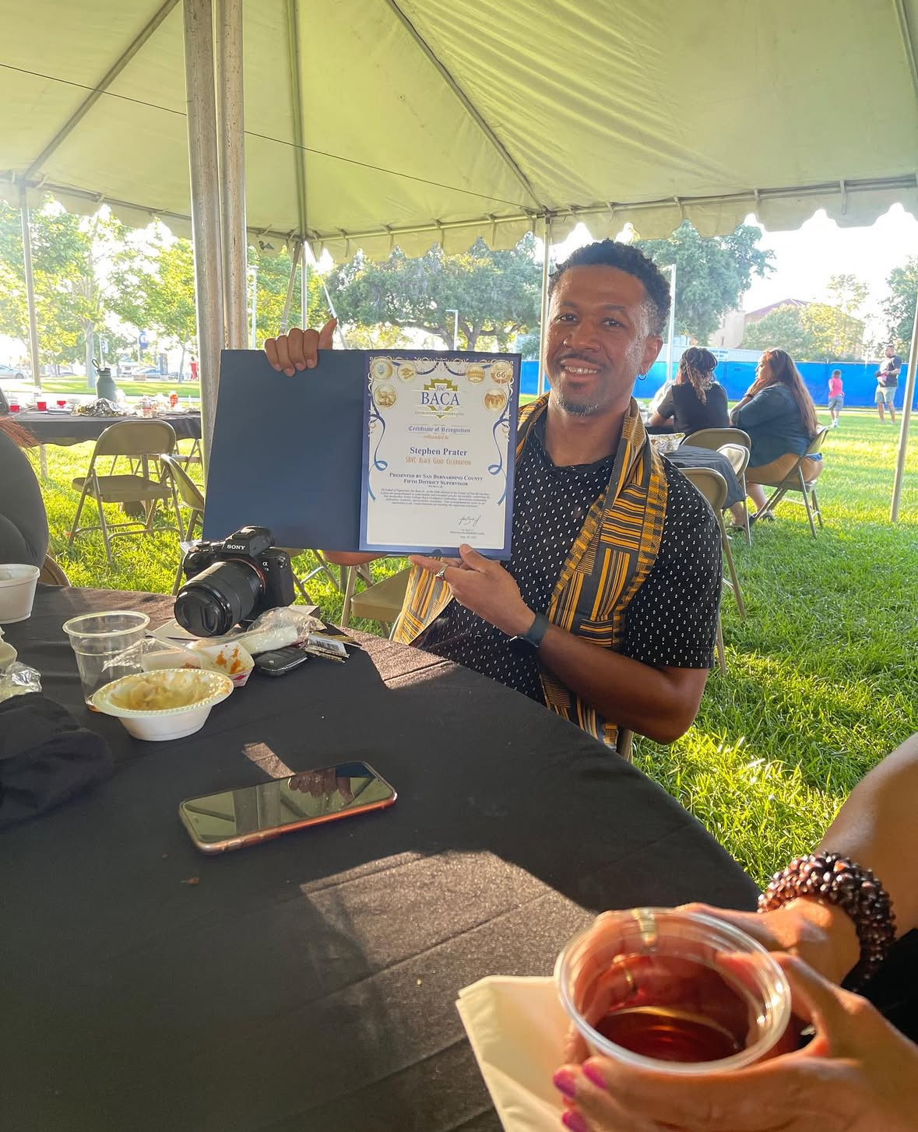
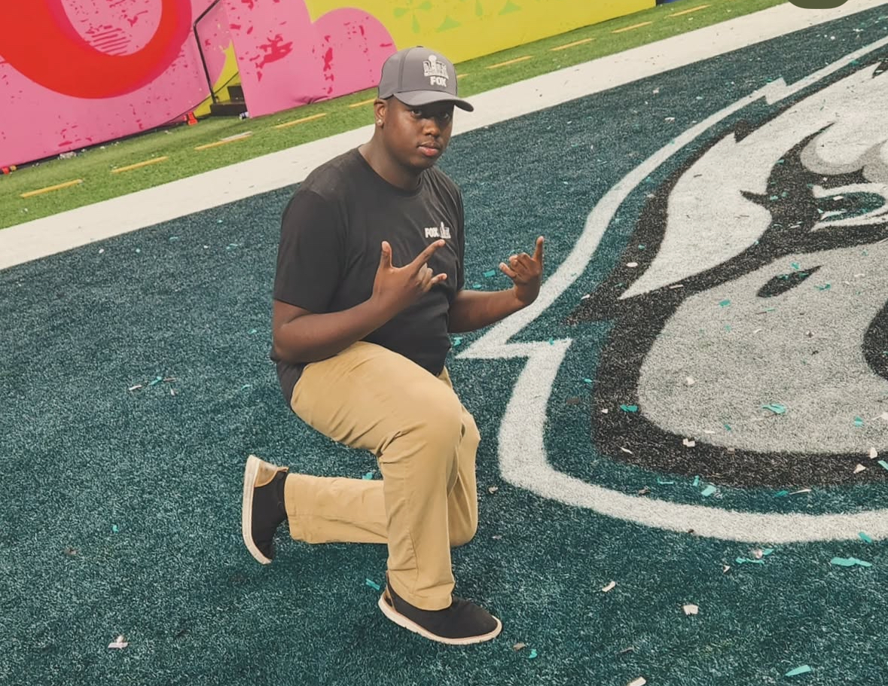
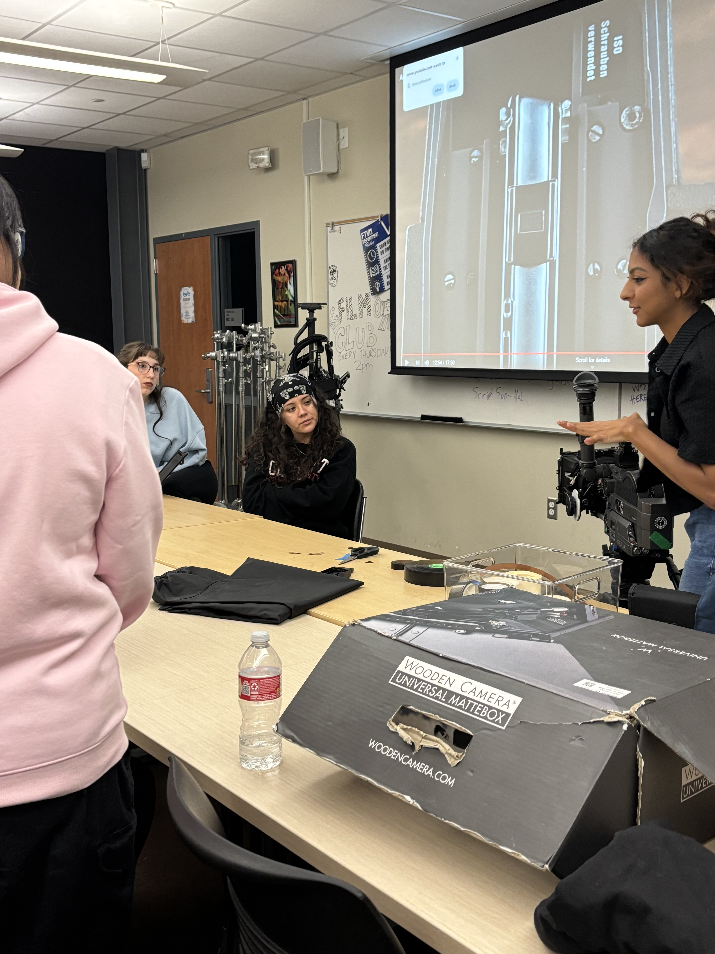
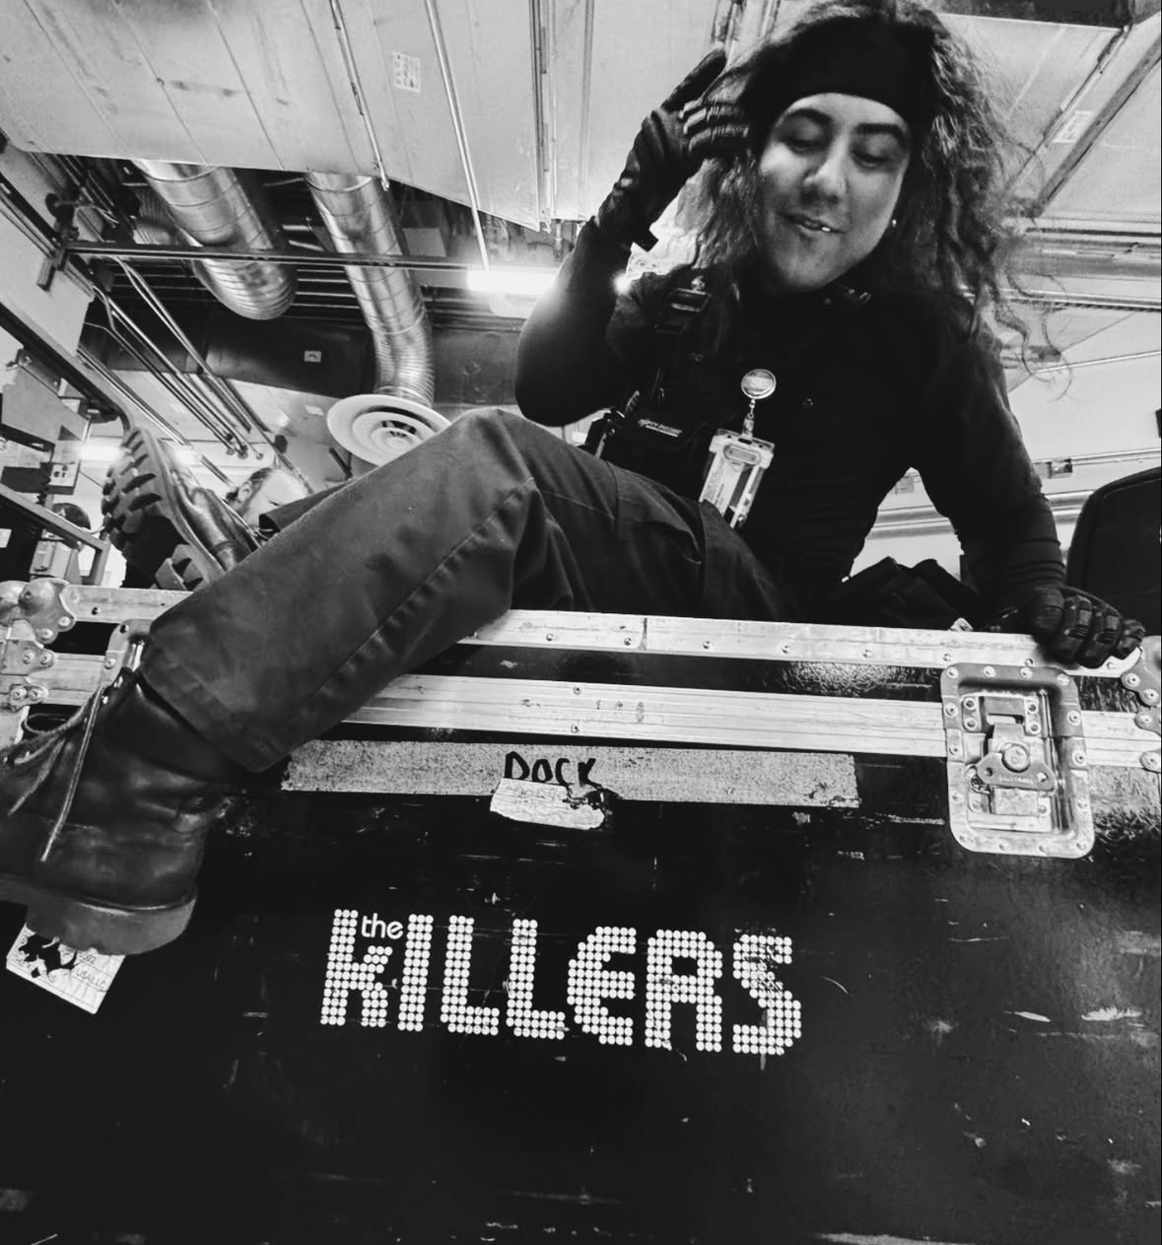
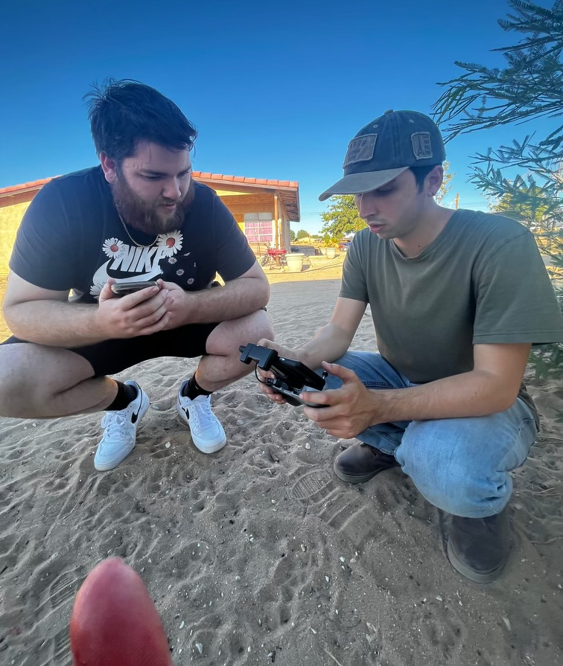
Lasting Outcomes
Imari ‘22– Fox Sports
Segment Producer
Stephan ‘23– KVCR/ESPN
CSUN – Doc Track
Briana – KVCR Producer
Mariana – FNX Producer
Mars
Isaac ‘22 – Yaamava'
Stagecraft and Video
Nic ‘21– SBVC/Ent. 19
FTVM Lab Tech./Producer

Slide 16
Q and A
Questions, comments, quips, quarries, or quotes

