Slide 1


Integrated ERP Project Update April 16, 2025

Slide 2
Agenda
Integrated ERP Project Overview
Current Challenges and Need for Integration
Key Benefits and Expected Outcomes
Stakeholder Engagement
Implementation Plan and Timeline
Questions

Slide 3
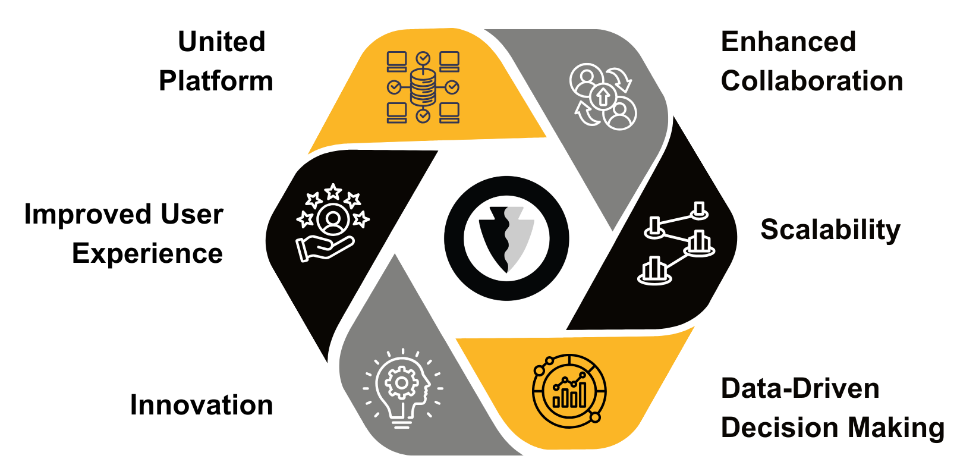
I. Integrated ERP Project Overview
Notes:
Unified Platform: The integrated ERP and Student Information System will provide a single, cohesive platform for managing all administrative processes, reducing complexity and improving efficiency.
Improved User Experience: Students, faculty, and staff will benefit from a more streamlined and user-friendly interface, making it easier to navigate and complete tasks efficiently.
Innovation – The integrated system will enable us to leverage automated processes, AI, Machine Learning and Prodictive Analytics.
Enhanced Collaboration: By integrating various departments and functions, the system will foster better collaboration and communication across the institution.
Scalability: The new system will be designed to scale with the institution's growth, ensuring it can adapt to increasing demands and evolving educational needs.
Data-Driven Decision Making: With access to comprehensive and integrated data, the institution will be able to make more informed decisions, driving strategic planning and operational improvements.

Slide 4
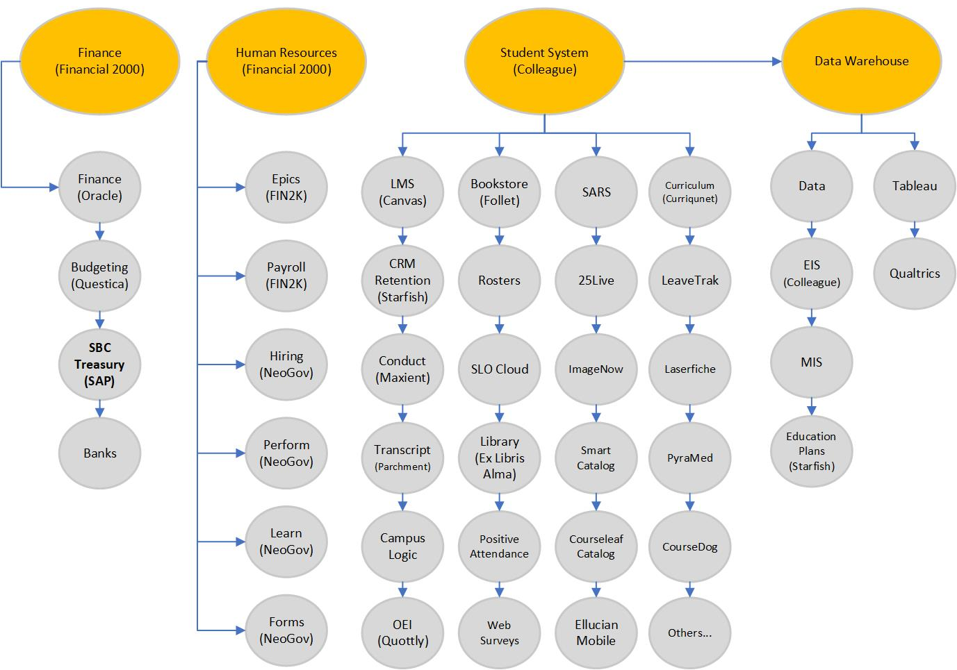
II. Current Challenges and Need for Integration

Slide 5
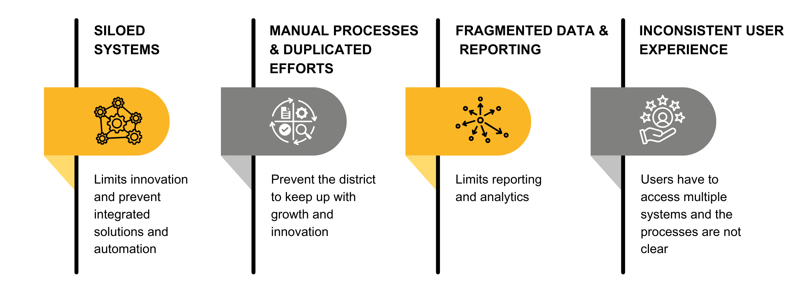
III. Current Challenges and Need for Integration
Notes:
Innovation – Siloed systems limit innovation and prevent integrated solutions and automation
Scalability – The manual processes and duplicated entry prevent the district to keep up with growth and innovation.
Manual Processes – Administrative tasks are performed manually and require duplicate entry int multiple systems.
Student Engagement – A centralized platform provides students with clear visibility of requirements and progress.
Inconsistent User Experience – Students, Faculty and Staff have to access multiple systems and the processes are not clear.
Fragmented Data and Reporting – Data is siloed across different systems and limits reporting and analytics.

Slide 6
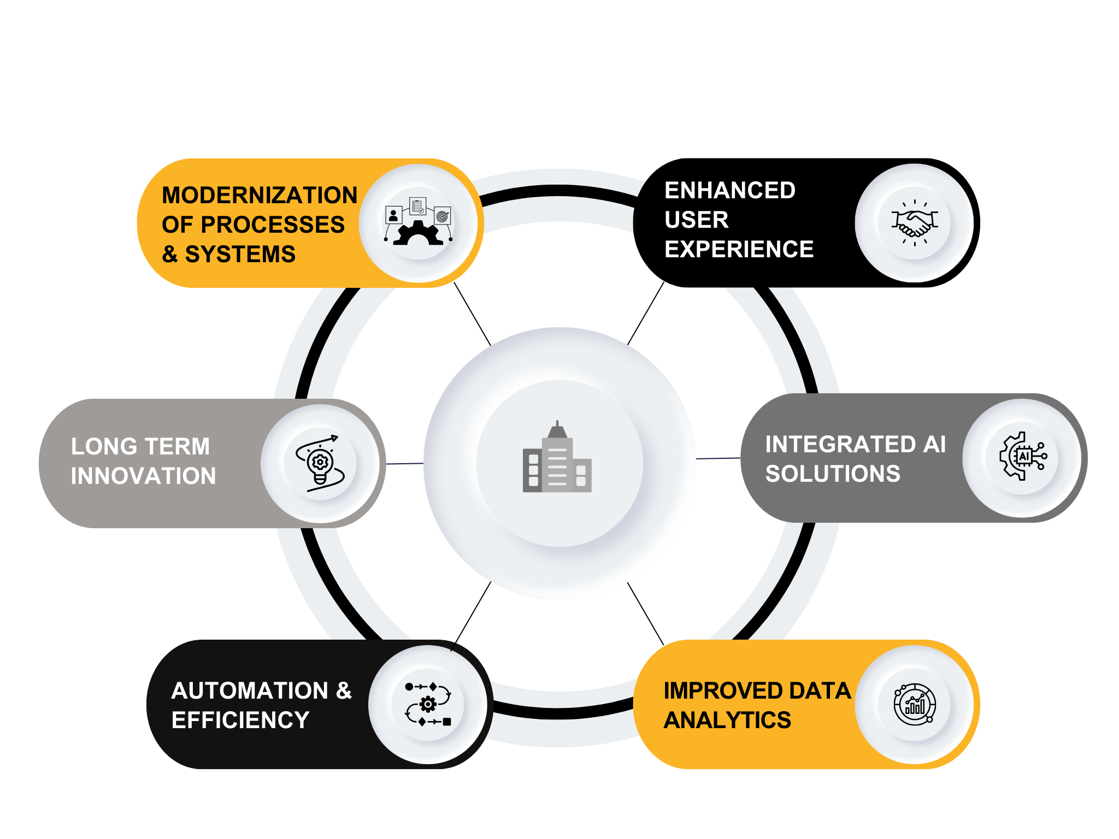
IV. Key Benefits and Expected Outcomes
Notes:
Modernization - The Integrated ERP and Student Information System will modernize operations and improve student success.
Enhance Student Experience – Enable students to complete administrative processes through a single application, running on any device.
Innovation - This transformation will lay the foundation for long-term innovation, enabling our institution to adapt and grow with changing educational demands.
Integrated AI Solutions - The system’s integrated AI solutions will enhance decision-making, automate routine tasks, and provide predictive analytics to support student success and institutional efficiency.
Automation and Efficiency - Enable automation of manual processes, reduce errors, and improve efficiencies.
Improved Data Analytics – Reporting solutions will have access to the integrated data to enable informed decision-making based on institutional data.

Slide 7
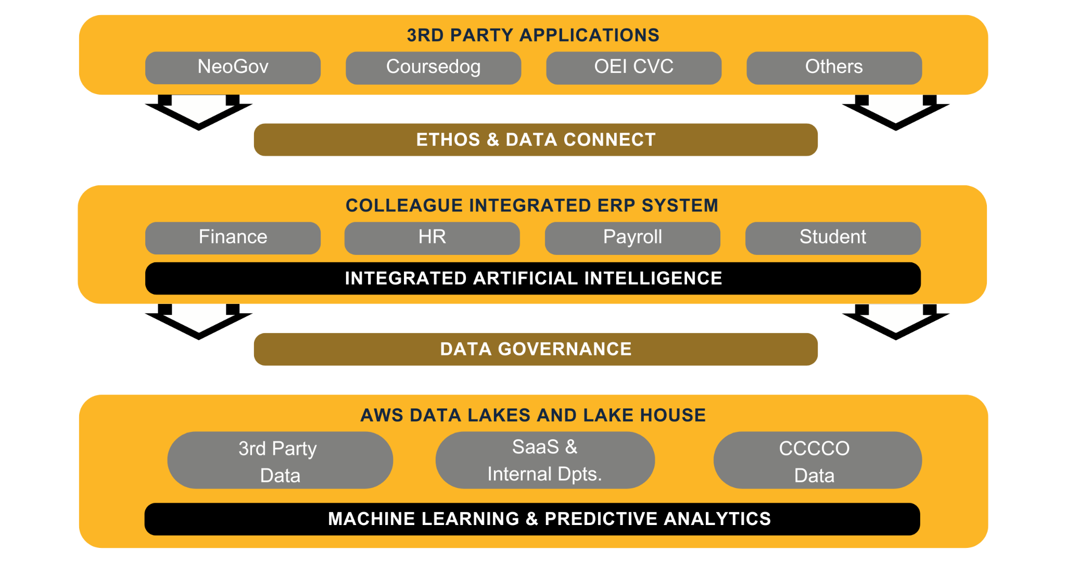
V. Key Benefits and Expected Outcomes

Slide 8
VI. Stakeholder Engagement
Key stakeholders include faculty, staff, and students.
Stakeholders will be included and updated throughout the project.
Process review and functionality mapping.
Project implementation and workgroups.
User acceptance testing and training.
Project updates through district and college committees.

Slide 9
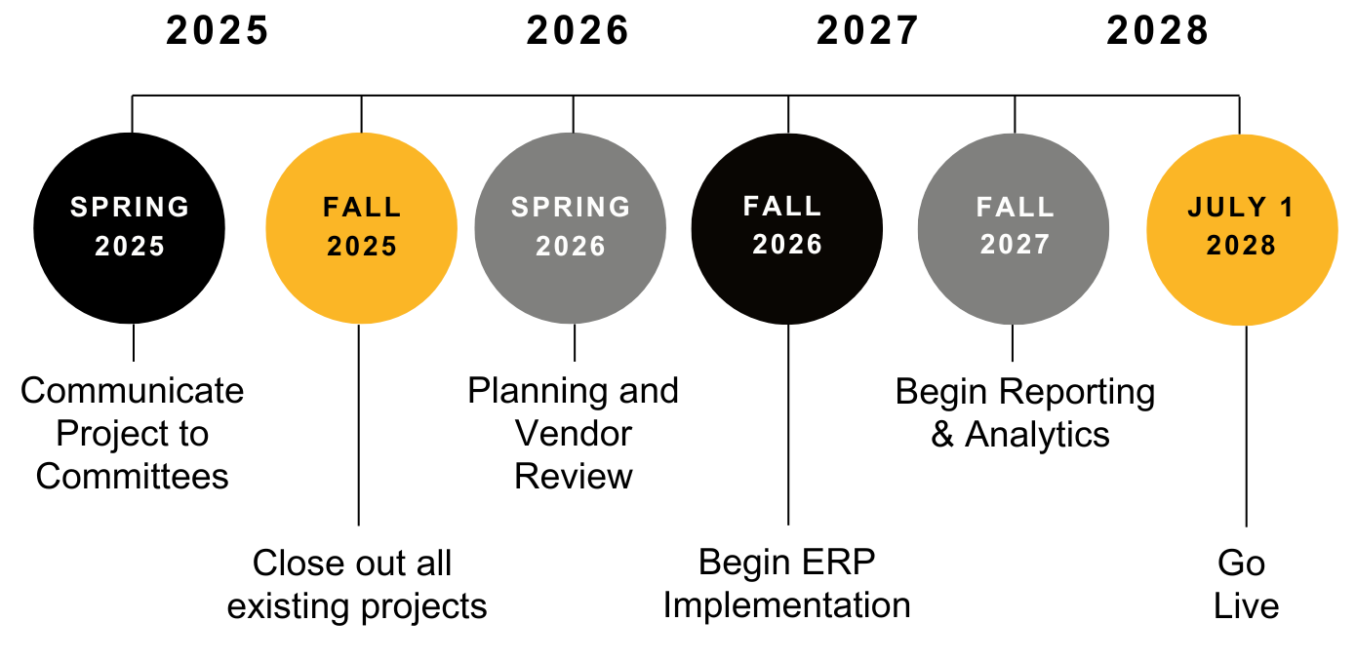
VII. Implementation Plan & Timeline
Notes:
March – June 2025 – Communicate Project to Committees
December 2025 - Close out all existing projects
January 1 – June 30, 2026 – Planning and Vendor Review
July 1, 2026 – June 30, 2028 - Implement Finance
July 1, 2026 – June 30, 2028 - Implement HR and Payroll
July 1, 2026 – June 30, 2028 – Implement Student
July 1, 2026 – June 30, 2028 – Implement Reporting & Analytics
July 1, 2028 – Go Live
Integrated ERP and Student Information System
Communicate Project to Committees
Develop Project Plan and Identify Teams and Resources
Vendor review of Current Environment and Mapping to Integrated Solution
Begin Colleague Finance, HR and Payroll SaaS Implementation
Begin Colleague Student Migration to SaaS
Begin Reporting and Analytics Migation
Integrated User Acceptance Testing and Training

Slide 10
Questions

