Slide 1

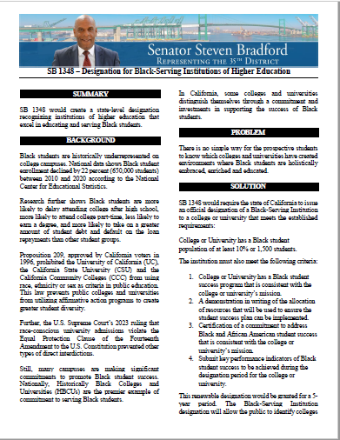
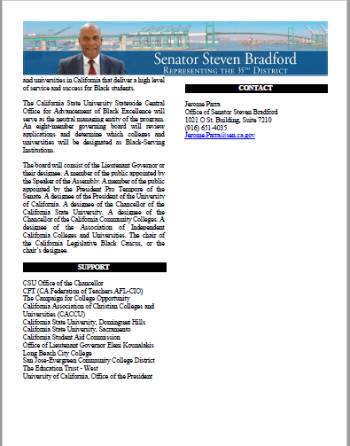
SB 1348
Designation for
Black-Serving Institutions
(BSI) of High Education
…Would create a state-level designation recognizing institutions of higher education that excel in educating and serving black students

Slide 2

The problem:
There is no simple way for the prospective students to know which colleges and universities have created environments where black students are holistically embraced, enriched and educated

Slide 3






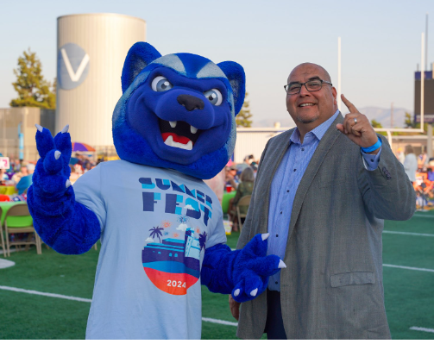


WHAT San Bernadino Valley College Has Done in the past:
One of the first California Community Colleges with a DREAMERS (DRC) and Veteran’s Resource Center (VRC)
On the Cutting Edge with The Guardian Scholars Program
Innovative with the 2008 pilot of the Valley Bound Commitment and the relationship San Manuel Band of Mission Indians
Developed “The Welcome Center” concept early
Long standing EOPS, STEM & MESA and TRiO Programs
AND MORE that has set us apart and prompted other CA Community Colleges to view us as a “model institution”

Slide 4







WHAT SBVC is doing… as it relates to Black Students, families, and the community
SBVC College Planning Documents specifically speak to/address the demographic in 4 of 5 of “The Metrics” (Successful Enrollment, Completion of Transfer Level Math/English in 1st year, Persistence/Retention, & Completion)
Flourishing Umoja-Tumaini Program; 600% growth over the last Academic Year! (from 40 students to over 260 and… growing)
Consistent SBCCD Black Faculty & Staff Association (BFSA)…going on 45 years of service to the community
2015 Creation of BROTHERS (Brothers Reaching Out to Help EVERYONE Reach Success), with the aim of specifically addressing the needs of Black Males at SBVC
Active partnership with the A2MEND (African American Male Education Network & Development) Organization. One of the original Student Charter Programs

Slide 5










What SBVC needs to do…to continue its reputation as a “model institution” and solidify its commitment/service to the needs of the black community

Slide 6

THANK YOU
April Dale
Interim Associate Dean – Outreach, Recruitment and
Educational Partnerships
Director of Admissions and Records
First Year Experience/Valley Bound/D.E.E.P/DREAMERS
Umoja-Tumaini

