Slide 1


Assembly Bill 1705 was signed into law by the Governor in September 2022.
Required Action for AB 1705 Implementation
1. By July 1, 2023, all United States high school graduates, and those who have received a high school equivalency certificate, regardless of background or special population status, who plan to pursue a certificate, degree, or transfer program offered by the California community colleges, shall be directly placed into, and, when beginning coursework in English or mathematics/quantitative reasoning, enrolled in, transfer-level English and mathematics courses.
AB 1705

Slide 2
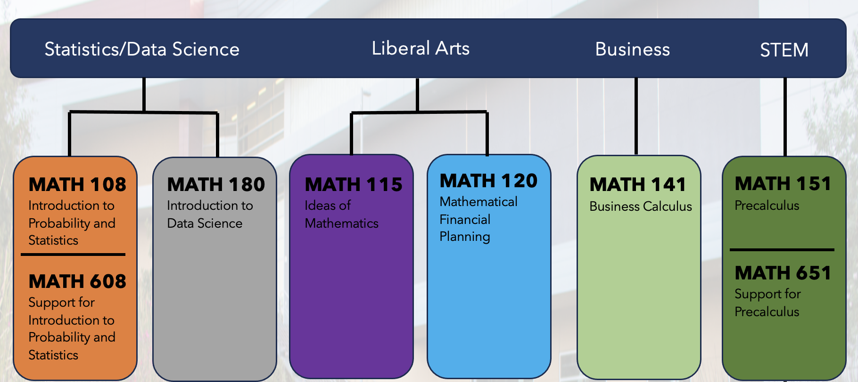
Response
Updated Guided Self-Placement:
Revised form to place students directly into transfer-level mathematics courses.
New Curriculum Development:
Created course options aligned with Guided Pathways program maps to provide relevant mathematics courses.
AB 1705

Slide 3
2. The transfer-level English and math/quantitative reasoning coursework shall satisfy a requirement of the student's intended certificate or associate degree or a requirement for transfer within the intended major.
  a. Extended timeline for non-STEM programs:
If the college currently requires students in non-STEM programs to take transfer-level prerequisites that do not satisfy the student's intended associate degree, colleges shall complete the data template provided by the Chancellor's Office by July 2023 to verify that the prerequisite improves student progress in the program per standards in Education Code §78213, subd. (e). The prerequisite requirement may only be continued after July 2024 if it meets these standards.
For example, the Transfer Model Curricula for Business Administration includes applied calculus or finite math as an option but does not include college algebra; therefore, if a college requires some students to take college algebra as a prerequisite to applied calculus or finite math, the college will need to complete the data template to show that college algebra meets the standards of Education Code §78213, subd. (e).
AB 1705

Slide 4
Response
Non-STEM Curriculum:
No non-STEM mathematics course requires a perquisite course. Students have immediate access to course upon placement.
AB 1705

Slide 5
  B. Extended timeline for STEM programs:
By July 2024, colleges shall have at most two transfer-level prerequisites that do not satisfy the student's intended associate degree. For example, calculus is the lowest level of math that satisfies the Transfer Model Curricula for Physics or lower division transfer requirements for an engineering major. Colleges that require some students to take three transfer-level math prerequisites, such as college algebra, trigonometry and precalculus, before gaining access to calculus will need to replace this three­ course preparatory sequence with at most two courses.
If the college currently requires some students in STEM programs to take any transfer­ level prerequisites that do not satisfy the student's intended associate degree, colleges shall complete the data template provided by the Chancellor's Office by July 2024 to verify that the student's progress is improved by taking the prerequisite(s) per standards in Education Code §78213, subd. (f). The prerequisite requirements may only be continued after July 2025 if these standards are met.
AB 1705

Slide 6
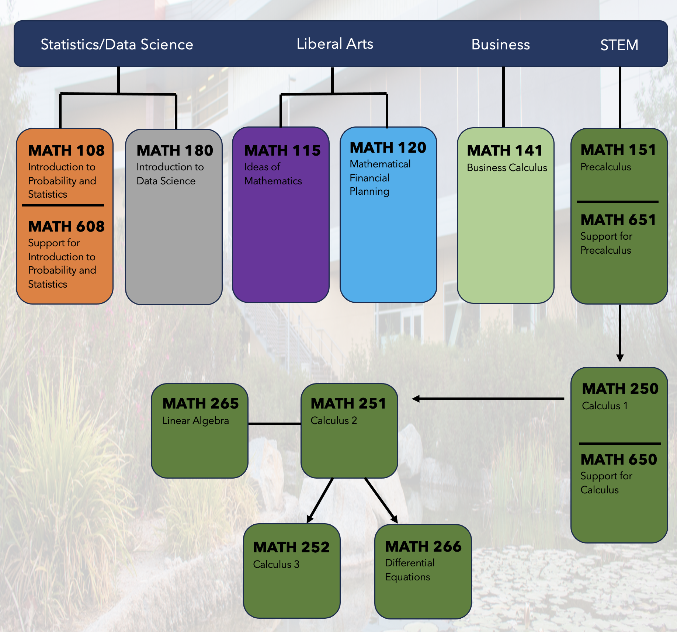
Response
STEM Pathway:
During the Spring 2024 semester, the mathematics department reached a consensus vote that the STEM pathway for the 2024-2025 academic year would be MATH 151 (Precalculus) and MATH 250 (Calculus 1).
AB 1705

Slide 7
3. By July 2023, a community college shall not require students to repeat coursework that they have successfully completed in high school or college or take coursework that repeats competencies that the student has demonstrated through other methods of credit for prior learning. STEM students who have successfully completed precalculus in high school shall have access to calculus if their program requires calculus.
AB 1705

Slide 8
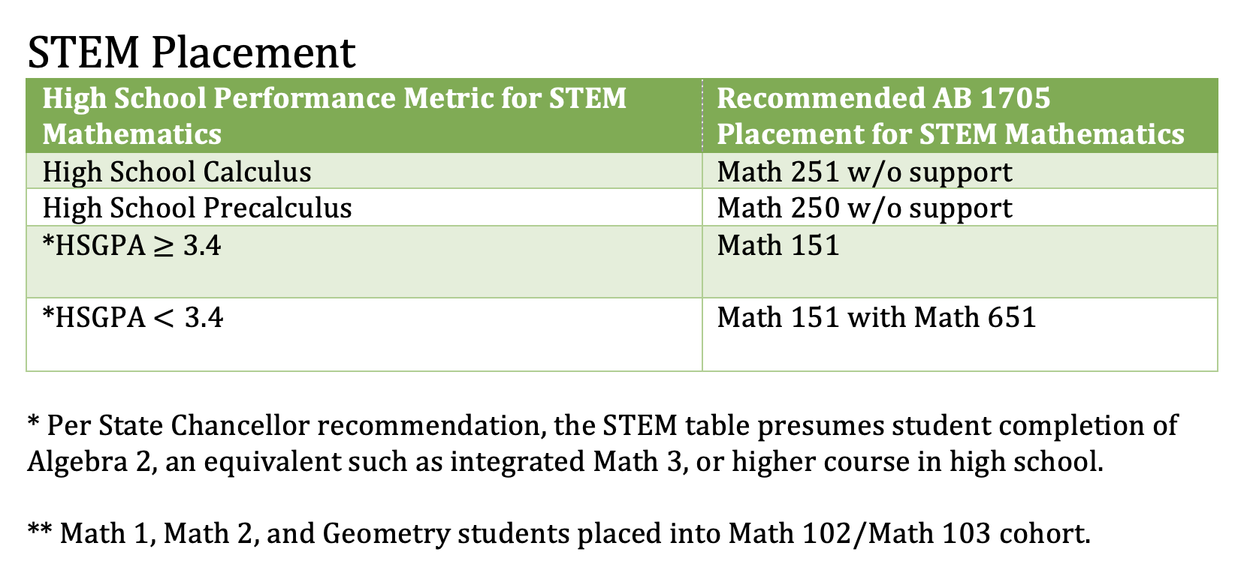
Response
Updated Placement Protocols:
During Spring 2023 semester, the following STEM mathematics placement tables were updated and supported by the Academic Senate.
Placement tables were implement into Guided Self-Placement form.
AB 1705

Slide 9
4. By July 2023, a community college shall not enroll into noncredit coursework students who have graduated from a United States high school or been issued a high school equivalency certificate, as a substitute or replacement for direct placement and enrollment into transfer-level English and mathematics coursework. Colleges can enroll students into non-credit corequisites that require co-enrollment in transfer-level coursework.
AB 1705

Slide 10
Response
Non-Credit Mathematics Coursework:
Non-credit corequisites include MATH 608, MATH 650, MATH 651.
Non-credit courses are linked to primary course during registration process.
AB 1705

Slide 11
5. By July 2023, pretransfer-level enrollment shall only occur for students described as exceptions to the core tenet of AB 1705 in Education Code §78213, subd. (j). For students in non-transferable certificate or associate degree programs with English or math requirements, pretransfer-level enrollment can occur only if the program's accrediting body or advisory board requires coursework that cannot be satisfied with transfer-level coursework.
AB 1705
Response
Pretransfer-Level Coursework:
The department currently offers no pretransfer-level mathematics courses.

Slide 12
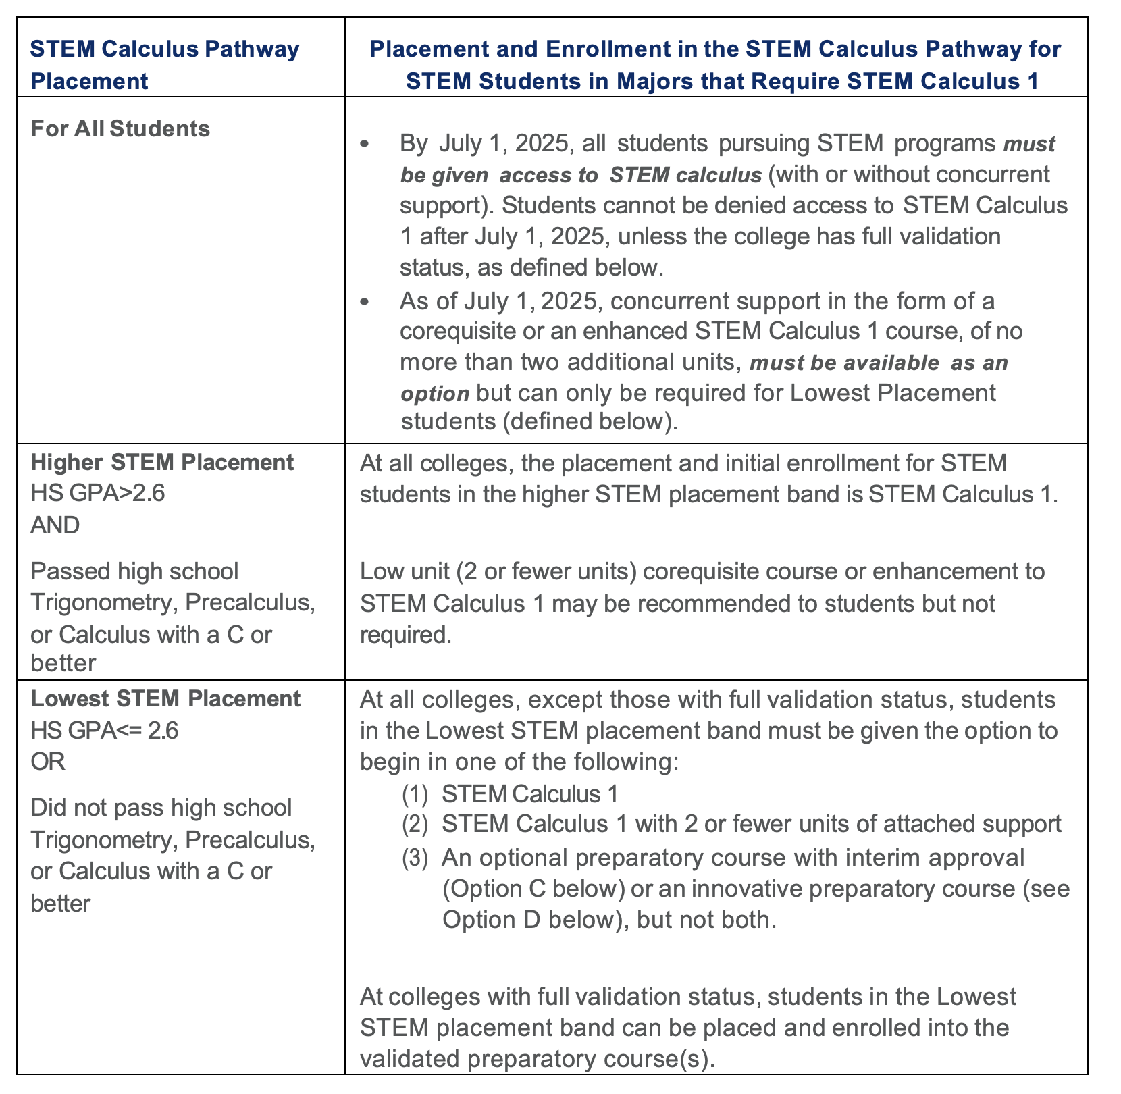
STEM Calculus Pathway Placement
These placement rules pertain only to students who require STEM Calculus 1 for their program or major. STEM students who need applied calculus for their major should begin in that course per previous AB 1705 validation efforts (Education Code §78213 (e)). STEM students who also need Statistics for their program or major may begin in that course, but when they start on the STEM Calculus Pathway, the following rules apply.
AB 1705
February 27,2024 Memorandum

Slide 13
Required Action: Certification of Progress Toward AB 1705 Validation for STEM Calculus Pathway Placement and Initial Math Enrollment
Option A (STEM Calculus 1 Implementation): Colleges choosing this option are meeting AB 1705 standards by replacing stand-alone preparatory courses with support-enhanced STEM Calculus 1 or linked corequisite support of no more than two additional units by July 1, 2025. If the college continues to offer stand-alone preparatory courses, enrollment will be proactively restricted to student populations described in §78213 (j). These colleges will still complete the certification form, but no data submission is required.
AB 1705
February 27,2024 Memorandum

Slide 14
Option B (Apply for Validation Approval): Colleges choosing this option are applying for full AB 1705 STEM Calculus Pathway Validation by validating an existing preparatory course or courses in the college's STEM Calculus pathway. This option requires local data to meet the three standards in §78213(f)(l) for the Lowest STEM Placement group. If the analysis provided by the Chancellor's Office in the college's report already provided this validation, please select Option Bin the certification form, but do not submit data. If the CO analysis did not already award validation status to the college, the college must submit data by July 1, 2024. If validation approval is granted, colleges will implement the STEM Calculus Pathway Placement rules with the validated course or courses required for Lowest STEM Placement students by July 1, 2025.
AB 1705
February 27,2024 Memorandum

Slide 15
Option C (Apply for Interim Approval): Colleges choosing this option are applying for interim approval of an existing preparatory course or courses in the college's STEM Calculus pathway that does not meet all 3 standards of the law §78213(f)(l). This option requires local data to demonstrate STEM Calculus 1 throughput in two years is 50% or greater for Lowest Placement Students starting in the course. If the analysis provided by the Chancellor's Office in the college's report already provided this approval, please select Option C in the certification form, but do not submit data. If the CO analysis did not already award interim approval to the candidate course, the college must submit data by July 1, 2024. If interim approval is granted, colleges choosing this option will implement the STEM Calculus Pathway Placement rules with the interim course option for Lowest STEM Placement students (see the placement rules table above). Interim courses will undergo additional validation by July 1, 2027, and must achieve full validation status in order to continue as a placement and enrollment option beyond July 1, 2027 (i.e., the course will need to meet all three standards described §78213(f)(l)).
AB 1705
February 27,2024 Memorandum

Slide 16
Option D (Implement an Innovative Course): Colleges choosing this option are planning to enact the STEM Calculus Pathway Placement rules with the innovative preparatory course option for Lowest STEM Placement students. An innovative preparatory course is no more than 4-units with no more than 2-units of concurrent support. This course will be offered during the two-year innovation period (Fall 2025-Spring 2027). An innovative course will undergo additional validation by July 1, 2027, and must achieve full validation status in order to continue as a placement and enrollment option beyond July 1, 2027 (i.e., the course will need to meet all three standards described in §78213(f)(l)). No data submission is required.
AB 1705
February 27,2024 Memorandum

Slide 17
Response
Option A (STEM Calculus 1 Implementation): Colleges choosing this option are meeting AB 1705 standards by replacing stand-alone preparatory courses with support-enhanced STEM Calculus 1 or linked corequisite support of no more than two additional units by July 1, 2025.
AB 1705
February 27,2024 Memorandum

