Slide 1



Overview of Faculty Participatory (aka Shared) Governance
MULTIPRONG EFFORTS
District Committees
Campus/College Committees
Task Forces/Advisory/User Groups/Adhocs
ACADEMIC SENATE

Slide 2
Our Local ACADEMIC SENATE
Full Senate Body
[‘24-25, N≈38 faculty]
Subcommittees
Elections
Legislative
Personnel Policy
Constituency/Academic Senate Standing College Committees
Formed by the Authority of the Academic Senate
Created to address specific academic and/or professional matters
Report to the Academic Senate
Report findings, recommendations, etc

Slide 3
Constituency/Standing College Committees of the SBVC Academic Senate
(Senate Bylaws 333; 12/02/20)
Accreditation & Outcomes
Curriculum Committee
Guided Pathways
Honors
Student Success & Support
Program Review

Slide 4
Academic Senate
College Council

Slide 5
Other College Committees
report/advise/recommend to their appropriate governance body For example
in ‘23-’24:
Facilities & Safety Committee
College Council

Slide 6

College Council
Membership (‘23-’24)
Budget Committee
Curriculum
Student Success and Support Programs
Facilities & Safety Committee
Professional Development
Program Review
Accreditation
Associated Student Government President
CSEA President
Classified Senate President
CTA President
VP, Administrative Services
VP, Instruction (Instruction/Accreditation)
VP, Student Services/Enrollment Management & Student Equity
Director, Technology Services
Co-Chairs
College President
Academic Senate President

Slide 7
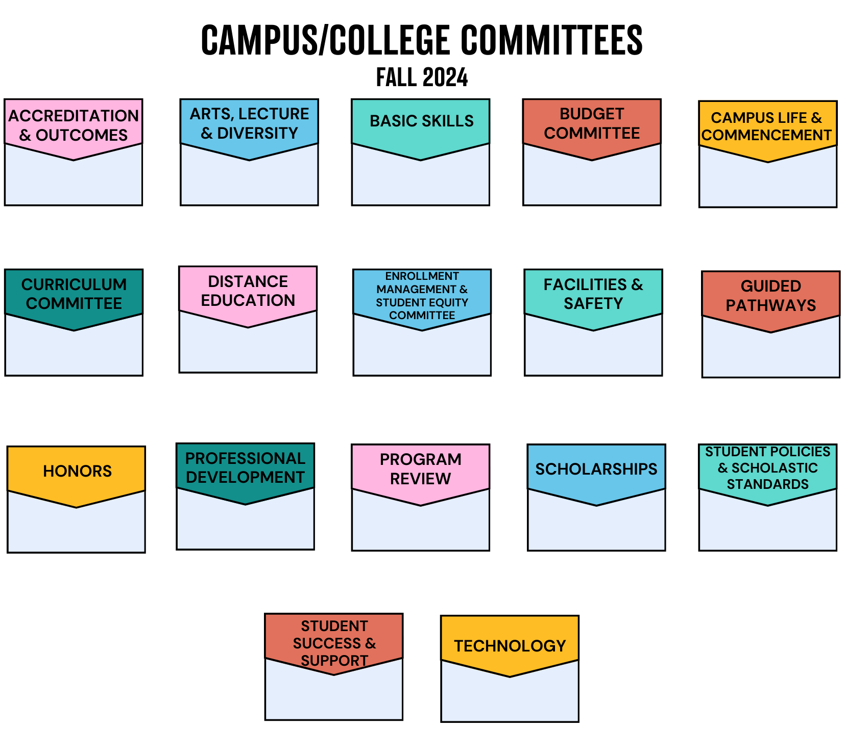

Slide 8
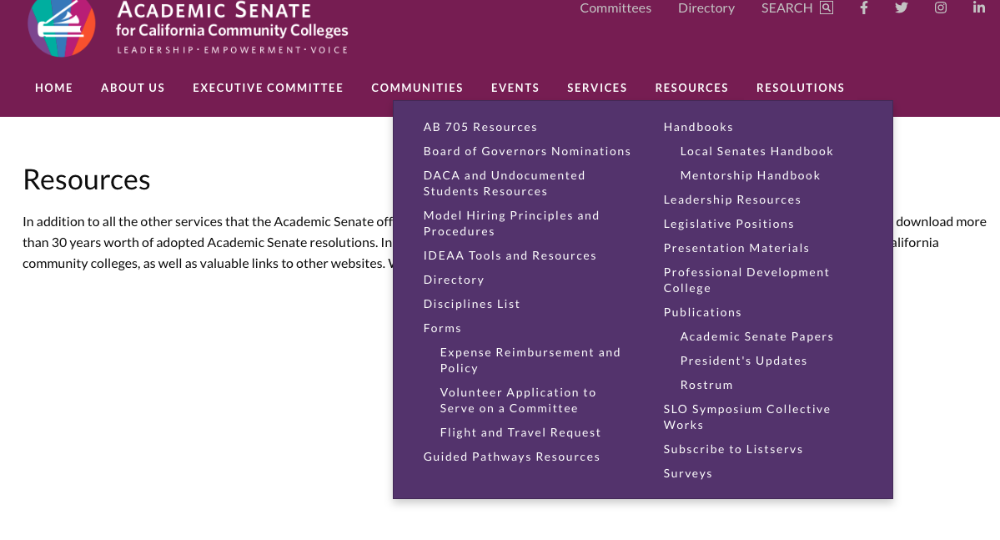

ASCCC Resources
- helpful resources on shared governance and so much more!

