Slide 1
Shared Governance Models
Why Change?
Create ‘umbrella’ committee space where committees with common interests can have discussion
  Closes gaps in communication & create path to ‘report up’
Short term projects and initiatives can be addressed by the appropriate ‘umbrella’ committee
Realign committee meeting times for efficiency and reduce the number of overlapping meetings.
Feedback Needed
What are the pros and cons of each model?
Additions? Subtractions? Realignment?

Slide 2
Shared Governance Models
Details
Fun Stuff
Meeting day/time changes will begin Fall 24
Why now? Meeting day/time changes need to be agreed upon before faculty can complete the 24/25-26/27 committee assignments, and complete the SBVC Governance Handbook
Creation or review of committee charges and membership will begin immediately after meeting pattern is approved.
Working with District to better align District & Campus meetings
Dedicated time period for Division/Department Meetings
Campus Leadership will no longer be scheduled to simultaneously attend 2-4 meetings
Passing time and driving time between meetings

Slide 3
Current Committee Meeting Pattern

Slide 4
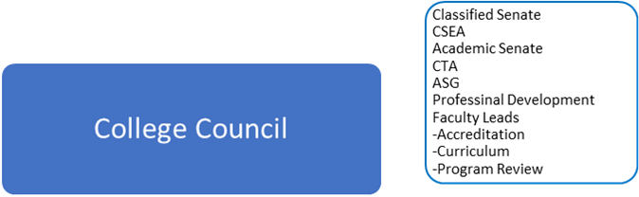
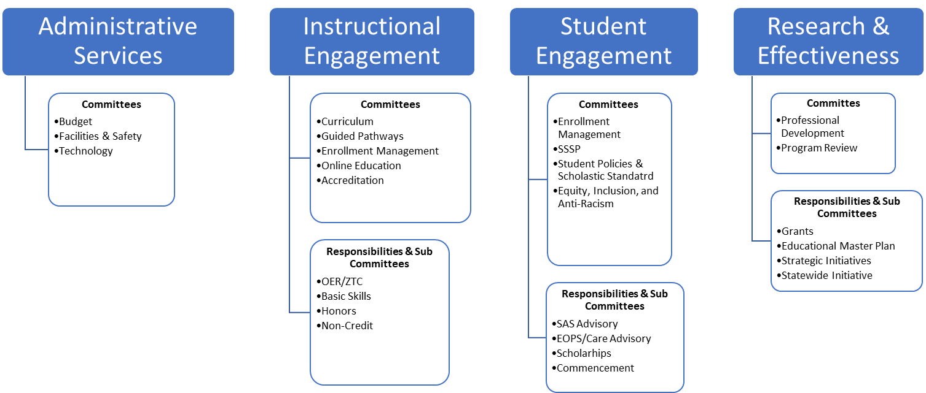
MODEL ONE

Slide 5
Shared Governance Draft: Reporting Model One | Membership
College Council | President CTA Representative CSEA Representative Classified Senate Representative Academic Senate President (co-chair) Budget & Facilities Chair(s) | Institutional Effectiveness Chair(s) Instructional Efficacy Chair(s) Student Success Chair(s) Enrollment Management Chair(s) Faculty Leads: Accreditation, Curriculum, Program Review Student Government Representative
Budget & Facilities | Vice President of Administrative Services Budget Committee Chair(s) Facilities & Safety Committee Chair(s) Technology Committee Chair(s) | CSEA Representative Program Review Representative Student Government Representative Affinity Groups Representatives Interested Faculty, Staff, Administration and Students
Research & Effectiveness | Dean of Institutional Research, Planning, and Effectiveness Program Review Faculty Lead Outcomes Faculty Lead Professional Development | CSEA Representative Classified Senate Representative Student Government Representative Affinity Groups Representatives Interested Faculty, Staff, Administration and Students
Instructional Engagement | Vice President of Instruction Accreditation Faculty Lead Curriculum Faculty Lead Academic Senate President Distance Education Chair CSEA Representative | Guided Pathways Chair Affinity Groups Representatives Classified Senate Representative Student Government Representative Interested Faculty, Staff, Administration and Students
Student Engagement | Vice President of Student Services Academic Senate Vice President Equity, Inclusion, and Anti-Racism Chair(s) (New Committee) Enrollment management Chair(s) Matriculation/SSSP Leads | CSEA Representative Classified Senate Representative Student Government Representative Interested Faculty, Staff, Administration and Students Student Government Representative

Slide 7
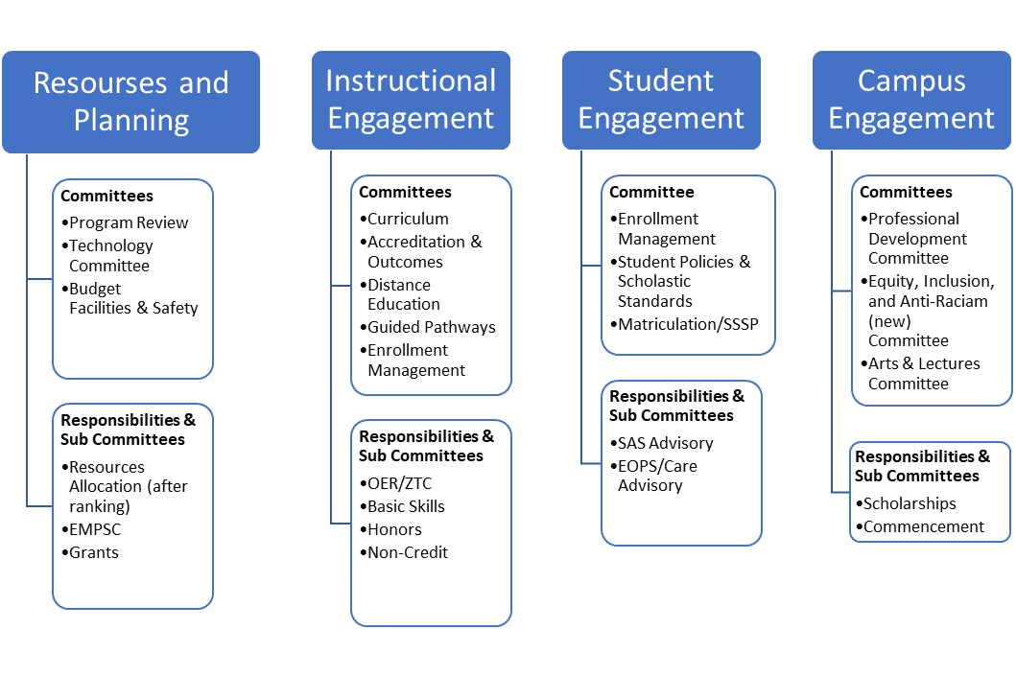
MODEL TWO

Slide 8
Shared Governance Draft: Model Two | Membership
College Council | President CTA Representative CSEA Representative Classified Senate Representative Academic Senate President (co-chair) Resources & Planning Chair(s) | Instructional Engagement Chair(s)Student Engagement Chairs(s) Campus Engagement Chair(s) Faculty Leads: Accreditation, Curriculum, Program Review Professional Development Student Government Representative
Resources & Planning | Vice President of Administrative Services Dean of Institutional Research, Planning, and Effectiveness Budget Committee Chair(s) Facilities & Safety Committee Chair(s) Technology Committee Chair(s) Program Review Committee Chair(s) | Classified Senate Representative CSEA Representative Student Government Representative Interested Faculty, Staff, Administration and Students Affinity Groups Representatives
Instructional Engagement | Vice President of Instruction Accreditation Faculty Lead Curriculum Faculty Lead Academic Senate President Distance Education Chair Guided Pathways Chair | CSEA Representative Classified Senate Representative Student Government Representative Interested Faculty, Staff, Administration and Students Affinity Groups Representatives
Student Engagement | Vice President of Student Services Academic Senate Vice President Enrollment Management CSEA Representative Classified Senate Representative | Classified Senate Representative Student Government Representative Interested Faculty, Staff, Administration and Students Affinity Groups Representatives
Campus Engagement | Dean of Student Engagement & Wellness Professional Development Chair Arts & Lectures Chair(s) Equity, Inclusion & Anit-Racism Chair(s) | Classified Senate Representative Student Government Representative Interested Faculty, Staff, Administration and Students Affinity Groups Representatives

