Slide 1


MAP & CPL
Military Articulations &
Credit for prior learning

Slide 2
How we got here…
Policies for consistency to award Military personnel and Veterans college credit from based on their JST’s
2018 Cervantes AB 1786
ASCCC Resolution 18.04 (2011)
Urges local academic senates to apply credit for educational experiences during military service toward the associate degree – including the fulfillment of general education, major coursework, certificates, and other degree requirements – in accordance with the recommendations listed in the American Council on Education (ACE) Guide to the Evaluation of Educational Experiences in the Armed Services.
Academic Credit for Military Experience: Specified that by March 31, 2019, the CCC Chancellor is to establish an initiative to expand military Credit for Prior Learning (CPL).
2018 Roth CA S 1071
Community Colleges Uniform Policy to Award Credit: Requires CCC Chancellor to work with Academic Senate for California Community Colleges (ASCCC) to develop a consistent policy to award military personnel and Veterans who have an official Joint Services Transcript course credit for Intersegmental General Education Transfer Curriculum, State University General Education Breadth or local community college general education requirements.

Slide 3
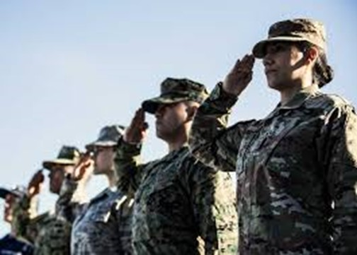
About Us
What is MAP (Military Articulation Platform)?
MAP is a collaborative effort enjoined by the Academic Senate of the California Community Colleges (ASCCC), the CCC Chancellor’s Office (CCCCO), ACE, CalVet, and local and regional legislators
.
(SB1071) requires the system to implement a consistent policy to award credit for veteran and military students using their Joint Services Transcripts.

Slide 4

About Us
What is the CPL (Credit for Prior Learning) Initiative?
  CPL is a collaborative effort enjoined by the Academic Senate of the California Community Colleges (ASCCC), the CCC Chancellor’s Office (CCCCO), ACE, CalVet, and local and regional legislators.
(AB1786) requires an initiative to expand the use of course credit at the California Community Colleges for students with prior learning.

Slide 5
MAP Initiative
The Beginning…Spring 2023
2022
2022
2022
2022
2022
March
April 18
April 26
May 10
May 24
Initial talks with CCC & the Norco Team regarding SBVC’s participation in the MAP cohort group
Initial talks with Registrar, evaluators and VCR ambassadors Alvarez and Kelley-Silagy regarding possibilities of MAP
Broader conservations & presentations about MAP with some constituent groups and the Norco group.
Fact finding with reps from VCR, evaluators, articulation officer, Senate President and Counseling
VCR ambassadors evaluating and critiquing MAP platform w/focus on JST uploads

Slide 6
The Beginnings
Where we are…
2022
2022
2023
2023
2023
Fall Semester
December
February
March
March
Strategic planning on what MAP might look like at SBVC & what personnel, funding, etc. would be needed
Secured seed funding for the MAP/CPL initiative
Convened strategic planning with VCR, A&R, and counseling
Positions & descriptions… (work group)
Continued Support and Informational Meetings: Chairs, academic Senate
Possible positions: Regional Facilitator, SBVC Lead MAP/CPL Facilitator, Evaluator, VCR counselor

Slide 7
Moving forward…
Here and there…
2023
2023
2023
2024
2024
Spring
Summer/Fall
Fall
Spring
Spring/Fall
Hiring and onboarding personnel
Hiring and onboarding personnel
Chair (designee), staff workshops:
VCR JST uploads; Evaluation processes critiqued and adjusted
All onboarding should be complete. VCR processes should be operational. CPL transitions and additional workgroups
CPL transitions
MAP formative/summative
evaluations
Possible positions: Regional Facilitator, SBVC Lead MAP/CPL Facilitator, Evaluator, VCR counselor

Slide 8
Questions…
Contacts: Jason Alvarez, Deanna Kelly-Silagy (MAP)
Norco Contact: Calvin Gloria
Lead Administrator: Stephanie Lewis

