Slide 1
SBCCD
Common Application Project
Status Update – February 23, 2023

Slide 2
I. Project Summary
Project Summary:
Allow Students to Apply to One College and Register for Courses at Either College
Project Kickoff in May 2022
Functional Meetings
  Course, Program, Catalog
  Application, Assessment, Ed Plans,
  Financial Aid,
  Registration, Degree Audit, Transcripts
  MIS Reporting, 320 Reporting
Project Completion in October 2022

Slide 3
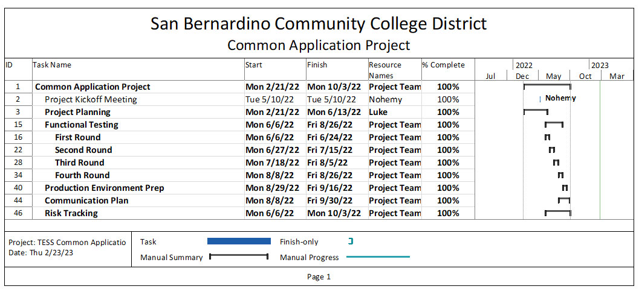
II. Project Plan

Slide 4
III. Functional Testing
Colleague Functional Testing
  Application, Assessment, Ed Plan
  Financial Aid Processes
  Registration at Both Colleges
  Degree Audit and Transcripts
  MIS Reporting, 320 Reporting

Slide 5
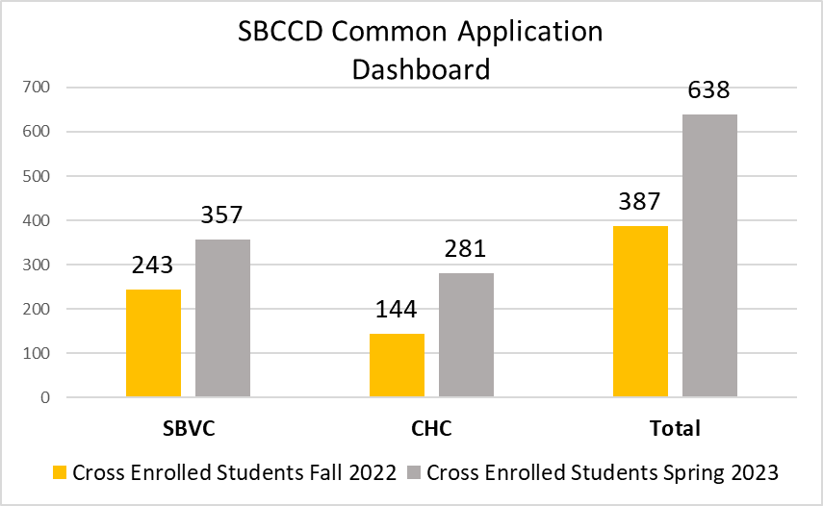
IV. Current Status

Slide 6
V. Next Steps
  Phase II Projects
    Ongoing Course Review between Colleges
    Laserfiche to CCCApply Assessment Submission

