Slide 1

AB 928
Transfer & Local
General Education (GE) patterns:
Review of “proposed changes”
September 21, 2022
Presented at Academic Senate: Janice Wilkins, Articulation Officer/Counselor

Slide 2
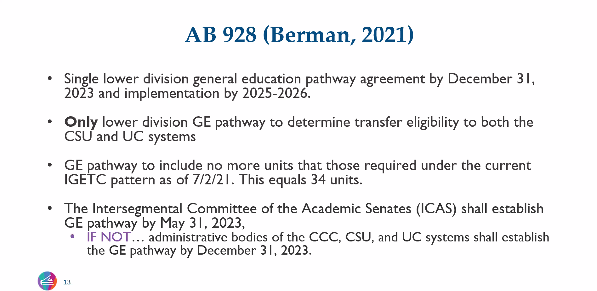
What we know (Transfer GE)

Slide 3
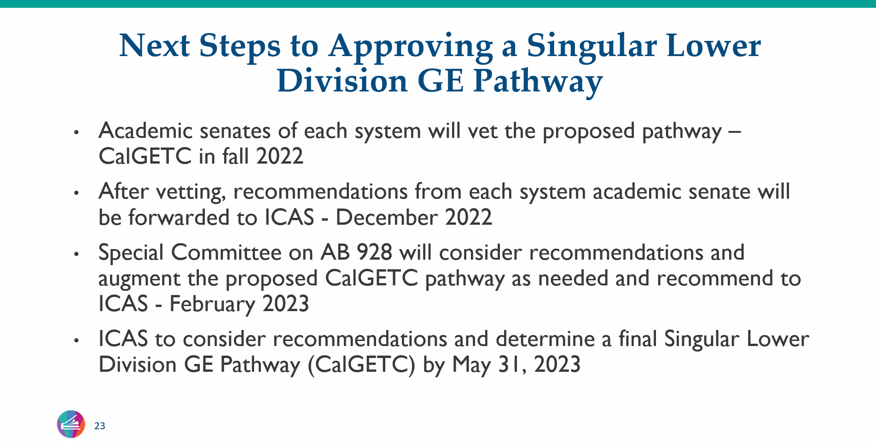
What we know (Transfer GE)

Slide 4
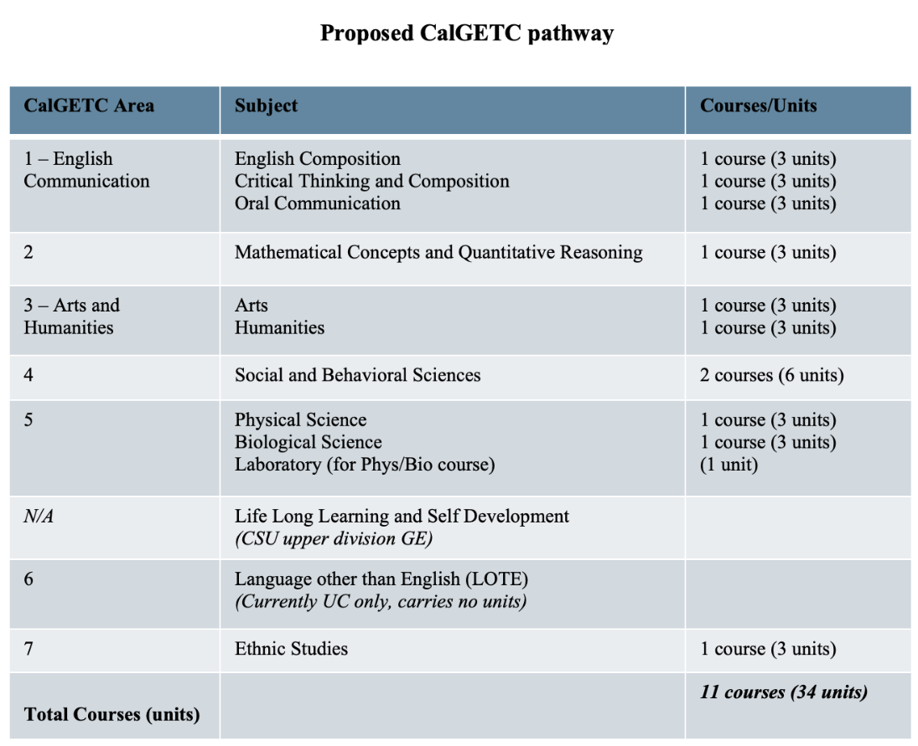
Proposed Differences with current Transfer GE patterns (IGETC & CSUGE)
Area 1 – English Communication
UC will accept Oral Communication as a new (third) course
  The CCC will revise and strengthen (if needed) courses fulfilling the Oral Communication subject requirement to meet new core competencies
Area 3 – Arts and Humanities
Decreases from three courses to two courses
  one in Arts
  one in Humanities
Area 4 – Social and Behavioral Sciences
Recently approved due to Ethnic Studies
Reduced from three to two courses
N/A
CSU will remove Lifelong Learning and Self-Development course from CSU GE and treat as upper-division GE requirement
Area 6 – LOTE
UC will remove its Language Other than English proficiency requirement from IGETC and treat it as a graduation requirement.
Area 7 – Ethnic Studies

Slide 5
What we know (Local GE)
ASCCC: Proposing a General Education Pattern for the Associate Degree
    The proposed general education pattern for the associate degree aligns with the proposed CalGETC pathway and remains consistent with the current associate degree requirements as stated in Title 5 §55063.
    Aligning the structure of associate degree general education requirements with CalGETC while utilizing guidance similar to current §55063 requirements will allow colleges to identify courses within each area that meet local general education requirements in addition to those approved for CalGETC
    a proposed “local” CCC GE Pattern has been created and is being shared with California Community College stakeholders for feedback.

Slide 6
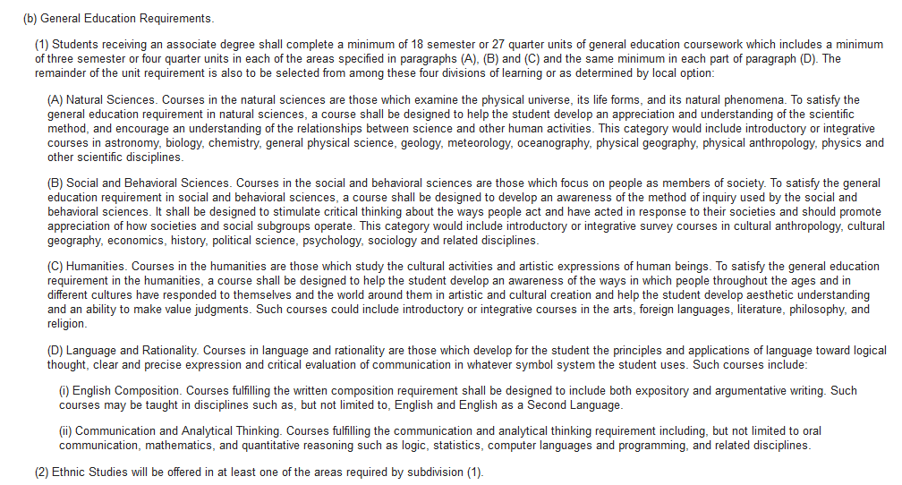
Title 5 §55063- Minimum Requirements for the Associate Degree
Current Requirements

Slide 7
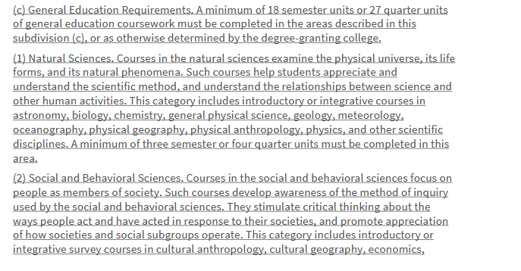
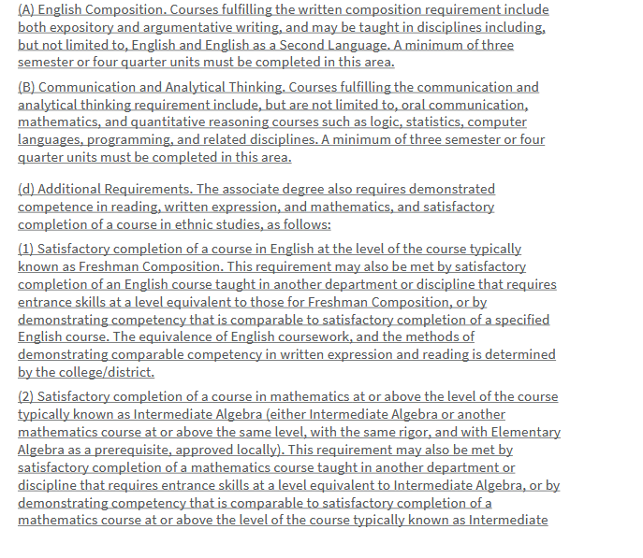
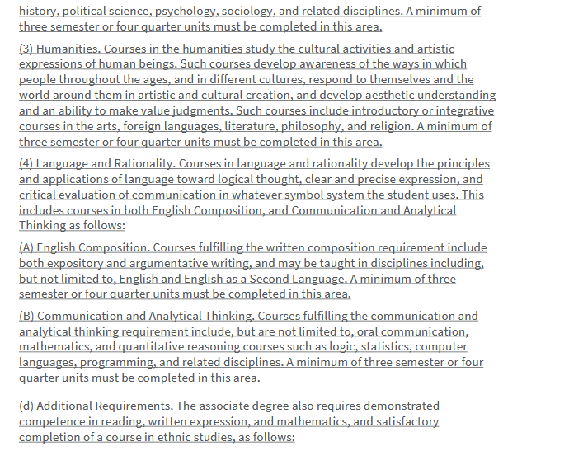
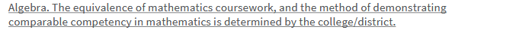
Title 5 §55063- Minimum Requirements for the Associate Degree
BOG Approved

Slide 8
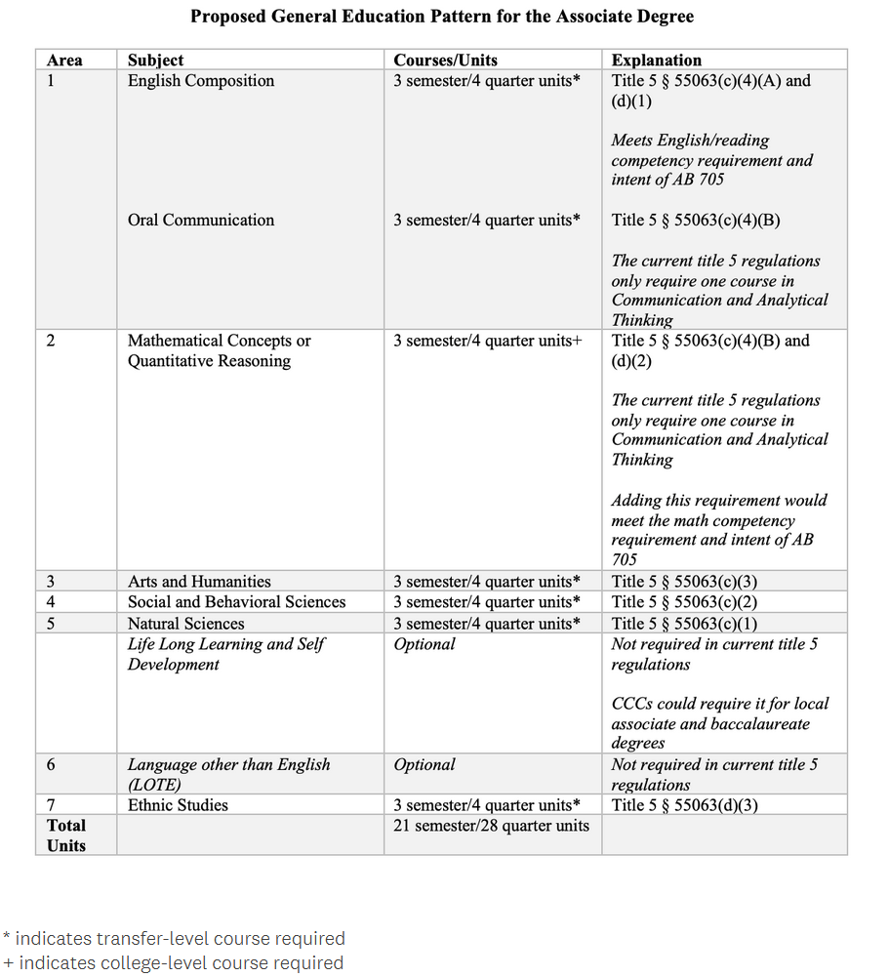

Slide 9
Proposed Title 5 Associate Degree GE Graduation Requirements
SBVC GE Crosswalk
Proposed per alignment AB 928 singular GE |  | Current SBVC GE
Area | Requirement | Category | Requirement
1 | English Composition (minimum 3 units) + Oral Communication (minimum 3 units) | IV | Communication & Analytic Thinking area ENGL 101/ENGL 101H required competency 1 course in COMMST, MATH/STATISTICS, PHIL, or READ area
2 | Mathematical Concepts or Quantitative Reasoning (minimum 3 units) | ---- | Formerly included as an option in the Communication and Analytical Thinking area. Adding this requirement will satisfy the required math competency
3 | Arts & Humanities (minimum 3 units) | III | Humanities Reduced from 2 to1 course
4 | Social and Behavioral Sciences (minimum 3 units) | II | Social and Behavioral Sciences Reduced from 2 to1 course
5 | Natural Sciences (minimum 3 units) | I | Natural Sciences Currently students have the option to choose 1 course with a lab or 2 courses with no lab
6 Optional | Language Other Than English (LOTE) | ---- | UC will remove its LOTE proficiency requirement from IGETC and treat it as a graduation requirement.
7 | Ethnic Studies (minimum 3 units) | VI | Ethnic Studies
Optional | Lifelong Learning and Self Development (minimum 3 units) | V | Lifelong Learning and Self Development CSU is removing this area from CSU GE, but will include this area as an upper-division requirement students will complete after transfer
A minimum of 18 semester units required |  | Current local GE Total Units: 27-29 Proposed Total Units: 21-23 without Optional areas 24-26 units with Optional area
Created by: JW, Articulation Officer- 09/21/2022

Slide 10
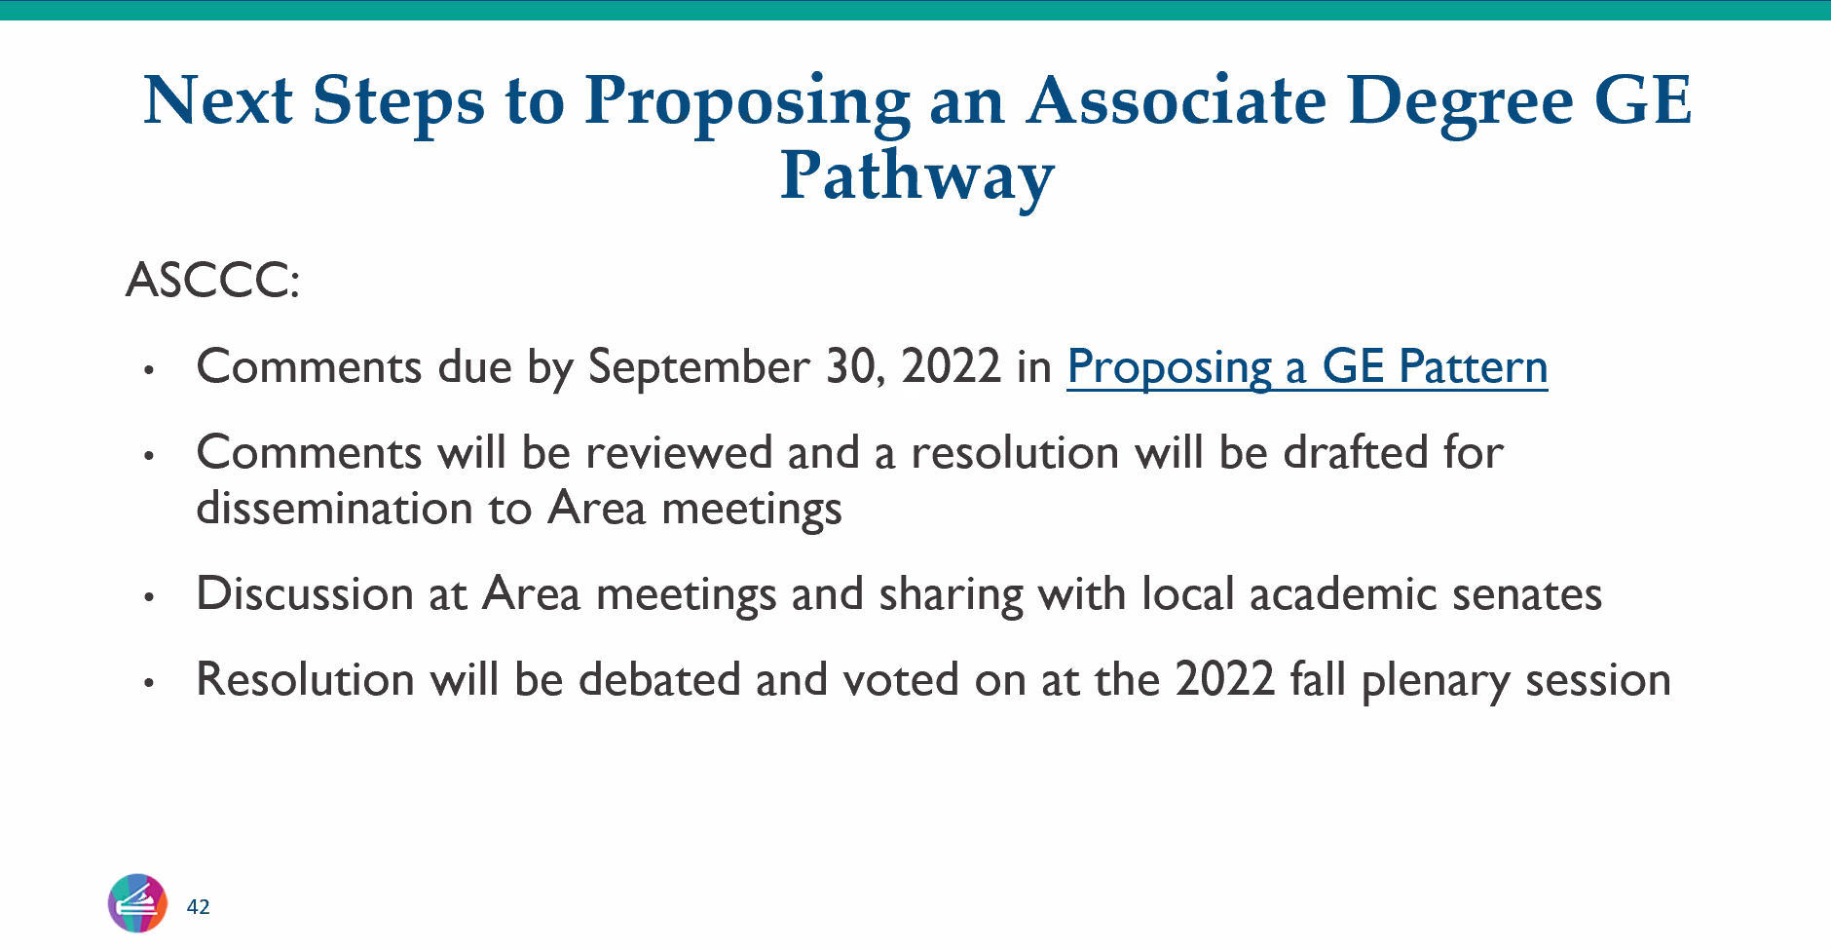

Slide 11
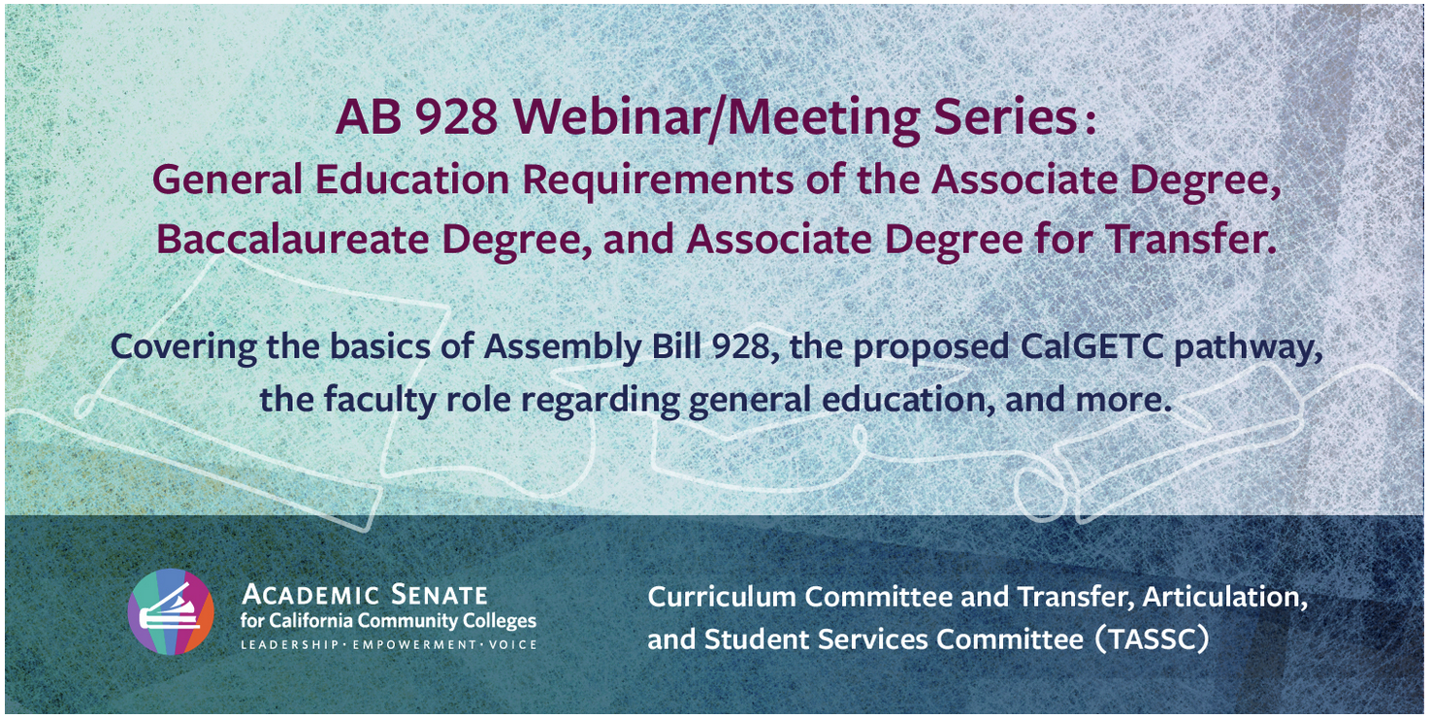
Important Webinar
Zoom links for each session available at: https://asccc.org/
Tuesday, September 27, 2022 (12:00pm – 1:30pm)
Role of local Academic Senates and Curriculum Committees in regard to General Education (GE)
Wednesday, September 28, 2022 (2pm – 3:30pm)
Role of Articulation in Transfer in regard to GE
Monday, October 3, 2022 (9am-10:30am)
Thursday, October 6, 2022 (2pm-3:30pm)
Webinar Recording- September 12, 2022
Addressing the impact of CalGETC, as proposed, on
local colleges, programs, courses and students

Slide 12

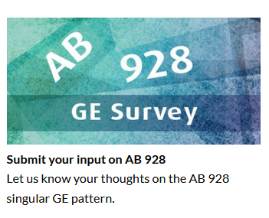
Submit YOUR Comments & Concerns
Responses to the survey are due September 30, 2022
Responses to the survey are due October 1, 2022.
Surveys are available on: https://asccc.org/

Slide 13
AB 928
Drop-in (virtual) Office Hours
  Questions
  Clarification
  Implications on transfer and local GE
  Thursday, Sept. 29th, 9am- 10am & 11am-12noon
  more dates/times will be added, as needed

