Slide 1

Guided Pathways
Matt Robles – Guided Pathways Faculty Lead
Ty Simpson – Guided Pathways Faculty Lead
John Stanskas – Guided Pathways Faculty Lead

Slide 2
Approved by the SBVC Academic Senate September 2020 as direction to the Guided Pathways Committee
Include student voices in the SBVC Guided Pathways effort. This includes:
a. asking the Associated Student Government for two student representatives on the committee
b. working with the Research and Planning office to collect data, perhaps both qualitative and quantitative, about our onboarding processes, career field guides, and other observations about how students interface with the college
and what they want from the college in terms of support.
Engage the campus in mapping programs of study for OUR students. Possibly create student profiles, evaluate the availability
of instructional and support services through a variety of lenses that reflect our student population.
Actively collaborate with the Academic Senate, Professional Development, and other existing structures of the college to
create a cohesive plan that infuses both guided pathways and anti-racism/no-hate goals of the institution.
Evaluate career development tools currently on hand and inform the entire campus about the tools and resources available
to students.
5. Evaluate and propose changes to the hiring processes of the district with a lens toward racial justice and equity.
Support and/or lead campus dialogue about culturally responsive andragogy.
Evaluate student success and support team models from other campuses and determine their effectiveness or appropriateness for our students.

Slide 3



four part forum
Equity in Hiring @SBCCD

Slide 4
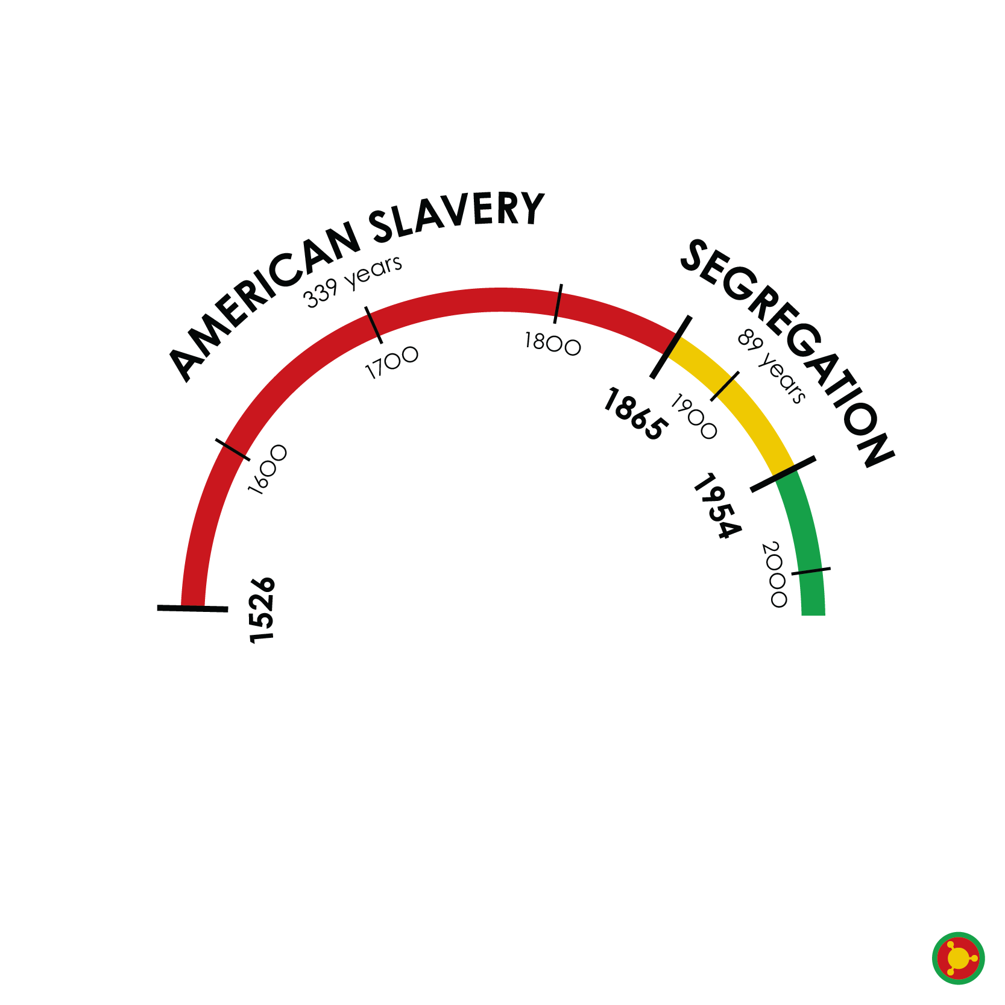
We are not in a post-racial society
66 years

Slide 5

Call for Action from the Academic Senate for California Community Colleges
Make agendas that include anti-racism/no-hate education.
1
Acknowledge the college houses the biases and prejudices of its founding time.
3
Redesign the evaluation of hiring and evaluation processes.
4
Request services from the ASCCC about any of these topics here.
5
Find the voices among your faculty missing in governance.
6
Create constructive ways students can express themselves.
7
Prioritize culturally responsive curricular redesign.
2
Notes:
http://createsend.com/t/y-406A779B3CC74AB2

Slide 6

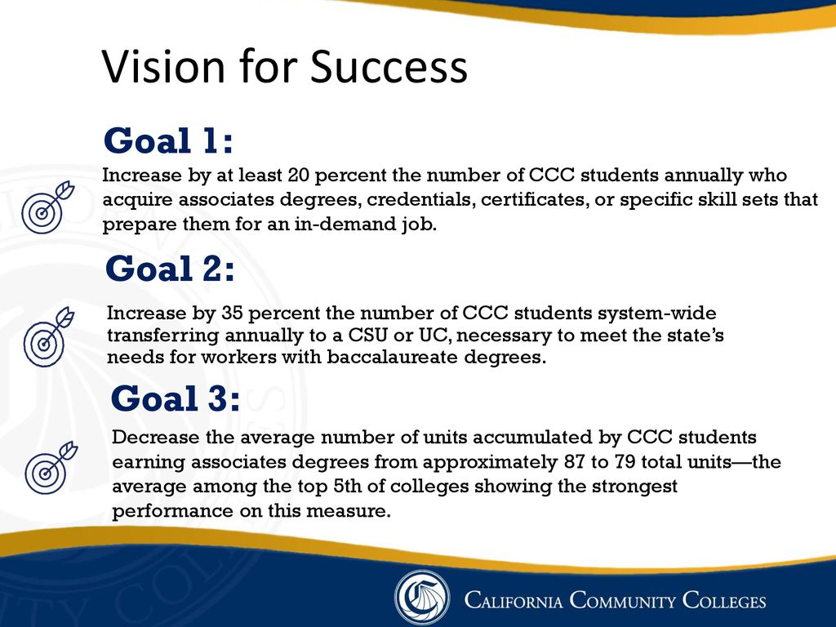

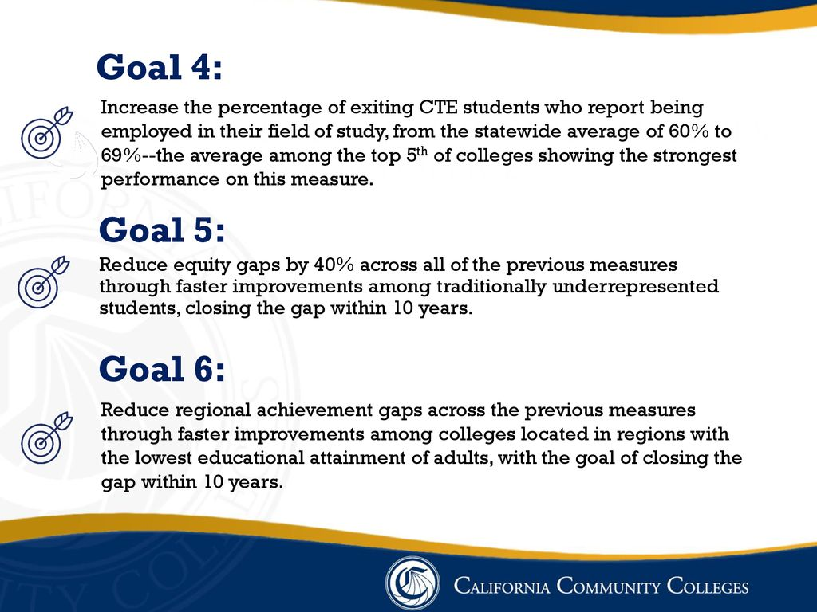
Student Success
Equity and Diversity
Operational Efficiencies
Facilities
June 11, 2020 Board Resolution: Commitment to Racial Justice and Equity
San Bernardino Community College District Strategic Goals
Student Success
Equity and Diversity
Operational Efficiencies
Facilities
June 11, 2020 Board Resolution: Commitment to Racial Justice and Equity
Notes:
Emphasize that one mechanism implemented by the legislature and adopted by the system to address these goals is Guided Pathways.
Emphasize goal #5 re: closing equity gaps

Slide 7

SBVC Resolution SU20.01
Resolved, That the SBVC Academic Senate will actively infuse the anti-racism/no- hate education by:
  Integrating an accurate portrayal of the roles and contributions of all groups throughout history across curricula, particularly groups that have been underrepresented historically,
  Identifying how bias, stereotyping, and discrimination have limited the roles and contributions of individuals and groups and how these limitations have challenged and continue to challenge our society,
  Encouraging all members of the educational community to regularly examine assumptions and prejudices, including but not limited to racism, sexism, and homophobia, that might limit the opportunities and growth of students and employees,
  Coordinating with organizations and concerned agencies which promote the contributions, heritage, culture, history, and health and care needs of diverse population groups, and
  Promoting a safe and inclusive environment for all;

Slide 8
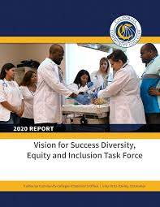
Vision for Success DEI Task Force Report
2016-17 FY:
73% students of color
61% of tenured faculty are White
60% of non-tenured faculty are White
63% of classified staff are White
59% of College Senior Leadership are White

Slide 9

SBVC Data from 2017 EEO Report
Students Latinx: 68% SB City: 65%
Students African-American: 12% SB City: 14%
Administrators Latinx: 40% Staff: 50%
Administrators African-American: 11% Staff: 13%
Full-Time Faculty Latinx: 22% Part-Time: 20%
Full-Time Faculty African-American: 22% Part-Time: 9%
Notes:
http://www.sbccd.org/~/media/Files/SBCCD/District/HR%20%20Documents/SBCCD%20EEO%20Plan.pdf
From the federal census bureau for San Bernardino City https://www.census.gov/quickfacts/fact/table/sanbernardinocitycalifornia,sanbernardinocountycalifornia/RHI225219

Slide 10
What we learned on November 12
Advertising is important as well as timing
Restructure job descriptions to highlight the values of the institution regarding DEI
Consider recommendation to HR regarding evaluation of diversity of the pool prior to convening the first level committee
Try internship programs to widen the pool of applicants when a position is available
Utilize prior work by EEO, Enrollment Management and Equity Committee, and Arts, Lectures, and Diversity Committee
Cultivate relationships with local employers, graduate schools, HBCUs, that may have potential new employees for SBCCD
Maintain relationships with our students on their educational journey for possible employment in the future
Consider mechanisms for classified staff to move into faculty ranks if they desire to do so
Our current contract structure does not align with expanding the diversity of our part-time faculty pool

Slide 11
What we learned on November 19
Regular and ongoing unconscious bias training for all, not just committee members
Revised diversity component in announcement and initial applicant screening
Create better opportunities for adjunct pools and creating pathways for graduate students (internships, etc.)
Campus equity committees should communicate with campus leadership and HR
Review confidentiality regulations and create ways to ensure confidentiality is maintained
Revise committee composition to value both discipline expertise as well as the ability to serve the diverse needs of our students
Include students in hiring process for faculty
Devise mechanisms that demand hiring committees consider the implications of paper screening criteria related to both minimum qualifications for faculty and potential impact on the diversity of the pool of applicants

Slide 12

What we learned on Dec. 3
We lack consistency in our interview/screening process
Student should be involved more in the process
We are too much on the first MQ during the 1st level screening/interview process and neglecting the second MQ
EEO training/DEI Professional Development should be institutionalized and not just during a recruitment
We need to explore other ways to ensure the process is fair (blind screening, two-column scorecards – one for each MQ, etc.)
Interview questions are being repeated, reused and not capturing what we need

Slide 13

What we learned on Dec. 9
The first screening committee should forward as many candidates as are qualified to the second screening between 0 and 5.
The Board of Trustees should ask for aggregated hiring data once per year at a public meeting and not on the consent agenda.

Slide 14
Summary of Changes to AP7210
Minimum qualifications:
For faculty and administrative positions, job requirements shall include (A) a sensitivity to and understanding of the diverse academic, socioeconomic, cultural, disability, gender identity, sexual orientation, and ethnic backgrounds of community college students as demonstrated by skills and abilities in cultural responsiveness and cultural humility; and (B) a demonstrated commitment to recognizing patterns of inequity in student outcomes, taking personal and institutional responsibility for the success of students, engaging in critical assessment of own practices, and applying a race-conscious awareness of the social and historical context of exclusionary practices in American Higher Education.

Slide 15

Summary of Changes to AP7210
Human Resources
Human Resources will also evaluate the diversity of the pool of applicants to determine if further outreach is required before proceeding.
Inclusion of students on hiring committees
Revision to include the possibility of a guest lecture as part of the interview process

Slide 16
Not in AP7210 but Recommended
Holistic revision to job announcement and advertising beyond the usual places
Revise current EEO mandatory training to a more DEI professional development model
Screening criteria using a two column list – one for each of the minimum qualifications
Encourage the Board of Trustees to evaluate aggregate data on the diversity of our hiring processes in an open meeting not on consent
Empower Human Resources to ask questions of the first-level committee regarding impact on the diversity of the candidates and provide relevant information regarding how different choices of the committee will impact the diversity of any pool of candidates.

Slide 17

Next Steps
Consult with Crafton Hills College about their progress
Present to the Guided Pathways Committee changes to AP7210
Deliver a recommendation to the SBVC Academic Senate re: changes to AP7210
Create a separate policy to address part-time faculty hiring (AP7210A?)

Slide 18




Questions?

