Slide 1
Insights from the 2013 Environmental Scan with Two Discussion Questions for DSPC
Dr. Gloria M. Fisher, Interim President SBVC
James Smith, Dean of Research, Planning, and Institutional Effectiveness
Campus Presentation on Campus Climate and strategic planning

Slide 2
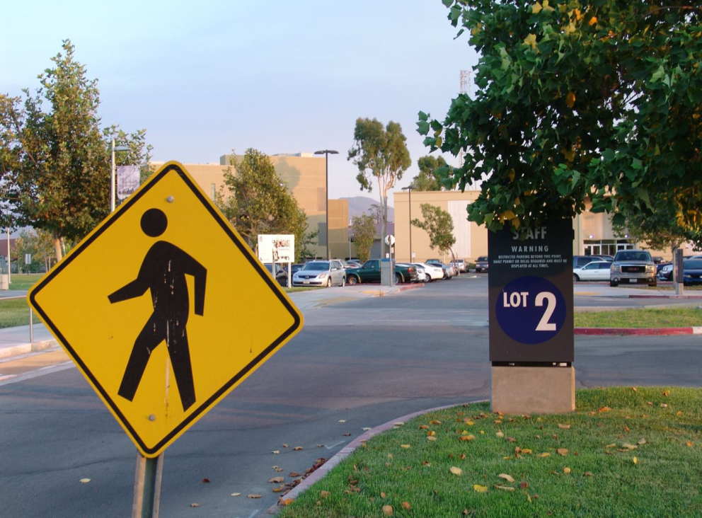
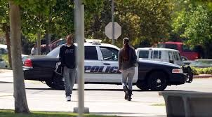
Areas Touched by the Strategic Plan
-Access
-Campus Climate
-Student Success
-Technology
- Etc.
-Parking and pedestrian mobility
-Customer service
-Safety and security
-Signage
-Graduation and transfer

Slide 3
How is all Campus Planning Linked to Accreditation?
System Benchmarks
Accreditation Standards
-Mission
-Services
-Resources
-Leadership
Campus Benchmarks
Strategic Plan
-Access
-Campus Climate and Culture
-Institutional Effectiveness
-Partnerships
-Student Success
-Technology
Program and Department Benchmarks
Other Plans
Enrollment Management
Matriculation
Professional Development
Grants
Facilities
Budget
Research
Educational Master Plan
Regional system -> District /Campus -> Program/Department
Notes:
Standards: Mission and Effectiveness; 2) Instructional services and Student Services; 3) Resources (HR; budget, physical/facilities, technology) 4) Leadership
Progress toward the goals and objectives of each plan serve as evidence for the Accreditation Self-Study:
New planning directions (at this stage): 1) Student Success, 2) Professional and staff development, 3) cultivate community connections, 4) safety and security, 5) technology, 6) Modern and inviting facilities, 7) leadership and institutional effectiveness

Slide 4
What do we include and how far have we come?
Conducted SWOT surveys
Campus community
Business community
Local community groups
Four-year colleges
Focus Groups
Students
Faculty
Managers
Classified staff
Environmental Scan
Town hall style meetings
Feedback has been collapsed into goals and objectives
Commonalities have been identified between the strategic plan and specific area plans.

Slide 5
Effective Strategic Planning Requires Input From the full Spectrum of Stakeholders
Dialogue with all stakeholders
Notes:
Some stakeholders are involved in other campus planning activities. These planners need to interact with those who are putting the strategic plan together.

Slide 6
Example of Goals, measurable objectives, benchmarks, annual targets. Evaluation: Is this a good measure of Access?
 | Baseline 07-08 | 08-09 | 09-10 | 10-11 | 11-12
1.1.2 By Fall 2011, all basic skills classes will achieve and maintain a 90% fill rate.
1.1.2.a English | 98% | 99% | 100% | 102% | 103%
1.1.2.b Reading | 93% | 94% | 91% | 96% | 96%
1.1.2.c Math | 75% | 67% | 80% | 82% | 91%

Slide 7
Strategic Initiative: Campus Climate & Culture:: We are committed to a safe, welcoming, culturally rich learning-centered environment.
Goal 2.1: To Enhance The Image of The College. Desired Outcome: SBVC will be recognized for its excellent reputation and as an inviting place to work and study.
Benchmark – A standard by which something can be measured | baseline 07-08 | 08-09 | 09-10 | 10-11 | 11-12
2.1.1 By 2012, 80% of the stakeholders will indicate satisfaction with the safety, reputation and quality of educational programs and services.
Managers (Reputation) Managers (Safety) | 53% 77% | 54% 64% | 65% 53% | 71% 77% | 65% 53%
Faculty (Reputation) Faculty (Safety) | 79% 77% | 80% 74% | 53% | 79% 74%
Classified (Reputation) Classified (Safety) | 62.1% | 69.5 | 56% 73.5% | No survey | 53% 77%
Students (Reputation) Students (Safety) | 44% 79% | 65% 81% | No survey | 76% 83% | 65% 84%
Notes:
No Room on PP to add note:
Note: Survey responses will come from alternating years of self-study and campus climate surveys for faculty and staff. ([1]-Q#47,48 manager survey); ([2]-Q# 46,47 faculty survey); ([3]-Q#23; [4]-Q# 24,38,15,16,17 staff survey) ); ([5]-Q# -22-f and [6]-56 on the student CC survey)

Slide 8
Goal 5.2: To Increase Student Persistence & Retention (ARCC) Desired Outcome: There will be an increase in the number of students who complete Certificate and Degree programs.
Benchmark – A standard by which something can be measured | Baseline 07-08 | 08-09 | 09-10 | 10-11 | 11-12
5.2.1 By 2012, the overall retention rate for SBVC students will increase 1% a year. | 78% | 79% | 79% | 81% | 81%
 | Baseline 05-06 | 06-07 | 07-08 | 08-09 | 09-10
5.2.1a. By 2012, ARCC reporting data will indicate that persistence of cohort students will increase 2% a year. | 56.6% | 61.8% | 61.0% | 67.3% | 68.7%

Slide 9
Where Does the Plan Fit in the Scheme of Things?
#).
Strategic Plan from the State Chancellor’s Office
SBCCD Board Imperatives
SBCCD Strategic Plan
SBVC Strategic Plan
Special Area Plans: Educational Master Plan, Technology plan, Matriculation plan, Enrollment Management Plan, Student Equity Plan, Grants Plan, Facilities Plan, Budget Plan, Marketing and Public Relation Plan, Sustainability Plan, etc.

Slide 10
2
Stories
Two Stories from the Data

Slide 11
Professional Make-up of the Core Area
SBCCD is located in a core area which is currently and historically blue collar.

Slide 12
Residential Stability

Slide 13
Growth in Occupations (SOC) p.123, 125, Exhibit IX-1
 | Growth projection 2010-20 | New job count
Business and financial operations (13-000) | 19% | 814
Computer and Math occupations (15-000) | 24% | 365
Healthcare practitioners (29-000) 2yr degree only | 22% | 1,368
Healthcare support (31-000) 2yrs of college or less | 24% | 812
Food preparation and serving (35-000) | 22% | 2,551
Personal care and service | 24% | 1,461
Sales and related occupations (41-000) 2yrs of college or less | 20% | 2,698
Transportation and logistics (53-000) | 24.9% | 2,594
Law enforcement and protective service worker (33-300, 33-900) Exhibit IX-1 | 19% | 527

Slide 14
Average daily Commute Time One-way driving time to work in minutes—percentage breakdown

Slide 15
Stay focused on student success

Slide 16
K-12 Pipeline (13% enrollment drop projected)
This drop in HS graduates occurs at the same time as population growth among school-age children moving through the system is expected to grow between 6% and 12%. The population of K-12 students who are currently enrolled far exceeds the number who successfully make it through. Although, this projection assumes a 25% drop-out rate, there seem to be substantially fewer making it through. Why are we losing so many students before they even get to us?

Slide 17
Projected Population Growth

Slide 18
Current (2012) Enrollment in the SBVC Core Area p.55

Slide 19
Current (2012) Enrollment in the CHC Core Area (p. 55)

Slide 20
Let’s find the Best Goals/Solutions to Fit the Problems in These Stories.

